Slide 1

Renal Pathology:
Introduction to Glomerular Diseases
Ren [Latin]= kidney
Maria M. Picken MD PhD
mpicken@lumc.edu

Slide 2
Goals
To explain the general mechanisms leading to glomerular diseases
Analyze what is known about their relationship to morphologic and clinical manifestations of glomerular injury

Slide 3
Learning Objectives
On completion of this lecture, the listeners should be able to:
Explain the pathogenesis of glomerular injury related to the formation of antigen-antibody complexes in circulation
Explain the pathogenesis of glomerular injury related to the formation of antigen-antibody complexes in-situ
Explain the pathogenesis of glomerular disease in injury by antibody directed against tissue antigens
explain the pathogenesis of glomerular disease in injury by abnormal activation of complement
Explain the impact of injury to visceral epithelial cells on glomerular filtration
Contrast and compare the different pathomechanisms of glomerular injury and explain how they may correlate with different patterns of glomerular injury and different clinical syndromes
Analyze mechanisms of podocyte injury in minimal change versus focal and segmental glomerular sclerosis
Identify the role of genetics in glomerular diseases in Alport syndrome and congenital nephrotic syndrome
Explain the concept of “risk alleles”
Explain the terms: glomerulonephritis, glomerulopathy, nephropathy, sclerosis …
Additional resources:
Robbins Basic Pathology, 10th edition, chapter 14, pages 550-555
Review: Robbins Basic Pathology, 10th edition, chapter 3 (pages 75-77), chapter 5 (pages 134-136,139-142)
Review: 1st year “Host Defense” course
Review: urinary tract histology part II (recorded, independent study)

Slide 4
Outline
Kidney diseases in general and glomerular diseases – the context
Glomerular histology – brief review
Pathogenesis of glomerular diseases: immune complex versus other
Pathophysiology of immune complexes (refresher) and concept of proximal versus distal zones
Circulating and in-situ immune complex mediated disease:
  postinfectious and membranous glomerulonephritis
Anti- glomerular basement membrane-mediated glomerulonephritis, crescent
Abnormal activation of complement-mediated glomerulonephritis
Other mechanisms: podocyte injury – minimal change and focal and segmental glomerular sclerosis
Genetics and glomerular diseases: Alport syndrome and congenital nephrotic syndrome, “risk alleles”
Summary
Vocabulary

Slide 5
Kidney Diseases

Slide 6
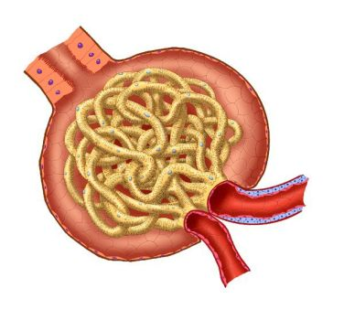
Kidney Disease s
Each year in the US >100,000 people are diagnosed
with end stage renal disease
>10% of adults in the US (>20 million people)
may have chronic kidney disease, of varying levels and seriousness
Causes of kidney failure:
- prerenal
- intrarenal
- postrenal
in general and glomerular diseases – the context

Slide 7
New cases of kidney failure by primary cause
Glomerular disease fit into a much
bigger category of intra renal diseases
and are actually much less common than diabetes and hypertension
However, their evaluation by biopsy plays
a major role in the selection of therapies

Slide 8
Glomerular histology

Slide 9
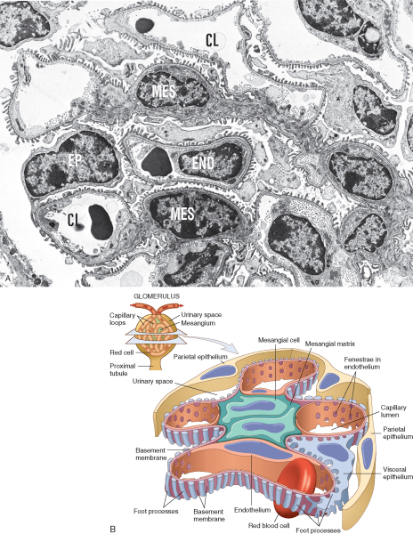
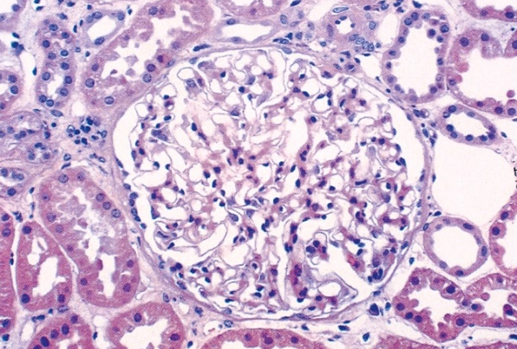
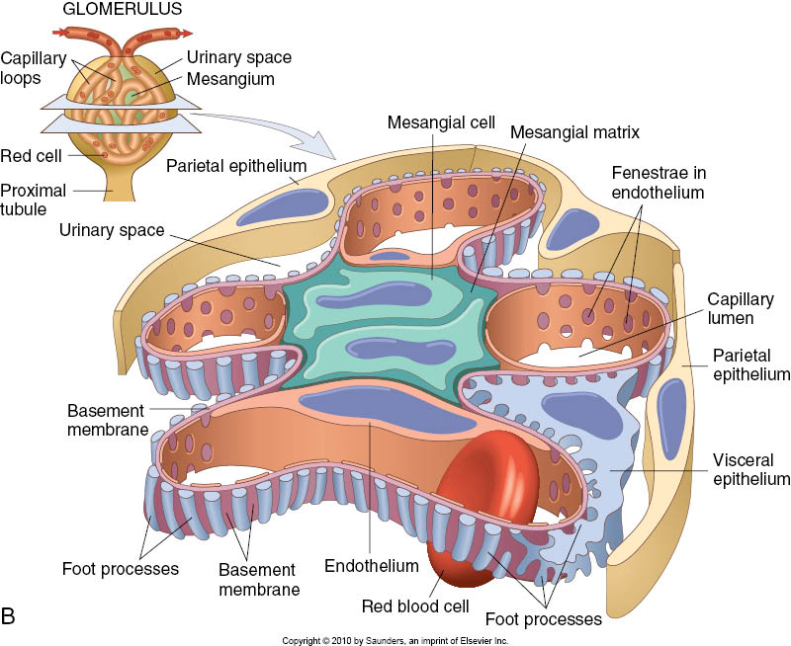
Glomerulus – histology review
(recorded, independent study)
Electron microscopy: black & white
Light microscopy: H&E stain
Glomerular tuft = network of capillaries
- endothelium
mesangium: cells & matrix
- basement membrane
visceral epithelium (aka “podocytes”)
Bowman’s capsule: basement membrane + parietal epithelium
Cellular function/response:
- phagocytosis, control of blood flow/intracapillary pressure: mesangial
- proliferation: mesangial, endothelial, parietal epithelial; NOT podocytes
Glomerular filtration barrier:
loss of structural integrity (hematuria)
loss of selective filtering (proteinuria)
see histology recording, segment II

Slide 10
Pathogenesis of Glomerular Diseases

Slide 11
Pathogenesis of glomerular diseases
IMMUNE MECHANISM-MEDIATED GLOMERULAR INJURY |  | OTHER MECHANISMS
Circulating immune complexes deposition |  | No immune complexes and no antibodies detectable by current methods
 |  | Nephron loss
In situ binding of antibodies with immune complex or without immune complex formation | anti-glomerular basement membrane antibody | Genetics | Monogenic diseases
 | antibody against antigen on podocytes
 |  |  | Polygenic diseases “risk alleles”
Abnormal activation of complement

Slide 12
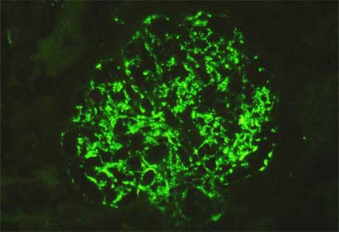
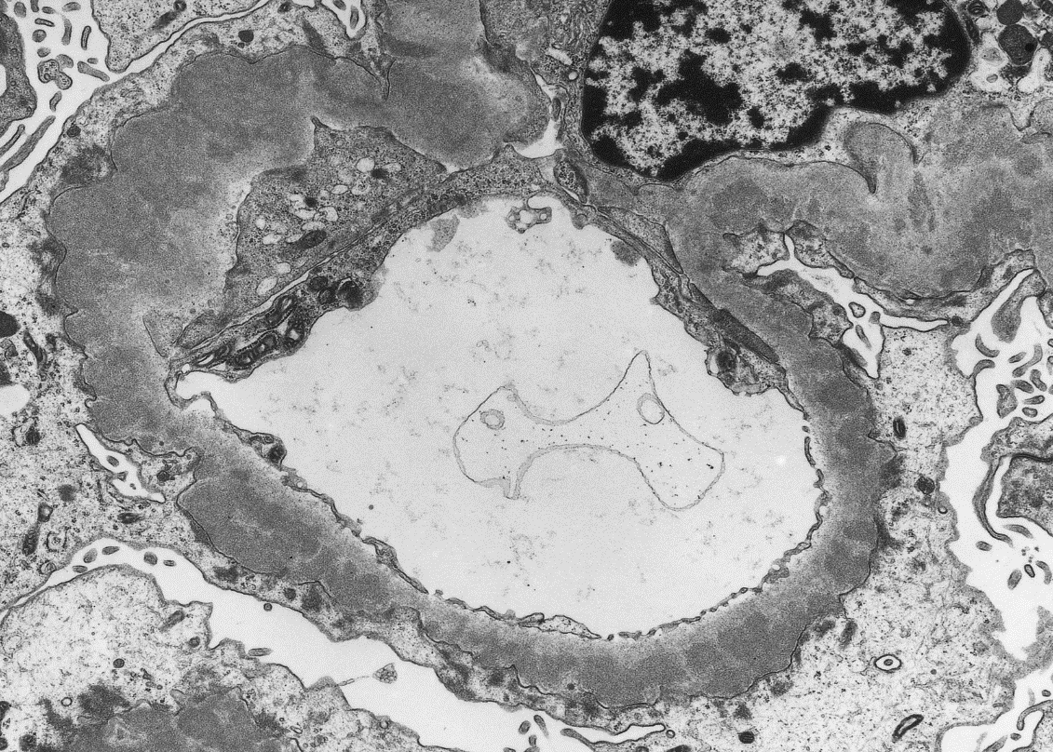
To study glomerular diseases caused by immune mechanisms
Immuno stains: type of antibody, etc
Frozen section immunofluorescence
Electron microscopy: precise localization, etc

Slide 13
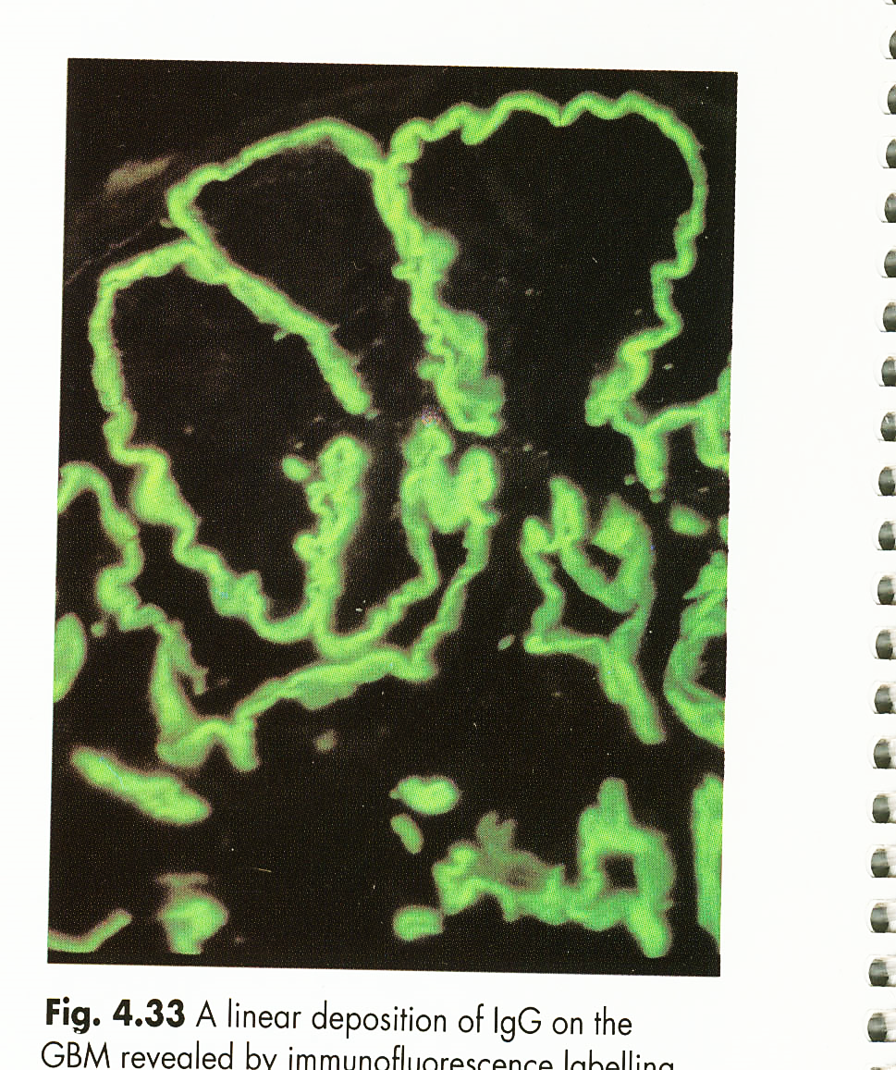
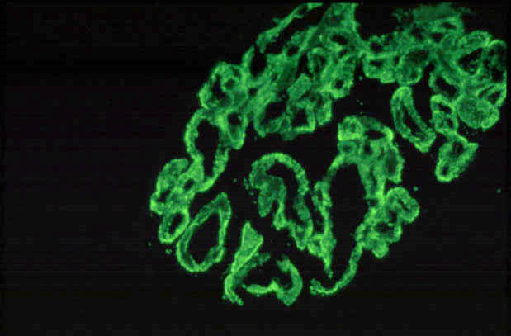
Immunofluorescence patterns
Granular:
Mesangium + basement membrane, basement membrane alone
Linear
along basement membrane

Slide 14
Circulating immune-complex-mediated diseases:
Complexes may be formed with:
endogeneous antigens (systemic lupus erythematosus)
exogeneous antigens (post-infectious glomerulonephritis)
unknown antigens
Notes:
14

Slide 15
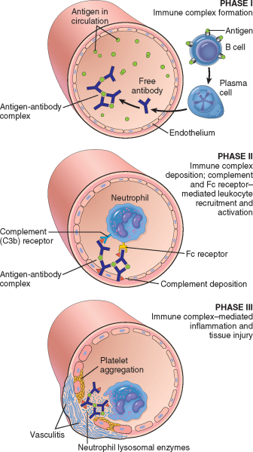
Pathology of circulating
immune complexes
Phase I: formation of antigen-antibody complexes
Phase II: deposition of circulating immune complexes in the glomerulus initiates complement and Fc receptor mediated leukocyte activation
Phase III: inflammatory reaction & tissue injury at the site of deposition
antibody has no specificity to glomerular components !!!
Complement activation & recruitment of leukocytes
= major pathway of antibody-initiated glomerular injury
Robbins Basic Pathology, 10th ed, p.141; see also chapter 3
Notes:
15

Slide 16
Formation of immune complexes does NOT ALWAYS lead to disease
The outcome of immune complex formation depends on several factors including factors impacting the
- pathophysiology of immune complexes (size)
- duration of antigen exposure
- host response
- localization of immune complexes in the glomerulus

Slide 17
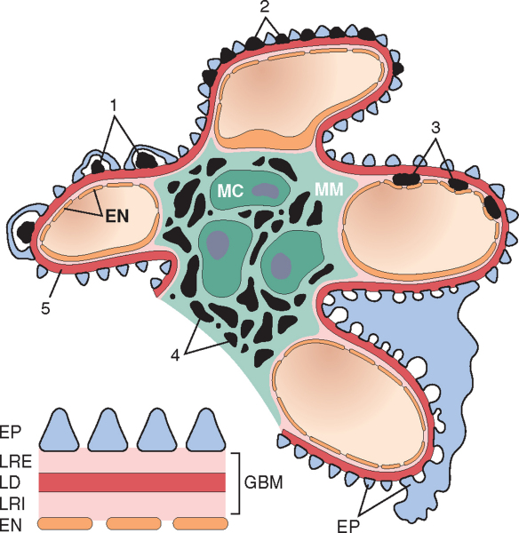
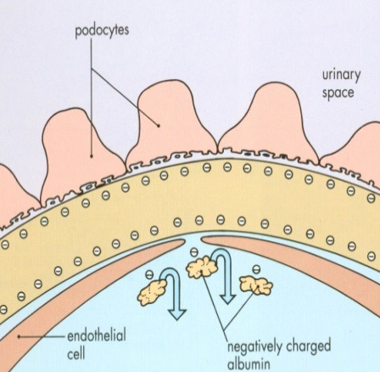
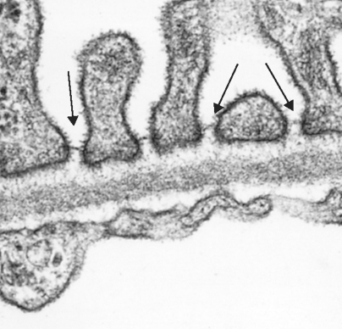
Localization of immune complexes in the glomerulus:
Size:
large in subendothelial, small in subepithelial
glomerular hemodynamics,
mesangial phagocytic function
Molecular charge:
highly cationic in subepithelial
highly anionic in subendothelial
neutral charge in mesangium
glomerular filtration barrier has negative charge

Slide 18

Glomerular filtration barrier: proximal versus distal zones
Distal zone
Proximal zone
= antigen
= antibody
= complement

Slide 19
Glomerular filtration barrier proximal versus distal zones
Complexes deposited in the
proximal zone of the glomerular
basement membrane
(sub-/endothelial space):
elicit inflammatory reaction and
proliferation in the glomerulus
infiltration of leukocytes and
structural injury of the filtration
barrier with hematuria

Slide 20
Glomerular filtration barrier proximal versus distal zones
The complexing of the antigen and antibody in the distal zone (sub-/epithelial space) of the glomerular basement membrane:
are non-inflammatory
affect podocytes (epithelial cells)
with alteration of the filtration barrier resulting in proteinuria

Slide 21
Immune complexing in distal zone of the glomerular filtration:
- the complexing of the antigen and antibody in the sub-epithelial space is unique
because the binding occurs on the urinary side of the glomerular basement membrane
- the subsequent activation of complement and cytokine factors is modified (reduced)
because the site of the deposit is remote from the activators that are normally present in the circulation (“non-inflammatory”)
- affect podocytes (epithelial cells) with alteration of the filtration barrier resulting in proteinuria

Slide 22
Glomerular filtration barrier proximal versus distal zones
The complexing of the antigen and antibody in the distal zone (sub-/epithelial space) of the glomerular basement membrane:
are non-inflammatory
affect podocytes (epithelial cells)
with alteration of the filtration barrier resulting in proteinuria
Complexes deposited in the
proximal zone of the glomerular
basement membrane
(sub-/endothelial space):
elicit inflammatory reaction and
proliferation in the glomerulus
infiltration of leukocytes and
structural injury of the filtration
barrier with hematuria

Slide 23
Immune Complex-mediated glomerulonephritis:
- circulating
- in-situ

Slide 24
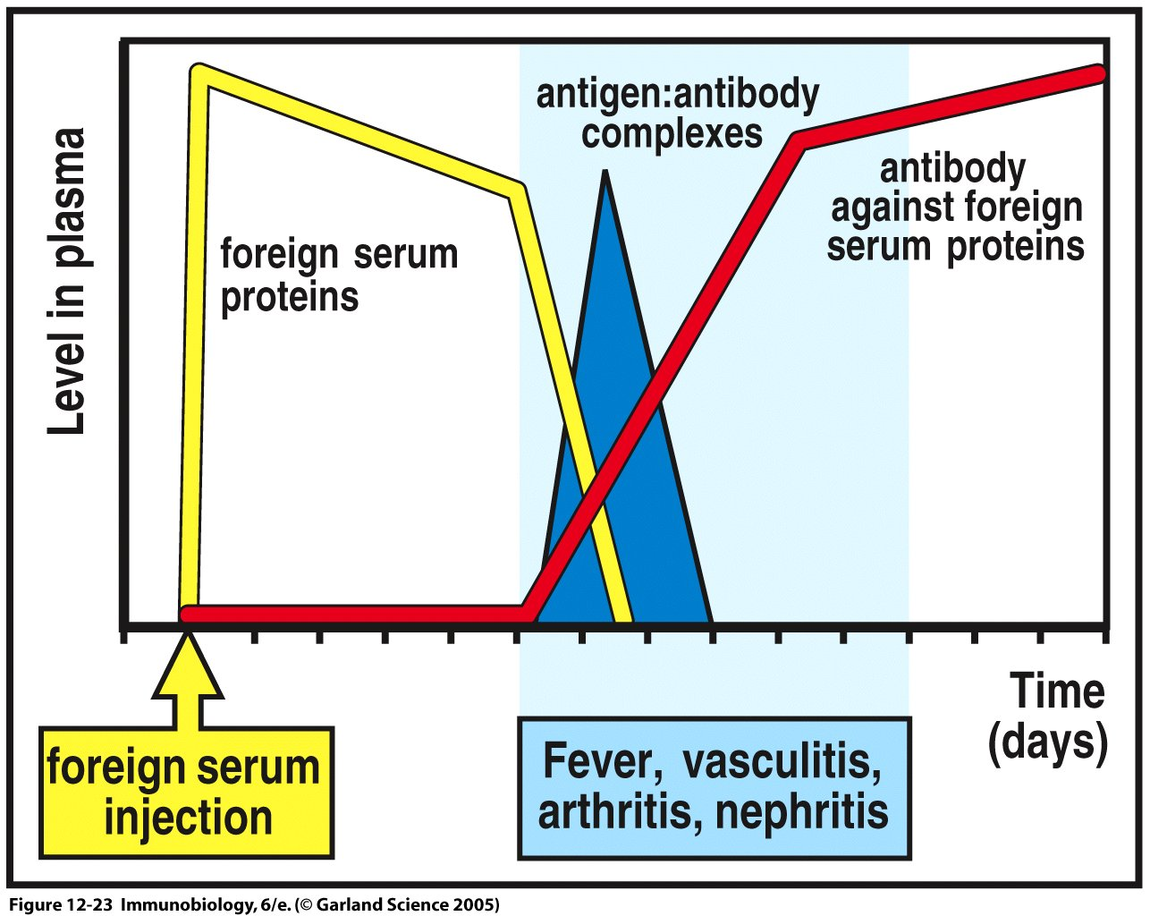
Circulating Immune complexes - experimental
Serum sickness model
Antigen-antibody complexes form in the circulation:
disease occurs when complexes are formed with antigen
in slight excess (complexes escape phagocytosis and
deposit in tissues/surface of blood vessels)
(“hypersensitivity disease” type III, see Robbins, pp 135-136, 140-142)
Deposited antibody (IgG) can be seen in the kidney
biopsy (green fluorescent granules)
Notes:
24

Slide 25
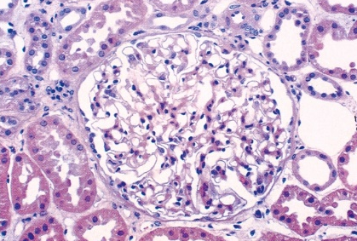
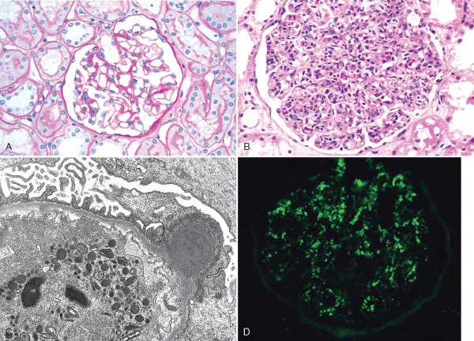
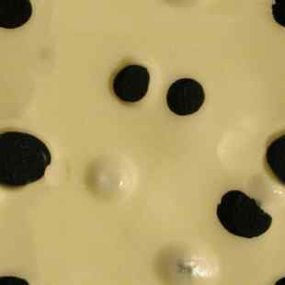
Circulating Immune complexes - human disease
Normal glomerulus
Glomerulus with
antibody (IgG) seen as granular fluorescent deposits on immuno stain
Example of human disease = postinfectious glomerulonephritis:
- infection is followed by development of antibodies
- immune complexes are formed in the circulation
- immune complexes are deposited in the proximal zone of the glomerular capillary wall
- inflammatory reaction with leukocytic infiltration, mesangial & endothelial proliferation
and structural damage (“Swiss cheese”) at the site of immune complex deposition
antibody has no specificity to glomerular components

Slide 26

Clinical syndrome: hematuria,
hallmark of the NEPHRITIC SYNDROME
also mild proteinuria, edema, renal failure, hypertension (HTN).
What can be the outcome of the inflammatory response?
Degradation of immune complexes by neutrophils, monocytes/macrophages and mesangial cells leads to healing phase with complete resolution in most patients, in particular in children

Slide 27
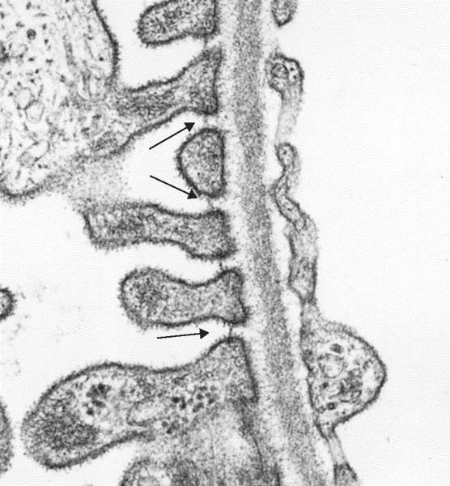

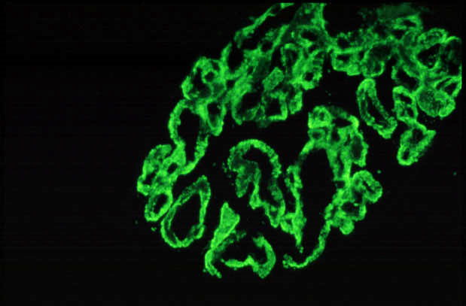
In-situ immune complex formation:
Foot process
Slit diaphragm
Electron microscopy -
normal
Electron microscopy - disease:
subepithelial electron dense deposits
Immunoglobulin IgG (antibody) deposits are seen as small granules along glomerular capillary wall (white arrow) on immuno stain
Stain for complement is also positive
Reaction of antibody with an antigen on basal surface of epithelial cells with in-situ formation of immune complexes
(seen as electron dense deposits ) under epithelial cells (sub-epithelial) leads to loss of slit diaphragms and
effacement (“fusion”) of the epithelial cell foot processes resulting in increased permeability with PROTEINURIA

Slide 28
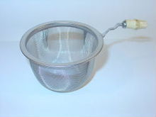
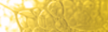
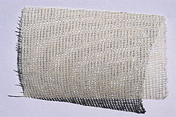
What is the clinical picture?
Sub-epithelial immune complexes = distal zone:
no inflammatory response, no “Swiss cheese” injury
effacement of foot processes and loss of slit diaphragms leads to increased permeability
  “gauze-like” or fine mesh effect → PROTEINURIA
  since larger particles are retained – NO hematuria
Clinical: proteinuria
(hallmark of NEPHROTIC syndrome:
heavy proteinuria, hypoalbuminemia, edema, ….)
Human disease: membranous nephropathy

Slide 29
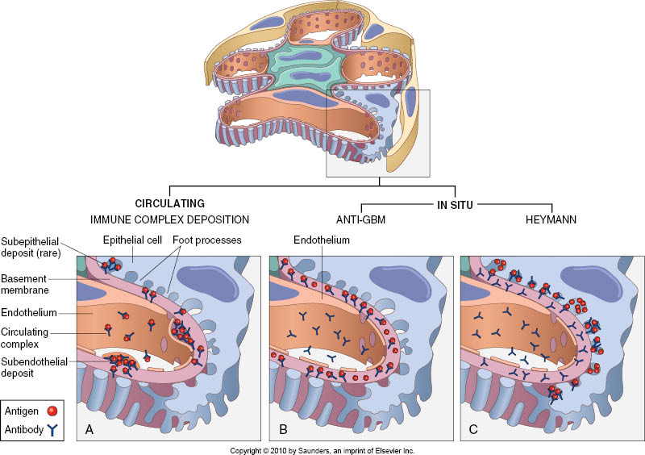
Membranous nephropathy – experimental model (Heymann nephritis)
RATS injected with antigen (proximal tubular brush border)
antibodies develop against proximal tubular brush border which
CROSS-REACT with basal surface of epithelial cells leading to formation of sub-epithelial immune complex deposits
Q: what happens in humans?

Slide 30
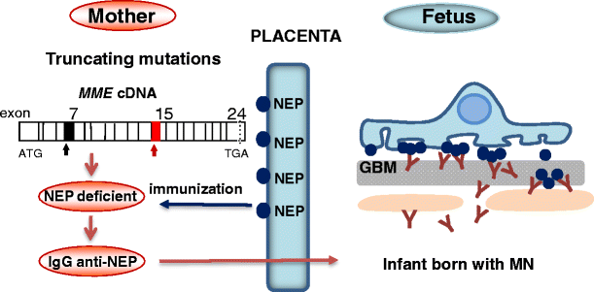
Pathogenesis of membranous nephropathy: from rats to humans
- several families with neonatal nephrotic
syndrome and membranous nephropathy
- mothers had mutations in neutral
endopeptidase (NEP) normal podocyte antigen
women who genetically lack NEP develop antibodies during pregnancy when exposed to NEP (blue dots) expressed by placental cells and by fetal cells entering the mother’s blood
From about the 18th week of gestation, maternal antibodies of the IgG class are actively transported across the placenta to the fetus, where they bind (in-situ) to the NEP antigen expressed on podocytes
These observations validated the in situ paradigm in human membranous nephropathy (NEJM 2002, 346:2053)
subsequent proteomic studies identified phospholipase A2 receptor (PLA2R) and
thrombospondin type-1 domain containing 7A (THSD7A) as target antigens in 80% of patients with
primary membranous nephropathy (NEJM 2009; 361:11-21; NEJM 2014; 371:2277–2287)
the remaining 20% still?

Slide 31
Humans: membranous nephropathy
autoimmune process with antibodies reacting with intrinsic renal antigens or planted antigens: nucleosomal complexes (systemic lupus erythematosus)
viral, bacterial products, drugs…
The podocyte is at the center of the pathogenesis of membranous nephropathy either by
(i) providing a source of endogenous antigens or by
(ii) creating an environment favorable to deposition and accumulation of immune complexes containing exogenous (non-podocyte) antigens
The podocyte is also a victim of complement activation and antibody activity, and hence there is a subsequent podocyte effacement with proteinuria
As our understanding of membranous nephropathy evolves, it is apparent that this nephropathy does not fit well into the classification scheme of hypersensitivity diseases i.e. it shows some overlap between type II and type III

Slide 32
different mechanisms of glomerular injury are not mutually exclusive and in humans
>1
may contribute to injury

Slide 33
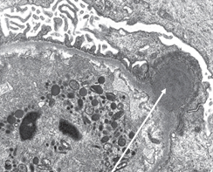
In post-infectious glomerulonephritis
1. infection elicits antibody response (immunoglobulin G, IgG)
2. immune complexes form in circulation (antigen + IgG + complement)
3. deposition of immune complexes in the capillary wall elicits inflammatory reaction leading to structural damage
(“Swiss cheese”) with hematuria and proliferation
4. however, immune complexes are also formed in-situ leading to formation of big sub-epithelial deposits
“humps” (white arrow) which are unique to postinfectious glomerulonephritis and therefore diagnostically useful
The humps contain SpeB (streptococcal exotoxin B) and streptococcal glyceraldehyde-3-phosphate dehydrogenase (GAPDH), which reaches the sub-epithelial aspect of the glomerular basement membrane owing to its cationic
charge – here the antigen is not intrinsic but “planted antigen”
Notes:
33

Slide 34
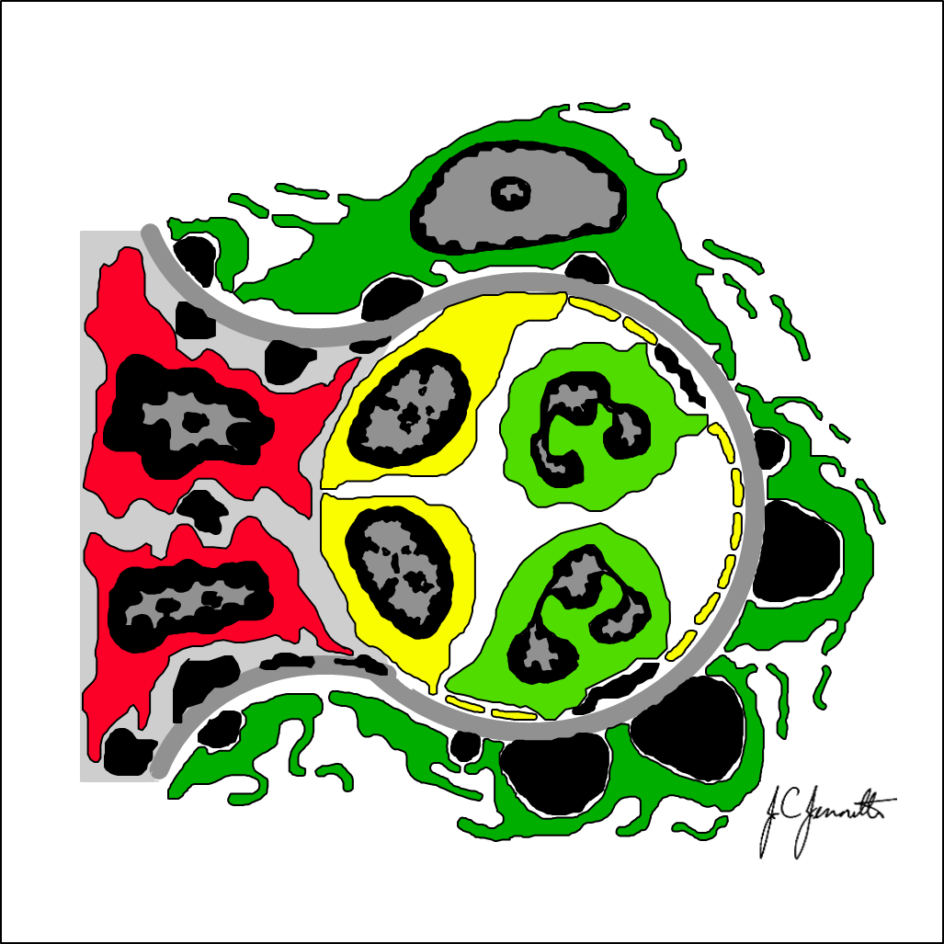

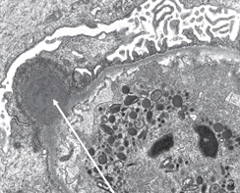
What have we learned from this?
experimental models are not perfect but offer some insight
in disease >1 mechanism is likely to be responsible..
various classifications have a limited “fit”
think postinfectious glomerulonephritis!
In fact, it is not clear if in postinfectious glomerulonephritis immune complexes are formed mainly in the circulation or in situ by binding of antibodies to bacterial antigens “planted” in the glomerular basement membrane

Slide 35
Antibody-mediated glomerulonephritis

Slide 36
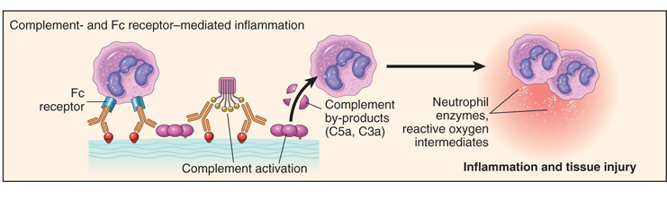
Antibody-mediated glomerular injury (type II hypersensitivity)
- antibodies bound to tissue antigens activate the complement by the “classical” pathway
- products of complement activation recruit neutrophils and monocytes triggering inflammation in tissues
- leukocytes may also be activated by engagement of Fc receptors, which recognize bound antibodies
See Robbins, pages 135-136, 139-140 - antibody-mediated injury

Slide 37
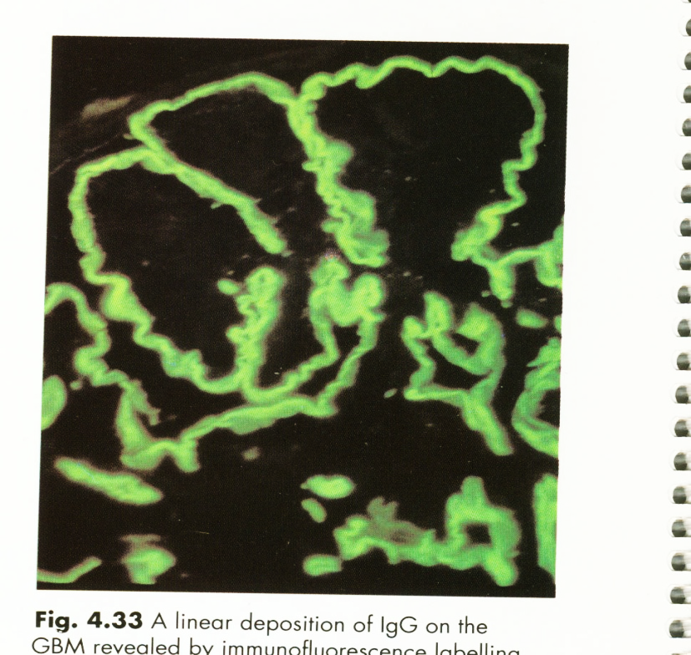
antibodies against antigens within glomerular basement membrane
IgG (antibody) seen as a linear stain along the entire length of the glomerular
basement membrane
Notes:
37

Slide 38

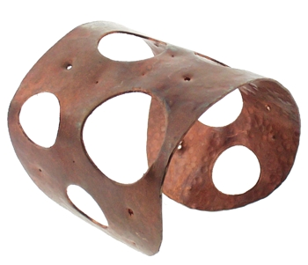
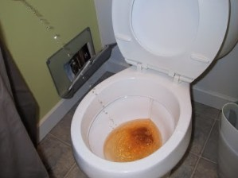
antibodies against antigens within glomerular basement membrane
antibodies bind diffusely along the glomerular basement membrane:
linear stain for IgG (antibody) = damage along the entire length
severe damage to the GBM with multiple areas of necrosis - “sieve-like” effect with big holes big leaking large number of RBCs with GROSS hematuria
Human disease: anti-glomerular basement membrane antibody disease
Notes:
38

Slide 39
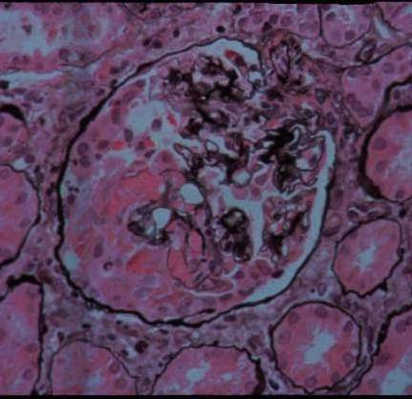
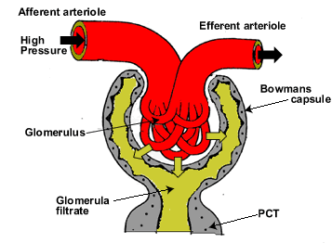

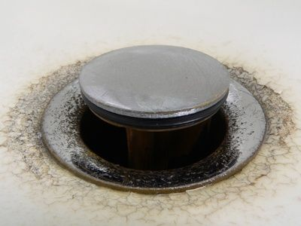
How to stop hematuria ? GLOMERULAR CRESCENT
Glomerular crescent = “glomerular stopper” -
stops bleeding in cases with severe damage to glomerular capillary wall (of various etiologies), but in this process also compresses the glomerular tuft, reduces filtration and leads to
→rapidly progressing renal failure

Slide 40

Anti-glomerular basement membrane antibody-induced glomerulonephritis
Experimental evidence – nephrotoxic serum (Masugi) nephrits in rats: inject anti-rat kidney antibodies (prepared in rabbits) linear IgG deposition
Human antigen = noncollagenous domain (NC1) of the α3 chain of collagen type IV (normally encrypted and does not elicit antibody response)
Cross-reactivity with pulmonary alveolar basement membrane = Goodpasture syndrome
(gross hematuria + pulmonary hemorrhage)

Slide 41
Pathogenesis of glomerular diseases
IMMUNE MECHANISM-MEDIATED GLOMERULAR INJURY |  | OTHER MECHANISMS
Circulating immune complexes deposition |  | No immune complexes and no antibodies detectable by current methods
 |  | Nephron loss
In situ binding of antibodies with immune complex or without immune complex formation | antibody against antigen on podocytes | Genetics | Monogenic diseases
 | anti-glomerular basement membrane antibody
 |  |  | Polygenic diseases “risk alleles”
Abnormal activation of complement

Slide 42
Abnormal activation of complement – mediated glomerulonephritis

Slide 43


Glomerular diseases caused by complement activation in the absence of antibody:
Unregulated/excessive activation of the alternative complement
pathway leading to complement-mediated injury –
transformation from low-grade physiologic activity (“tick-over”) to unrestrained hyperactivity
Triggers: excessive complement activation after minor vascular injuries
- acquired autoantibodies against complement components
- inherited abnormalities of complement regulatory proteins
Human diseases
Glomerular: dense deposit disease/C3 glomerulonephritis (lecture II)
Systemic (with significant renal manifestations): thrombotic microangiopathies (lecture III)

Slide 44

Complement system (Robbins, pp 75-77)
Components (numbered C1-C9) present in plasma in inactive forms; each activated by proteolysis to acquire own proteolytic activity, thus setting up enzymatic cascade. 3 initiating pathways:
Classical
trigger: Ab+Ag
adaptive immunity
MBL (mannose-binding Lectin)
trigger: lectin to mannose of bacteria innate immunity
Alternative, begins @ C3
constitutively active
innate immunity
C3a
terminal complement
cascade
C3 C3b
C5
C9
C3 convertase
MAC
(membrane attack complex )
amplification loop
both classical & lectin pathways begin with engagement of early complement components C1/C2, MASP
MASP (Mannose-binding lectin-Associated Serine Protease), very similar to C1 molecules of the classical complement pathway

Slide 45
Alternative Complement pathway
C3 convertase activity must be tightly controlled
in order to prevent excessive activation of complement
Alternative pathway
low-grade physiologic activity (“tick-over”)
C3→C3b
C5
stabilize
degrade
C3NeF(C3 nephritic factor)
an autoantibody against C3 convertase,
binds to C3 convertase & prevents its degradation
(stabilizes it) causing sustained complement activation
↑↑↑ C3 convertase ↓↓↓
H factor
- mutations in gene encoding factor H
autoantibodies to factor H
factor H deficiency
↓↓↓

Slide 46
Other Mechanisms of glomerular injury

Slide 47
Pathogenesis of glomerular diseases
IMMUNE MECHANISM-MEDIATED GLOMERULAR INJURY |  | OTHER MECHANISMS
Circulating immune complexes deposition |  | No immune complexes and no antibodies detectable by current methods
 |  | Nephron loss
In situ binding of antibodies with immune complex or without immune complex formation | anti-glomerular basement membrane antibody | Genetics | Monogenic diseases
 | antibody against antigen on podocytes
 |  |  | Polygenic diseases “risk alleles”
Abnormal activation of complement

Slide 48
Other mechanisms of glomerular injury:
NOT able to detect immune complexes/antibodies by current techniques (immunstains, electron microscopy)
less well known

Slide 49
Podocyte injury non immune complex/antibody mediated: “podocytopathies”
circulating “permeability factor” not as yet identified – recurrence in transplants
viruses
drugs
adaptation to elevated glomerular capillary pressures & flow rates (glomerular hypertension)
genetic defects
experimental models of podocyte injury: toxins (puromycin)

Slide 50
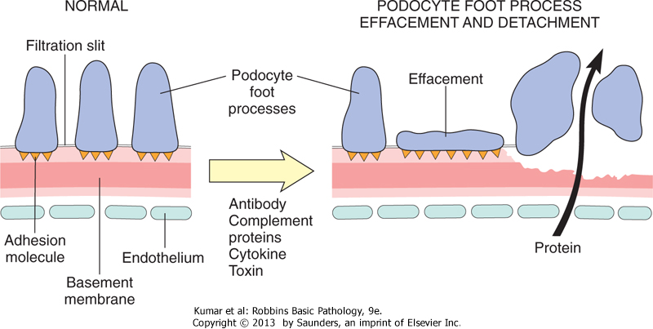
Pathology of podocyte injury
podocyte foot process effacement and loss of slit diaphragms can be reversible or not reversible
Irreversible podocyte injury leads to podocyte detachment and loss
mature podocytes have limited capacity to replicate, hence podocyte depletion leads to scarring (sclerosis)
loss of slit diaphragms/foot process effacement is most highly associated with proteinuria
clinically: heavy proteinuria with NEPHROTIC SYNDROME
reversible nephrotic syndrome: minimal change disease
irreversible nephrotic syndrome: FSGS [Focal and Segmental Glomerular Sclerosis]

Slide 51

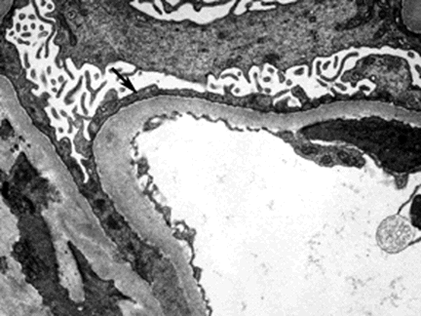
Podocyte injury as seen by electron microscopy
Normal: podocyte foot processes
and slit diaphragms preserved
Podocyte foot processes effacement with
loss of slit diaphragms & PROTEINURIA
NO immune complexes that we can see, NO inflammatory response
Reversible disease = minimal change disease
Irreversible disease = focal and segmental glomerular sclerosis (FSGS) … more lecture #2
BOTH diseases begin with podocyte effacement with loss of slit diaphragms

Slide 52
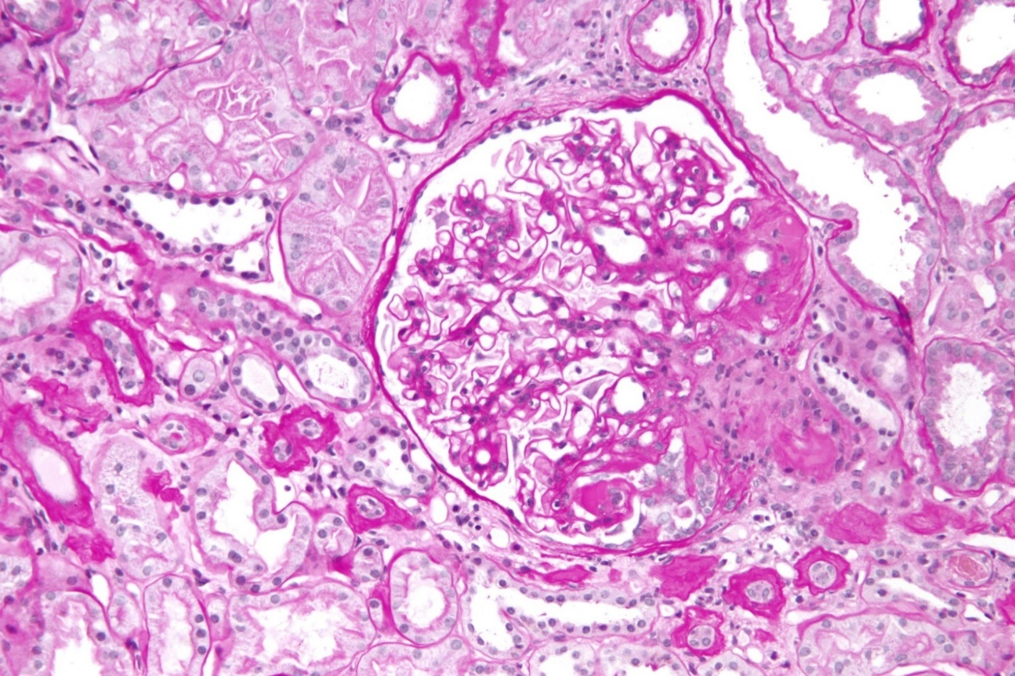
Minimal change disease
Minimal change disease
and FSGS:
one disease at opposite ends of a spectrum
OR
two different diseases
?
Treatment
FSGS
progression
despite
treatment

Slide 53
Nephron loss
Once renal disease, glomerular or otherwise, destroys sufficient nephrons to reduce
the glomerular filtration rate to 30-50% of normal, progression to end stage renal disease proceeds at varying rates via scarring, called glomerulosclerosis
Adaptive changes in response to the loss of nephrons at this stage are ultimately maladaptive and exacerbate progressive sclerosis

Slide 54
Genetics
Monogenic
Polygenic diseases and “risk alleles”

Slide 55
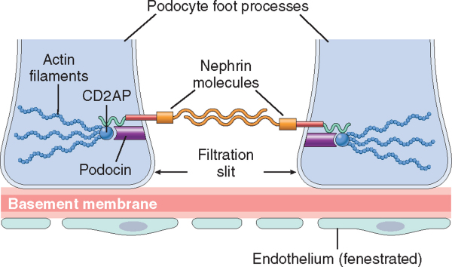
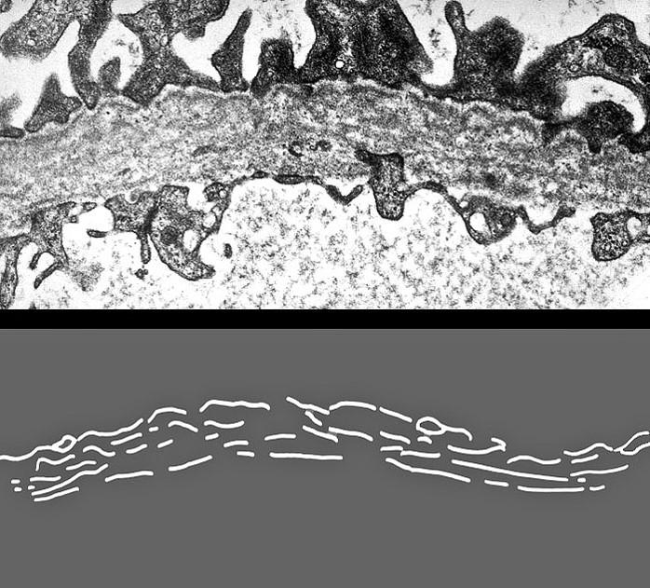
Genetic defects: monogenic
germline mutations in genes encoding:
- slit diaphragm proteins with nephrotic syndrome
- type IV collagen with hematuria (Alport syndrome)
NPHS1 encoding nephrin, NPHS2 encoding podocin
rare hereditary forms of the nephrotic syndrome
normal
Alport syndrome - hematuria
Notes:
55

Slide 56
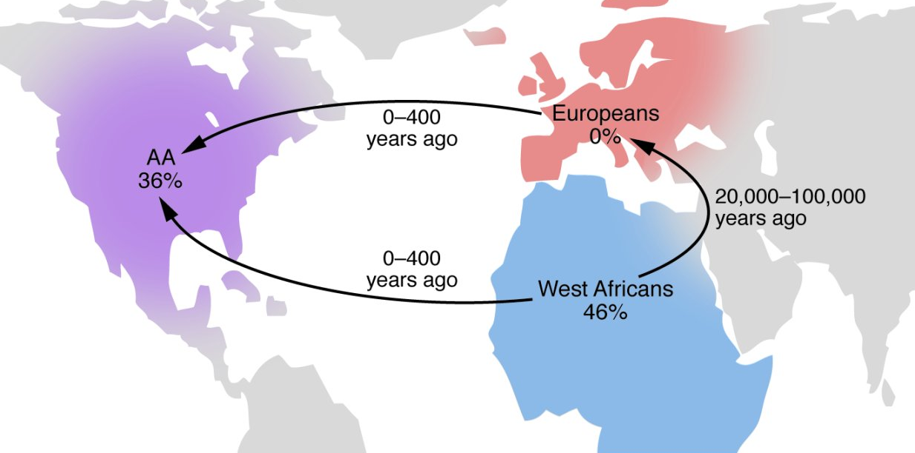
Genetic variants in the APOL1 gene account for a large fraction of the high rates of nondiabetic kidney disease in African Americans
APOL1 risk variants have large effects on several different types of kidney disease previously thought to be distinct entities, often previously labelled as “hypertensive nephropathy in African Americans”
These variants, found only in individuals with recent African ancestry, (<10,000 years) confer enhanced innate immunity against African trypanosomes. These alleles are nearly absent in populations of European and Asian ancestry
APOL1 risk variants arose approximately 4,000 years ago
in Africa and rose quickly to high frequency. In Nigeria, approximately 46% of chromosomes contain either the G1 or G2 allele. The ancestors of modern Europeans left Africa many millennia before the origin of these risk alleles, so the risk alleles are not found in Europeans. Today, approximately 36% of all African Americans carry the G1 or G2 alleles

Slide 57

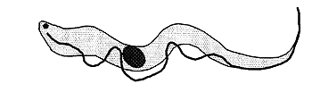
0 risk allele
1 risk allele
2 risk allele
APOL1 Nephropathy
People who have at least 1 copy of either the G1 or G2 APOL1 variant (allele) are resistant to infection by trypanosomes (protozoa), but people who have 2 copies of either variant are at an increased risk of developing a non-diabetic kidney disease
Trypanosomiasis
Heterozygous advantage
Trypanolysis
Monozygous disadvantage
Trypanolysis, kidney disease
Sickle cell trait confers protection against malaria caused by Plasmodium falciparum (a protozoan)

Slide 58
The presence of the alleles is not enough to have the phenotype
These are risk alleles rather than a single-gene disorders and additional
“hits” are necessary, which may be genetic, environmental, or both
Development of preventive measures for those at risk

Slide 59
Lessons learned:
genetic differences substantially influence an individual’s lifetime risk for kidney disease
evolution of genes related to host defense against pathogens may limit kidney longevity
expanding our understanding of renal development and function
the design of novel therapeutics for kidney disease as well as preventive measures for those at risk
The variants have proven to be useful for genetic screening in African Americans and in the selection of kidney donors

Slide 60
IgA nephropathy – and genetics
geographic and racial differences in IgA nephropathy prevalence have long been recognized
until recently it was still debated to what degree these were due to differences in disease diagnosis (e.g., due to diverse local biopsy practices) rather than biology
it is now clear that a substantial portion of disease risk is conferred genetically. Recent series of genome-wide association studies [GWAS] have identified several susceptibility loci
the genetic loci identified thus far comprise genes associated with innate and adaptive immunity, and the complement system
the complement locus involve genes encoding proteins which regulate the alternative complement pathway
World-wide genetic risk for immunoglobulin A nephropathy. Genome-wide association studies indicate different worldwide risks for IgA nephropathy
Kiryluk K et al., PLoS Genet 8:e1002765, 2012

Slide 61
Summary

Slide 62



Pathogenesis Summary
NEPHRITIC SYNDROME - HEMATURIA
circulating immune complexes – postinfectious glomerulonephritis (serum sickness model)
anti-glomerular basement membrane antibody mediated - anti-glomerular basement membrane disease
(nephrotoxic serum [Masugi] nephritis)
NEPHROTIC SYNDROME – PROTEINURIA
in-situ immune complex formation – membranous glomerulonephritis (Heymann nephritis model)
podocyte injury non-immune complex mediated
reversible = minimal change disease
irreversible = focal and segmental glomerular sclerosis (FSGS)
Genetics: (i) monogenic diseases or (ii) polygenic and “risk alleles”

Slide 63




Different pathways of glomerular injury are not mutually exclusive and
in humans more than one may contribute to injury
Host factors, which are usually also not static and include genetic diversity, are critical to determine who does and who does not develop nephritis
Thus, the disease is a dynamic process, more akin to a movie rather than a snap-shot

Slide 64
Vocabulary

Slide 65
Vocabulary
Glomerular diseases usually have the “glomerulo” prefix: see postinfectious glomerulonephritis etc
Glomerulonephritis is used preferentially in reference to glomerular diseases with an inflammatory/proliferative response
Glomerular pathologies, without an inflammatory response may be referred to as “nephropathy”or “glomerulopathy”; - see membranous nephropathy (glomerulopathy)
Nephrosis is meant to indicate a non-inflammatory nephropathy, which is associated with nephrotic syndrome
“nephritis” can also be attached/used in connection with other kidney diseases, such as “pyelonephritis”
nephros [Greek] = kidney, nephrologist = MD specializing in medical kidney diseases
ren [Latin] = kidney, renal pathology
urologist takes care of “surgical ”kidney diseases such as tumors, reflux, etc.
Latin ūrīna

Slide 66
Vocabulary – continued
Sclerosis:
Glomerular sclerosis: increased collagenous extracellular matrix that is expanding the mesangium, and subsequently obliterating the capillary lumen, or forming adhesions with the Bowman’s capsule
Vascular sclerosis:
Hyaline arteriolosclerosis: hyaline (proteinaceous) deposits with thickening of the wall and narrowing of the lumen of small arteries, i.e. “arterioles”
  Hyaline from Greek: crystal, glass. A hyaline substance appears glassy and pink in H&E stain
Arteriosclerosis: “hardening of the arteries”, wall thickening and loss of elasticity
Nephrosclerosis: “hardening” of the kidney due to vascular disease
H&E stain (hematoxylin & eosin stain) = routine pathology stain
cytoplasm is pink (staining with eosin) and nuclei are dark blue (staining with hematoxylin)

Slide 67

SM
Questions?
mpicken@lumc.edu
EC

