Slide 1
Sub-internship Wards Clerkship
Orientation
BRENDA BAILEY, MD – CLERKSHIP DIRECTOR
ANNE PEIFFER, MD – ASSISTANT CLERKSHIP DIRECTOR
VIVIAN ORTIZ – CLERKSHIP ADMINISTRATOR

Slide 2









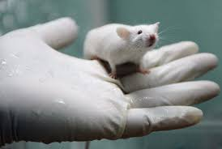
About Me

Slide 3

Objectives
Changes based on student feedback
Administrative Overview
An original count to 10
Grading and evaluation
Emotional Intelligence Time
STRITCH SCHOOL OF MEDICINE
Notes:
-Inspire changes in the faculty teaching process and the trainee understanding of those processes

Slide 4

Orientation Lecture
Cross-cover
Techniques for Teaching Medical Students
Order Writing
Pain Management
Effective Communication

Slide 5
What is a sub-i?
A fourth year medical student clerkship where students act as the intern
Sometimes called an acting internship at other institutions
Excellent practice in assuming ownership and responsibilities

Slide 6
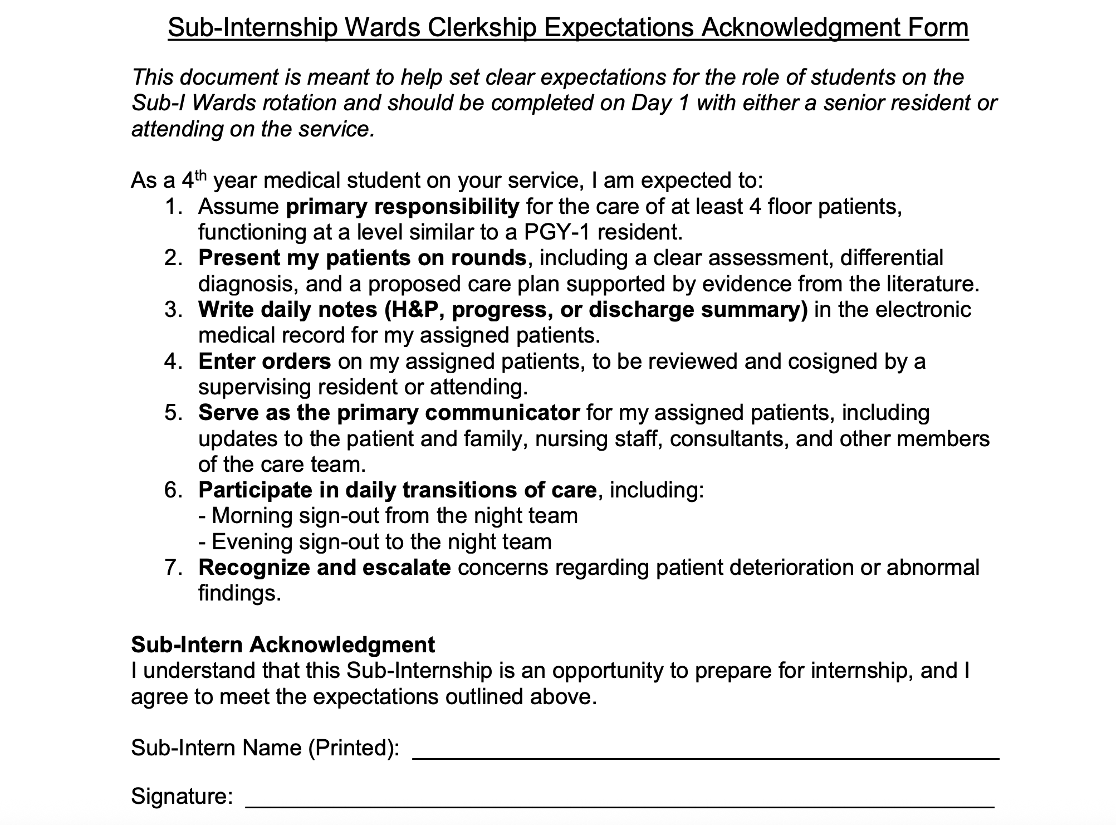
Sub-i expectation form

Slide 7
Administrative Overview
Sakai: SSOM Wards 124 AY26-27
All links to site information, materials and forms
Submit assignments on Sakai
  example 1: Bailey_B_Mid Eval
  example 2: Bailey_B_handoff
    Cannot be .heic

Slide 8
Administrative Overview - Attendance
Attendance and Days off:
  3 days off over 4 week rotation
    usually 1 day per weekend = 21 clinical days
  PGY-1 duty hour rules
    Max 80 hours/week
    1 day off in 7 averaged over 4 weeks
    No more than every 3rd night call
  Interview Season: October - January
    Option for additional 2 days off, but must make them up on the weekend after quiz and OSCEs
Notes:
Slide for March - Match Day and sick policy

Slide 9
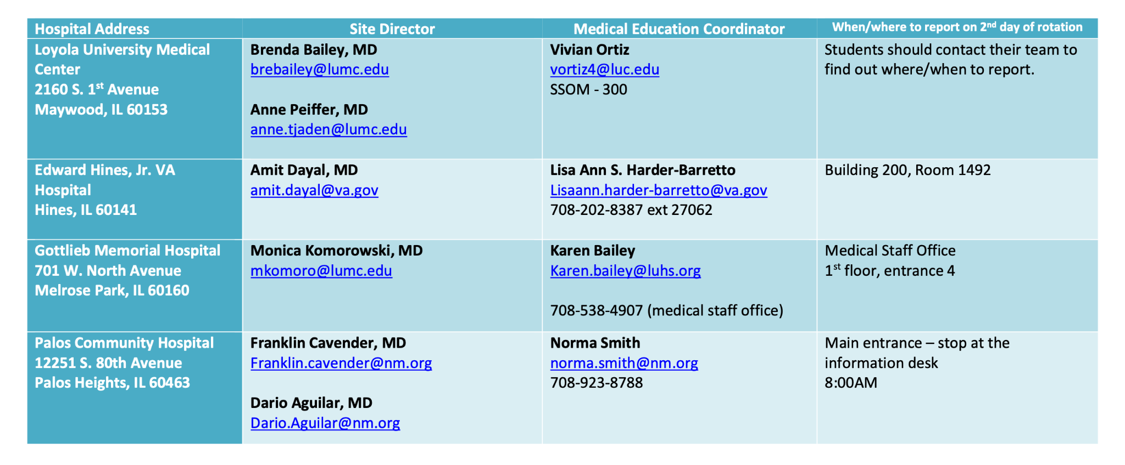
Contacts

Slide 10
Team Names - Trinity
LUMA Orthopedics/Trauma Provider Team
LUMA Emergency General Surgery (EGS) Provider Team
LUMA Otolaryngology Head and Neck Provider Team
LUMA Neurosurgery Provider Team
LUMA Plastic Surgery Provider Team
LUMA Urology Red or Gold Provider Team
LUMA Colorectal Surgery Provider Team
GMMP Vascular Surgery Provider Team
LUMA Obstetrics/Gynecology - Gynecology Provider Team
LUMA Gynecology Oncology Provider Team
LUMA Endocrine Surgery Provider Team
LUMA Surgical Oncology Provider Team
LUMA Vascular Surgery Provider Team
LUMA General Med/GM 5 Provider Team (etc)
LUMA Hematology/BMTU Provider Team
LUMA Pediatrics/General/A Provider Team
GMMP General Med/Hospitalist 1 (etc)
MNBE Family Medicine Inpatient Service Provider Team

Slide 11
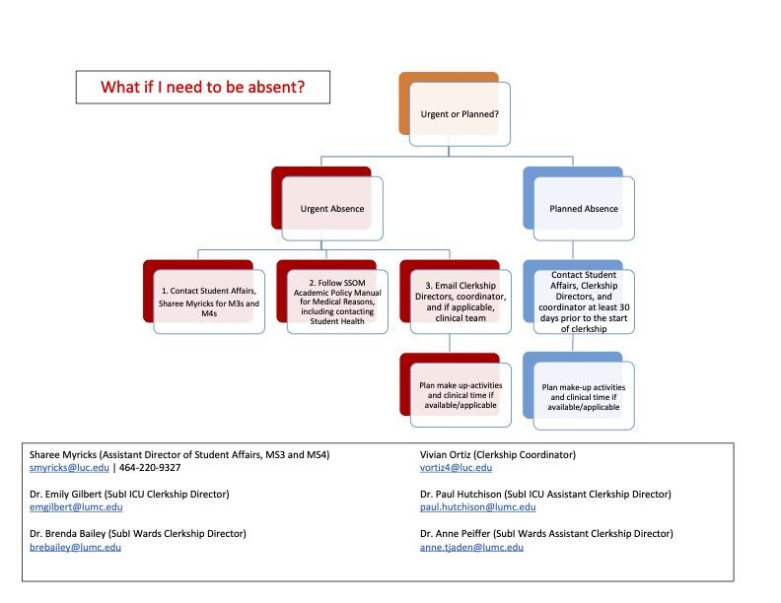

Slide 12
10
Assignments
There are 10 of them

Slide 13
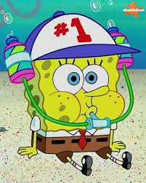
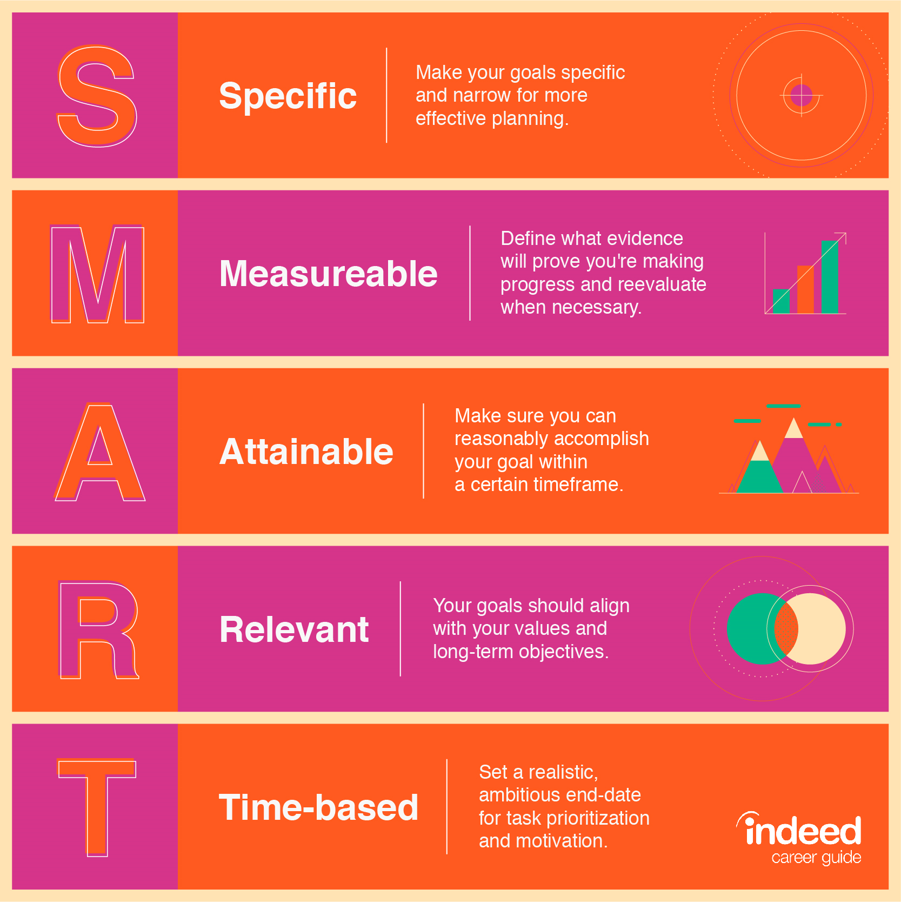
SMART goal
Due by the Friday of the week 1
1 - SMART Goal

Slide 14
Example
For the year of 2026, I will complete at least one Spanish lesson per day on Duolingo.
Why is it SMART:
S: Spanish lesson on Duolingo
M: one lesson per day
A: Achievable time commitment
R: Relevant to my goal in improving Spanish fluency
T: clear time

Slide 15
More examples:
During my 4 week sub-i, I will improve in my EKG interpretation by reading at least 1 per day and comparing my interpretation to the EKG report, consulting online resources or help from my team if needed.
My goal for the 4 week clerkship is to spend >10 min per night reading around my patients to establish the habit for residency and to review the topics I have read at the end of each week to ensure that I am achieving my goal.

Slide 16

Expectations form
Due by the end of week 1

Slide 17
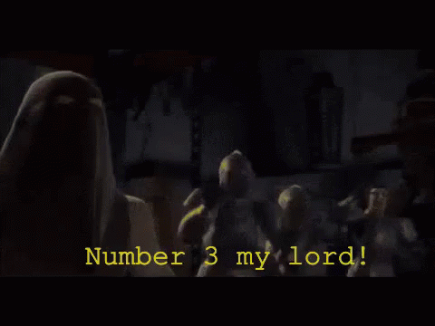
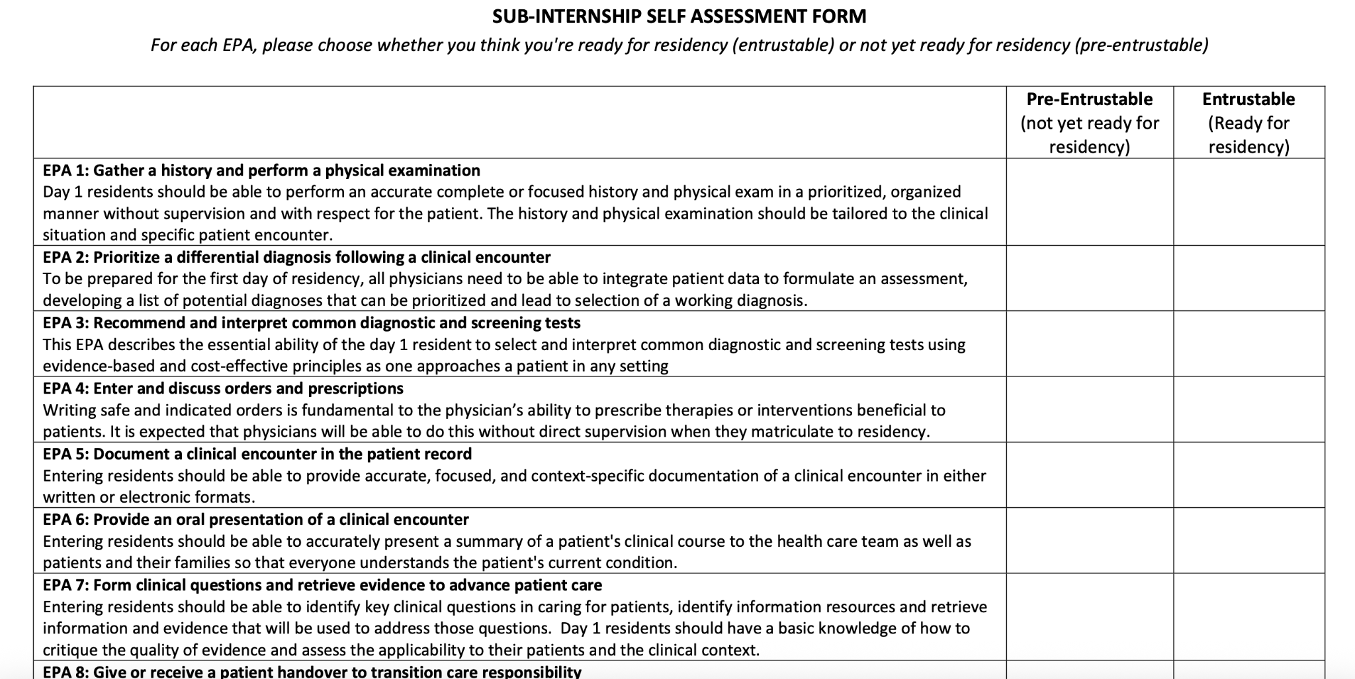
Midclerkship Feedback
Due the 2nd week of the rotation.

Slide 18
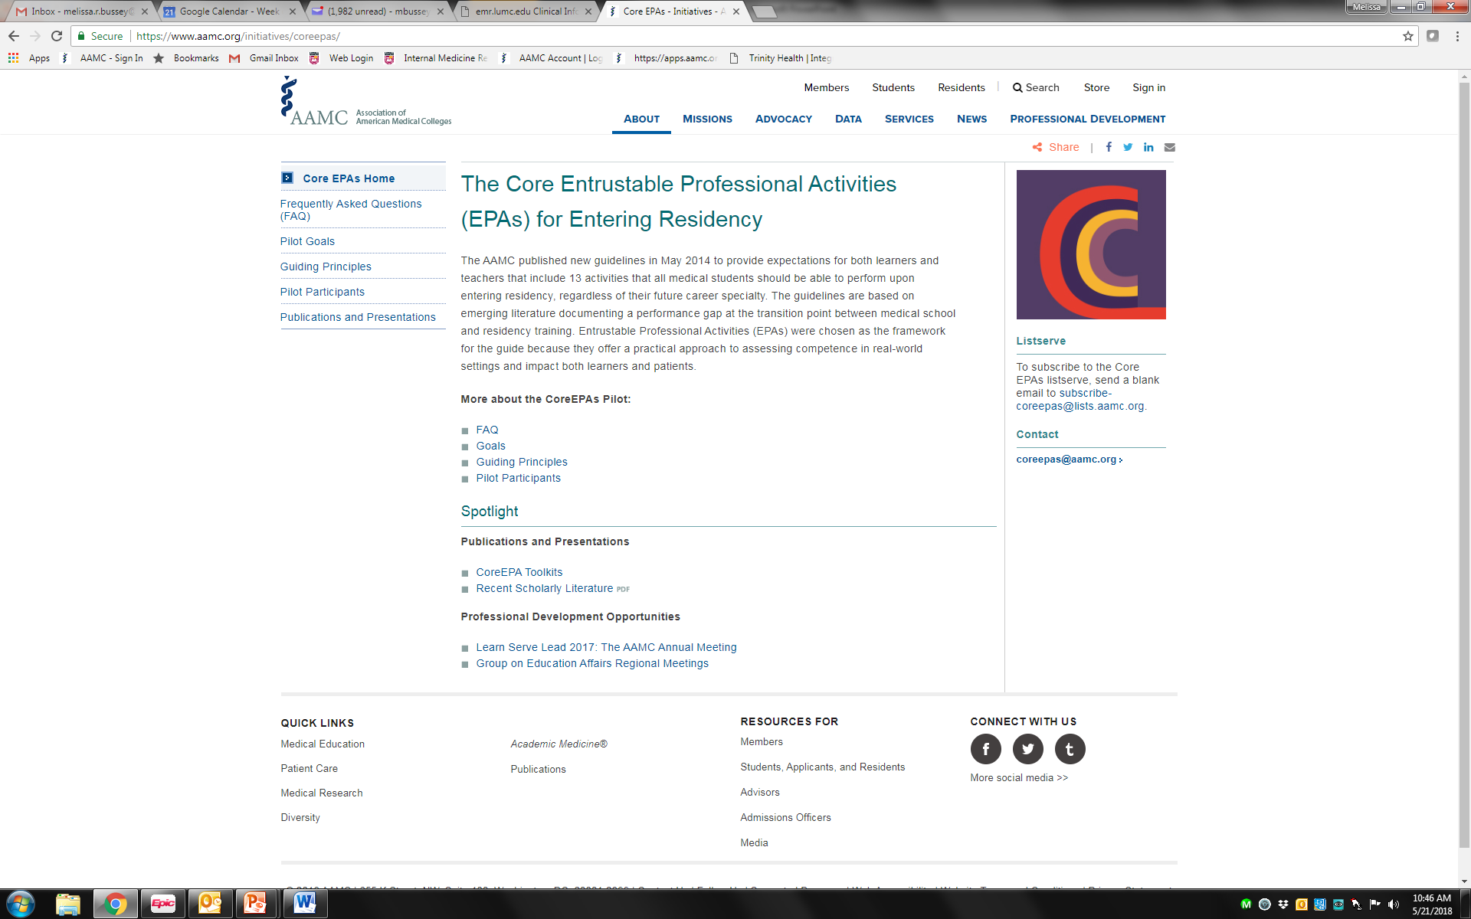
What are EPAs?

Slide 19
 | AAMC Core EPAs for Entering Residency
EPA 1 | Gather a history and perform a physical exam
EPA 2 | Prioritize a differential diagnosis following a clinical encounter
EPA 3 | Recommend and interpret common diagnostic and screening tests
EPA 4 | Enter and discuss orders and prescriptions
EPA 5 | Document a clinical encounter in the patient record
EPA 6 | Provide an oral presentation of a clinical encounter
EPA 7 | Form clinical questions and retrieve evidence to advance patient care
EPA 8 | Give or receive a patient handover to transition care responsibility
EPA 9 | Collaborate as a member of an interprofessional team
EPA 10 | Recognize a patient requiring urgent or emergent care and initiate evaluation and management
EPA 11 | Obtain informed consent for tests and/or procedures
EPA 12 | Perform general procedures of a physician
EPA 13 | Identify system failures and contribute to a culture of safety and improvement

Slide 20
Midclerkship Feedback
Due the 2nd week of the rotation.

Slide 21

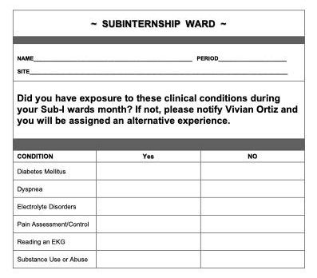
Wards Patient Data Log
***If you have not seen all of these clinical conditions, you MUST let us know by the 3rd week of the clerkship.
***This is required from LCME and you must complete an alternative experience if you are not exposed to all of these
***I may not release your grade until this is done
Due the 3rd week of the rotation.

Slide 22

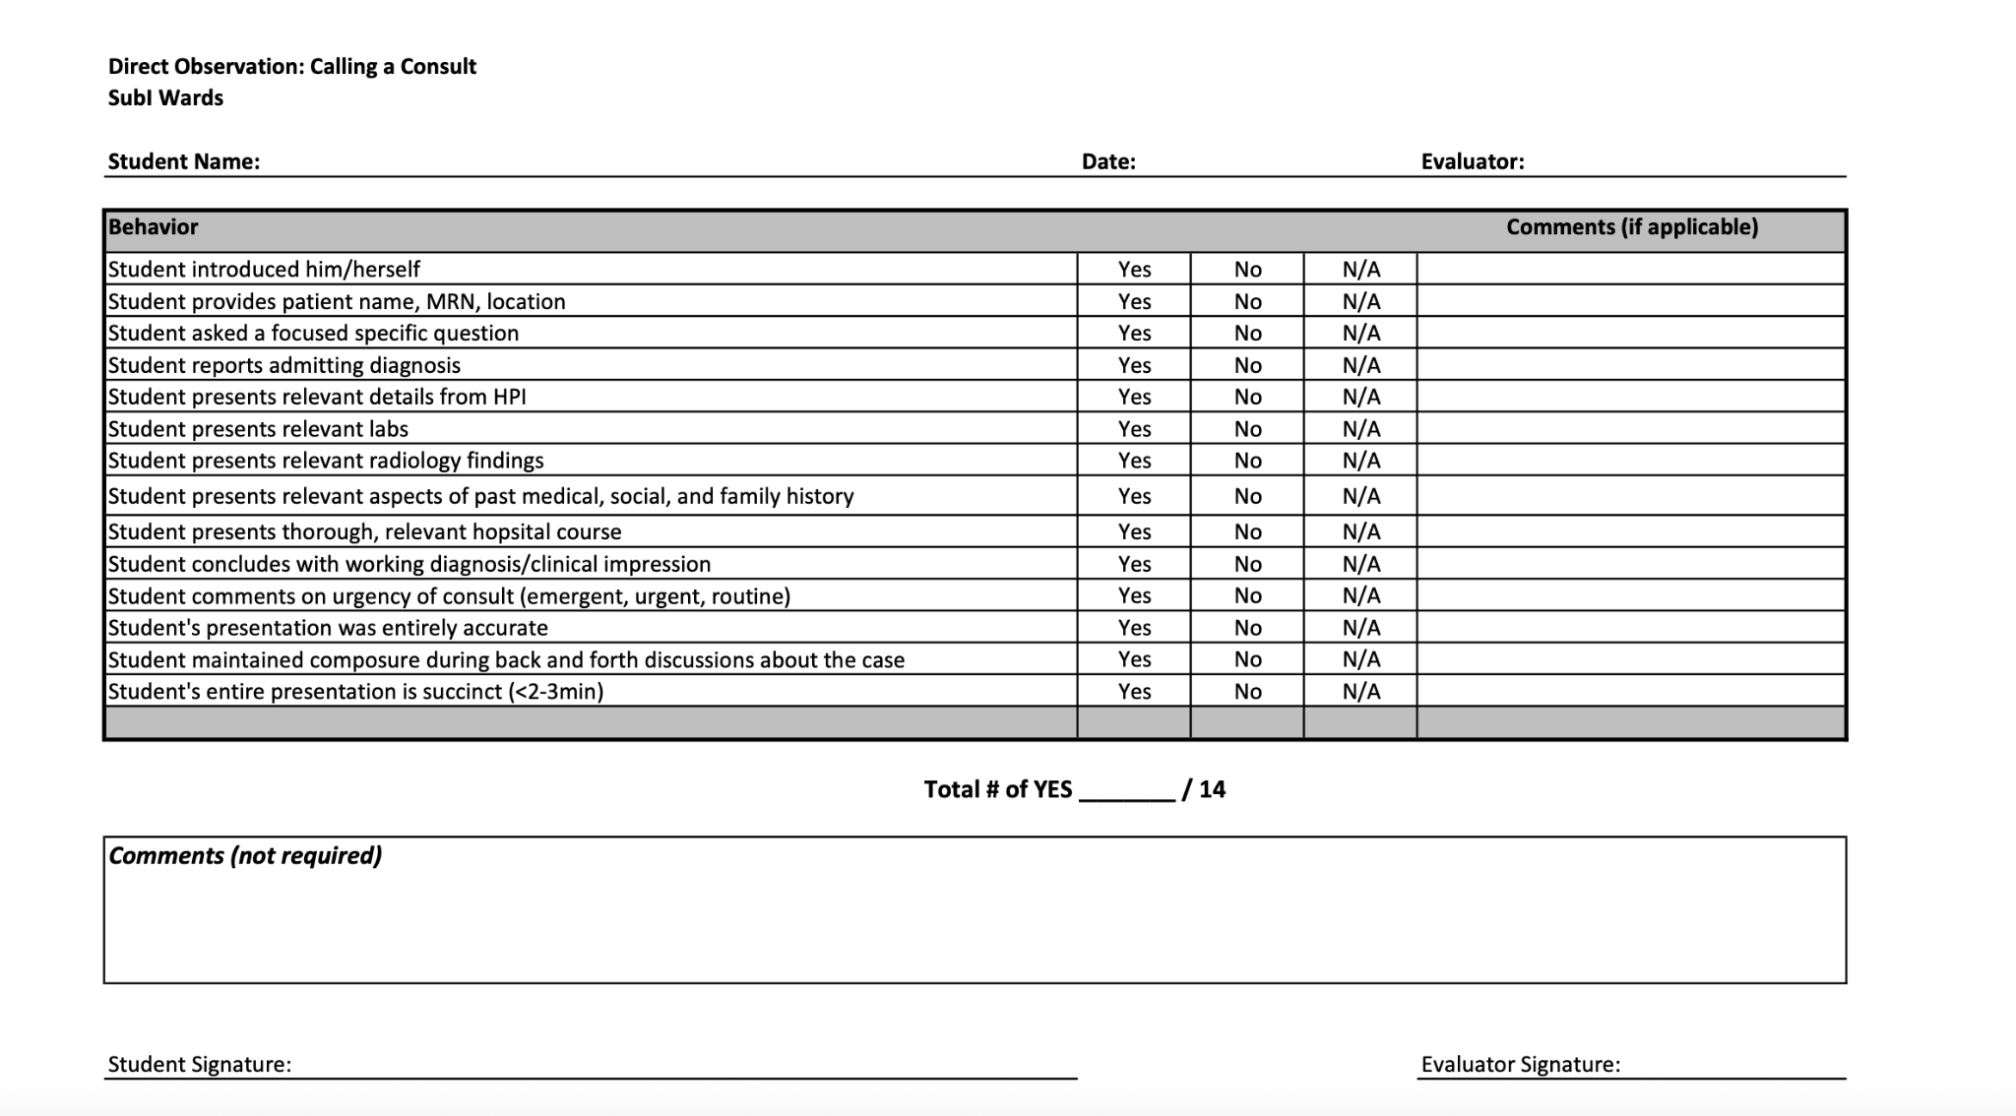
Direct observation: Initiating a consult
Due by the end of the rotation
Notes:
See if more in Margaret’s lecture about calling a consult - add in new comments form

Slide 23
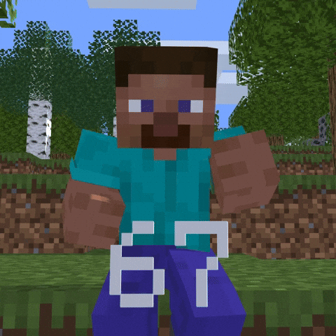
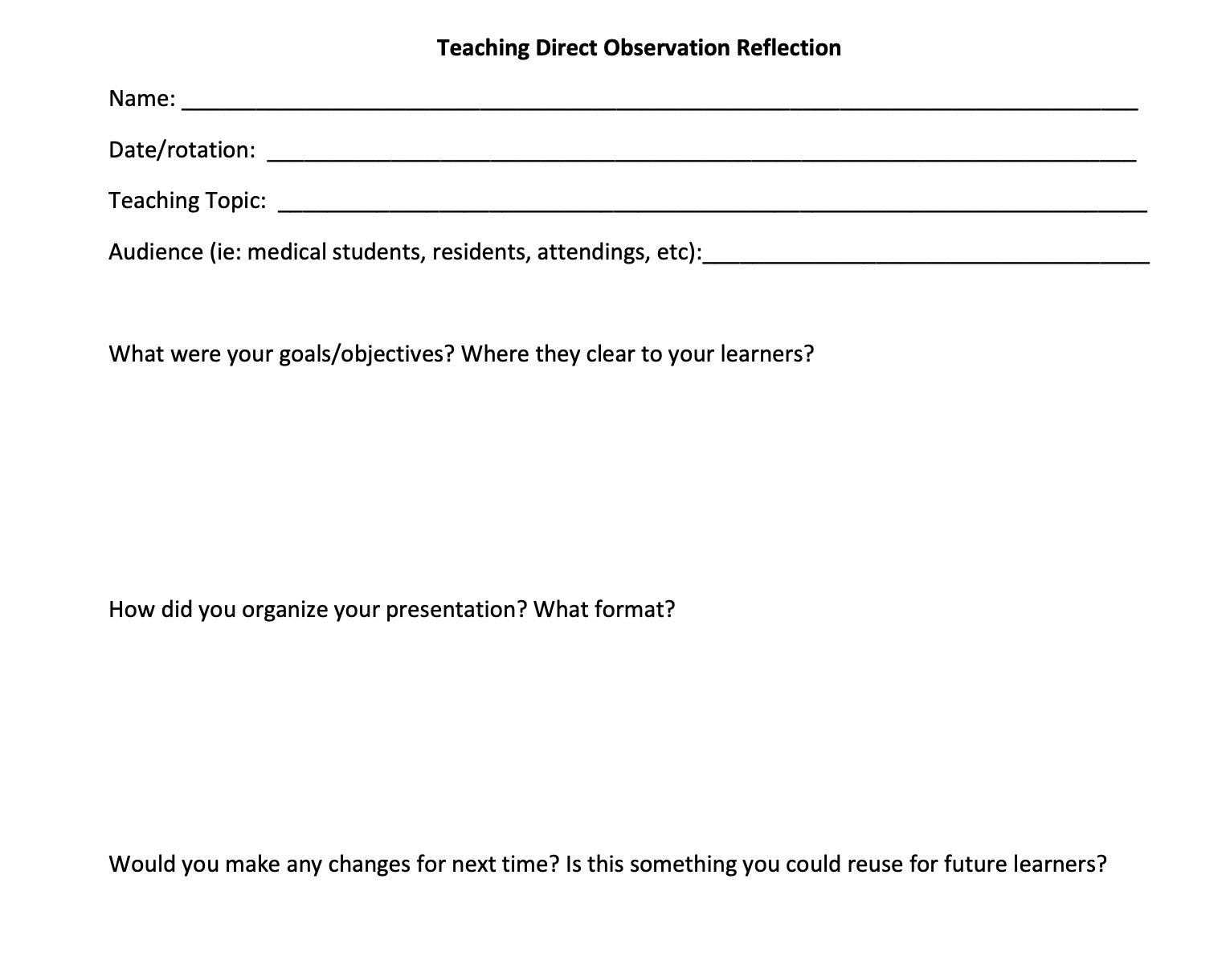
Direct observation: Teaching
Teaching Reflection + cck Marg slide
Due by the end of the rotation
Chalk Talk
Powerpoint
Board review questions
Kahoot
DIY sketchy
Notes:
Value of reflection - accountability, making chalk talks isn’t too hard, so practice and save it as part of your repertoir

Slide 24
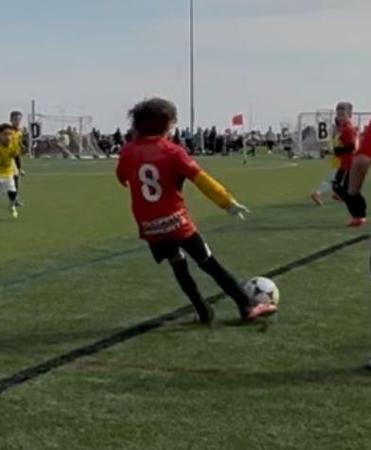
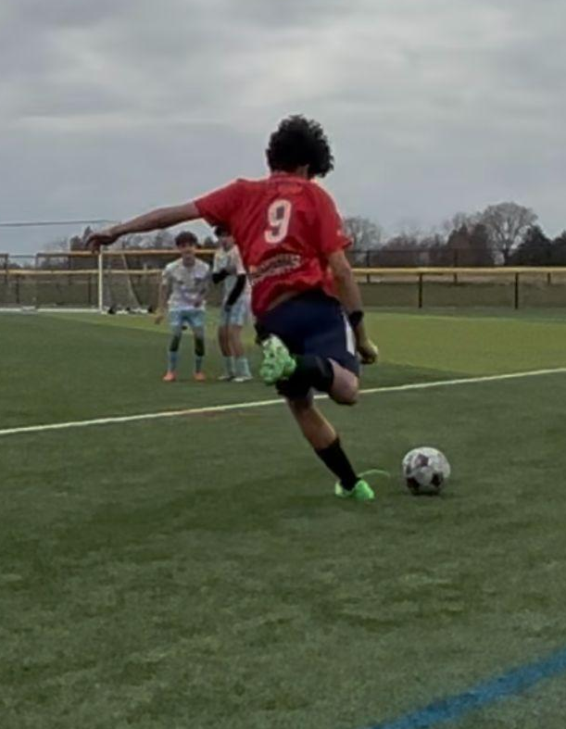
OSCE: Handoff
OSCE: Disclose a Medical Error
Handoff:
    Pick one of your patients to do the handoff
    Use the I-PASS format
    Not everyone does this on a sub-i, so we evaluate it with OSCE
Disclosure of Medical Error
    Introduce yourself and your role
    Don’t make excuses
    Be honest and you don’t have to take responsibility for things that you didn’t do
    Resources on Lumen or Sakai
In-person, the last day of the clerkship

Slide 25


Pain Quiz
In-person, the last day of the clerkship
The Pain Quiz is NOT a test, it is a quiz.
You do NOT get the day off prior to the last day (day of OSCE/Quiz) for studying. Sorry!
All based on lecture from today.

Slide 26
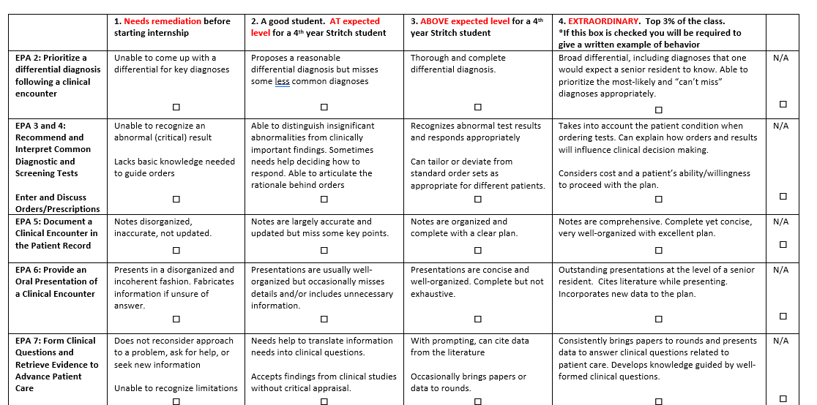
Evaluation form

Slide 27
 | AAMC Core EPAs for Entering Residency
EPA 1 | Gather a history and perform a physical exam
EPA 2 | Prioritize a differential diagnosis following a clinical encounter
EPA 3 | Recommend and interpret common diagnostic and screening tests
EPA 4 | Enter and discuss orders and prescriptions
EPA 5 | Document a clinical encounter in the patient record
EPA 6 | Provide an oral presentation of a clinical encounter
EPA 7 | Form clinical questions and retrieve evidence to advance patient care
EPA 8 | Give or receive a patient handover to transition care responsibility
EPA 9 | Collaborate as a member of an interprofessional team
EPA 10 | Recognize a patient requiring urgent or emergent care and initiate evaluation and management
EPA 11 | Obtain informed consent for tests and/or procedures
EPA 12 | Perform general procedures of a physician
EPA 13 | Identify system failures and contribute to a culture of safety and improvement

Slide 28
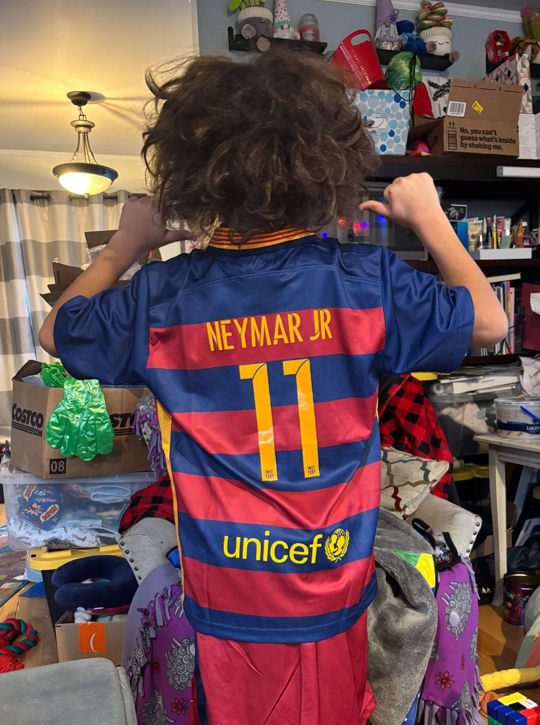
Assessment/Grading
Component | Weight
CPE | 50%
Pain Quiz | 10%
Disc. Med Error OSCE | 10%
Handoff OSCE | 10%
Direct Obs Teaching | 10%
Direct Obs Calling a Consult | 5%
Teaching Reflection Paper | 5%
Grading - You must pass all components to get Honors. You must complete all components to get any grade at all.
  Honor cutoff score 92
  HP cutoff score 80
  Pass cutoff score 60

Slide 29
“The 14th EPA” – Administrative tasks
Turn everything in on time
If late, we will take off 20% off your grade for those assignments unless you have a valid excuse
If the lateness is particularly egregious, it will be 40% off.

Slide 30

Emotional intelligence

Slide 31
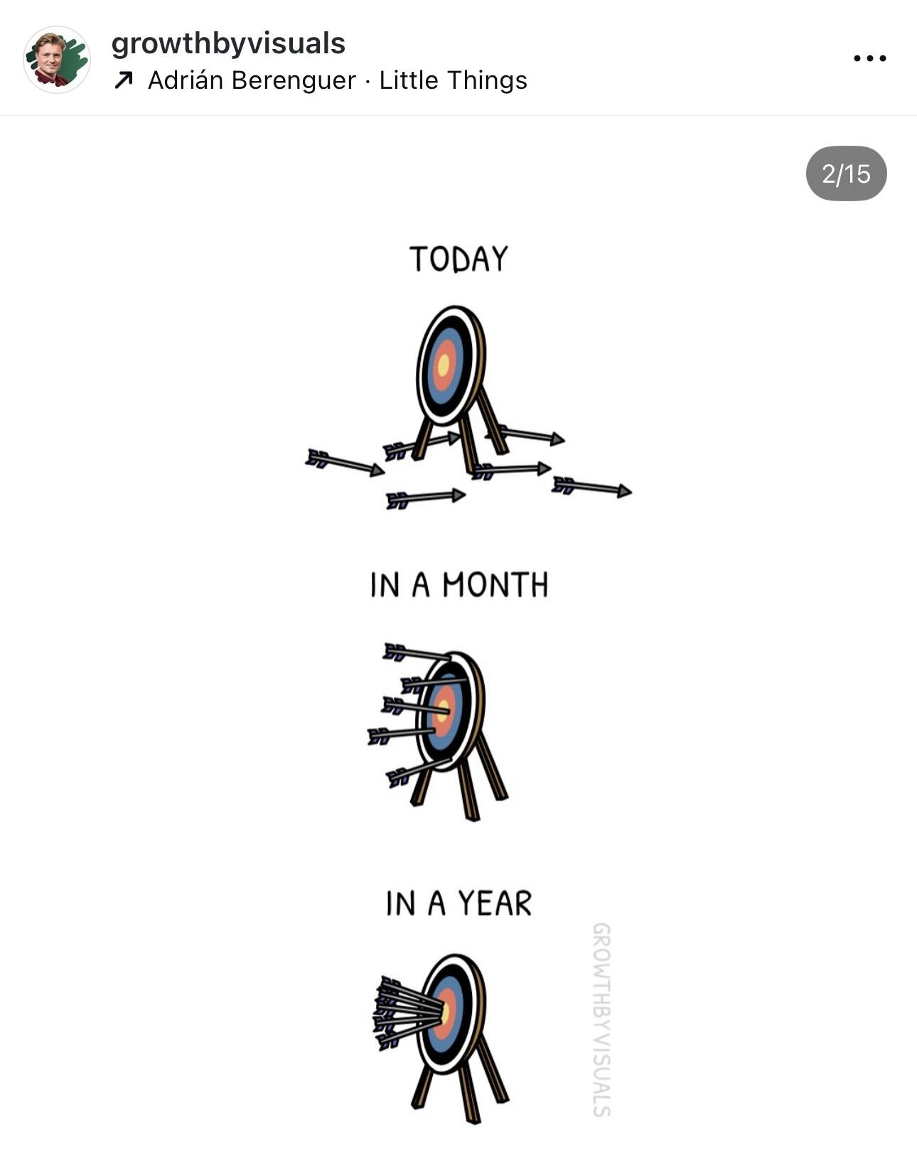
Things that make a good sub-i
Be curious
Take ownership
Clear communication requires asking questions
Remember your why
Be flexible
Create good habits

Slide 32
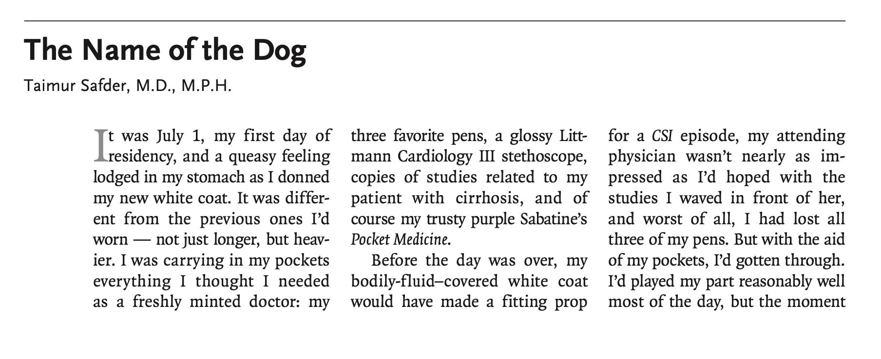
Humanism in Medicine

Slide 33

Remember Your Why
SMART goal?
Job security?
A future family?
Reflect and be honest with yourself

Slide 34

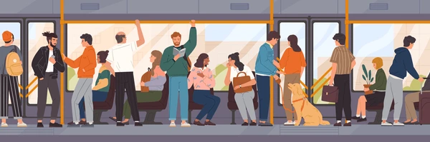
Train experiment:
People instructed to talk with strangers had increased positive feelings compared to control group

Slide 35
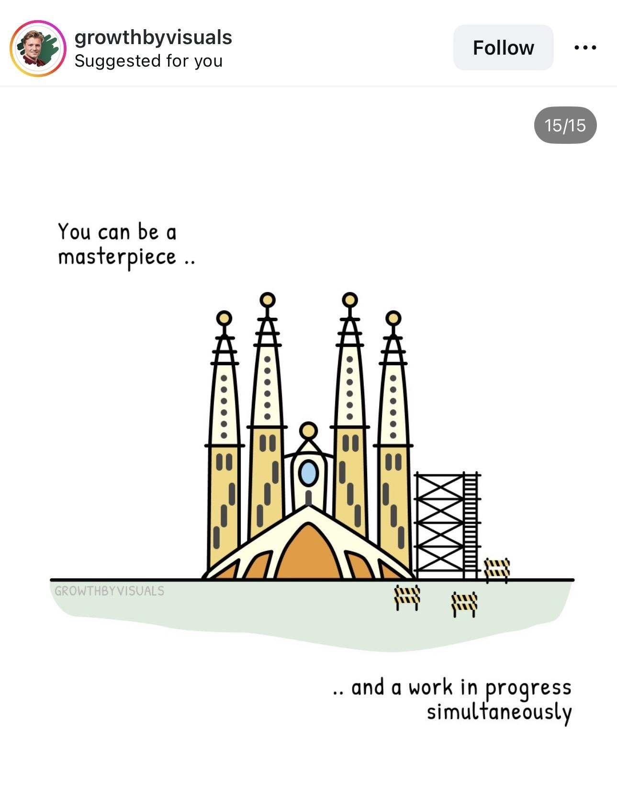
Questions?
Enjoy this experience
Send me any feedback you think might be helpful, good or bad
brebailey@lumc.edu

