Slide 1
The Cardiac Exam
Sandeep Mehta MD
Department of Cardiology

Slide 2
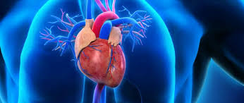
Learning Objectives
Cardiac Exam Basics
Normal heart sounds and physiology
Common abnormal heart sounds
Common murmurs

Slide 3
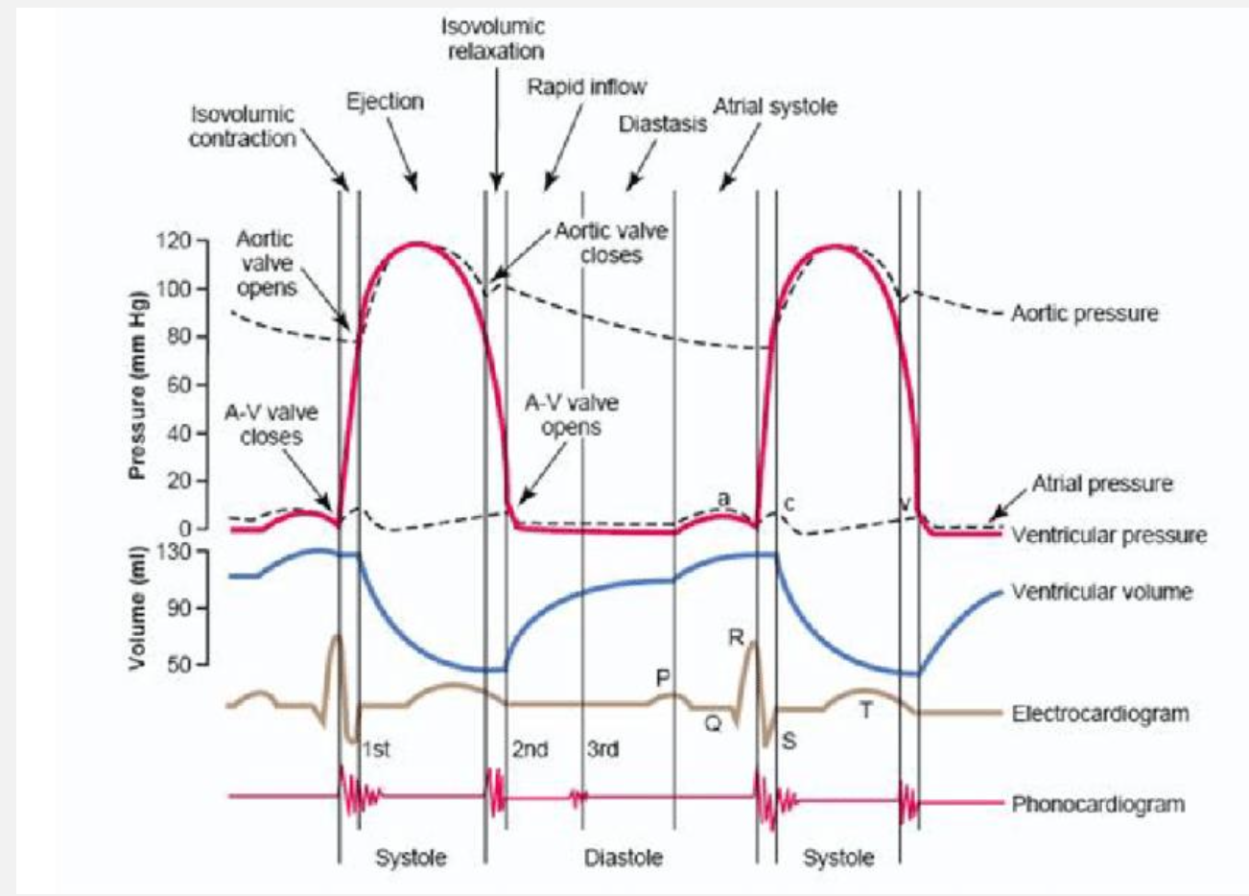

Slide 4
Cardiovascular Exam Basics
Vitals
Inspection
Palpation
Auscultation

Slide 5
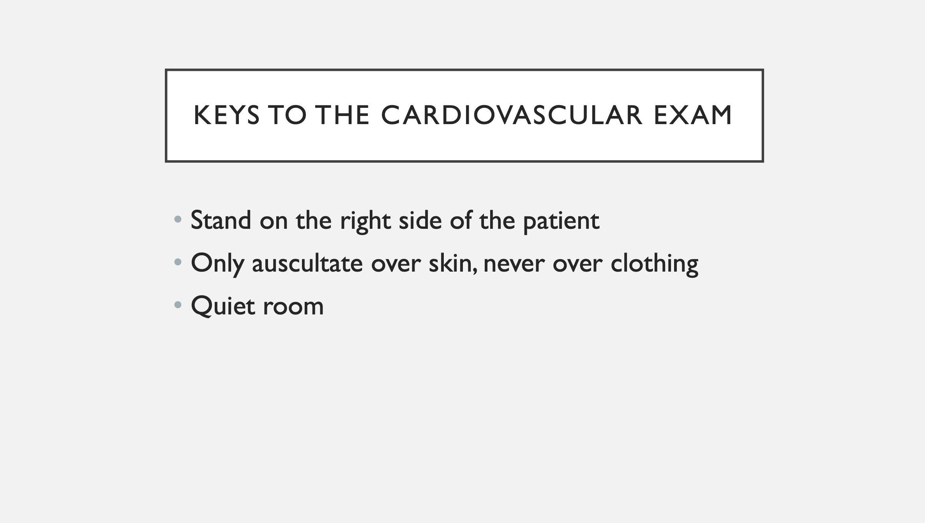

Slide 6
Vitals
Heart rate- tachycardia/bradycardia,
Blood pressure- systolic/diastolic, hypertensive/hypotensive, pulse pressure (narrow vs wide -normal is 40 mmHg )
Respiratory rate
Temperature

Slide 7
Inspection
General appearance-= comfortable or distress, cachectic, overweight, breathing comfortable
Mouth, nails, extremities- cyanosis?, edema?
Neck- JVP exam

Slide 8
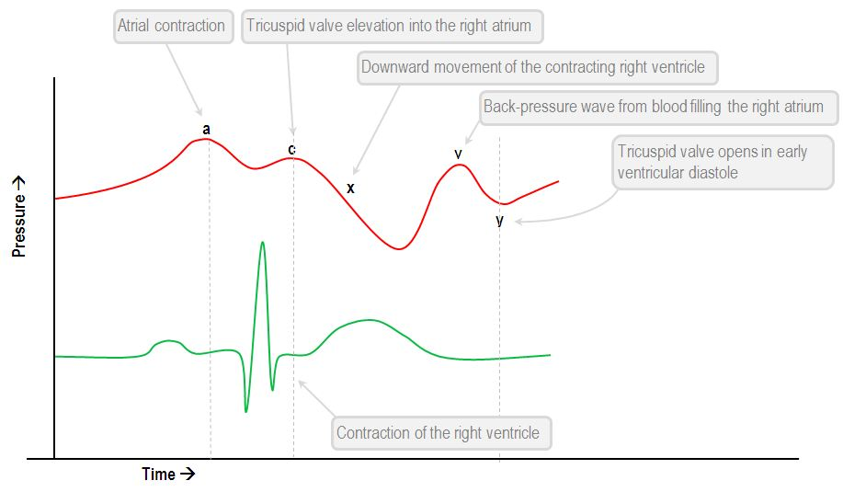
JVP (Jugular Venous Pulsations)
https://stanfordmedicine25.stanford.edu/the25/neck-exam-jugular-venous-pressure-measurement.html
https://www.youtube.com/watch?v=tJzBKdKg2k0
Watch these videos !!!

Slide 9
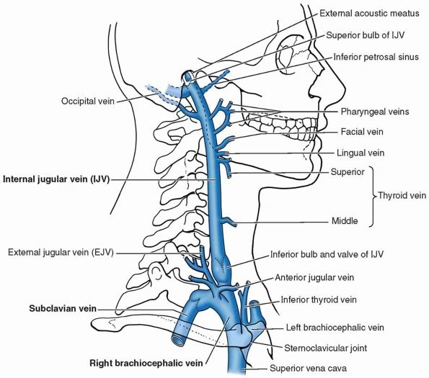

Slide 10
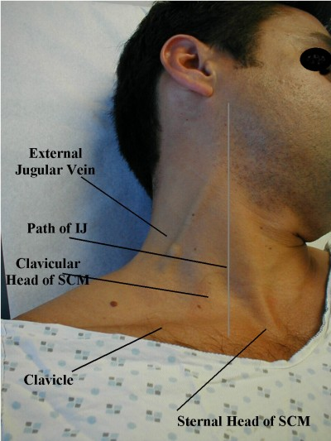

Slide 11
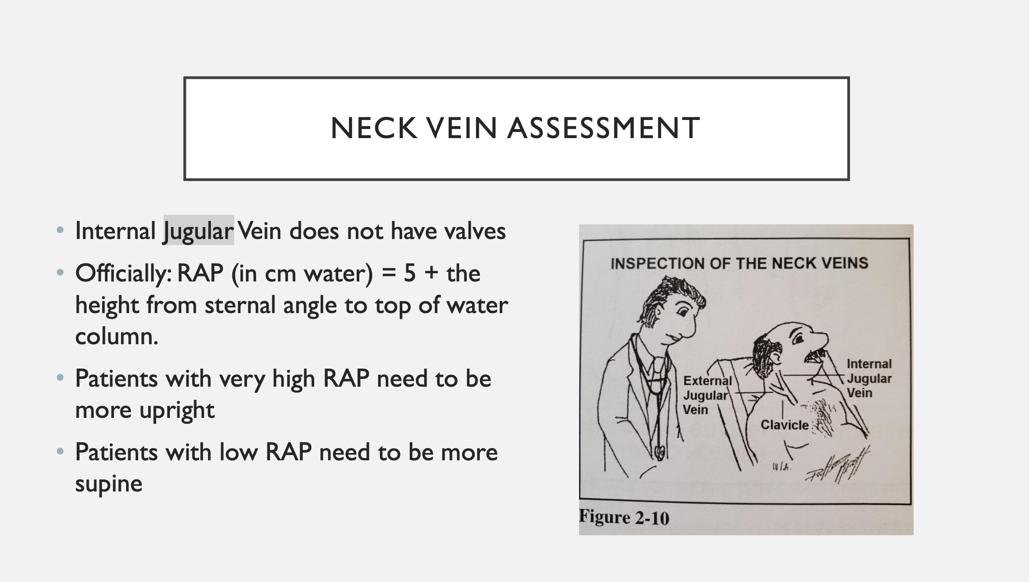

Slide 12
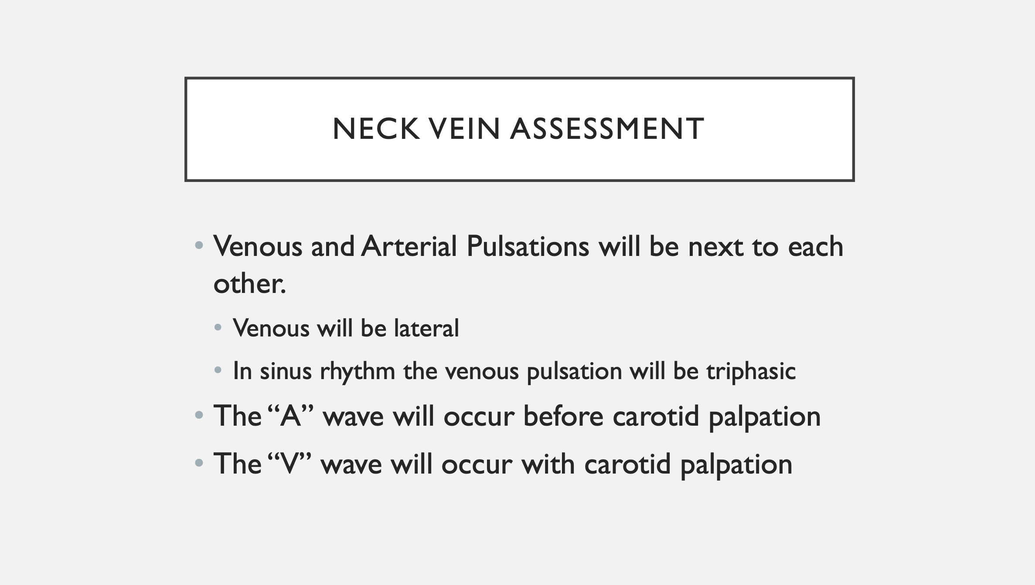

Slide 13
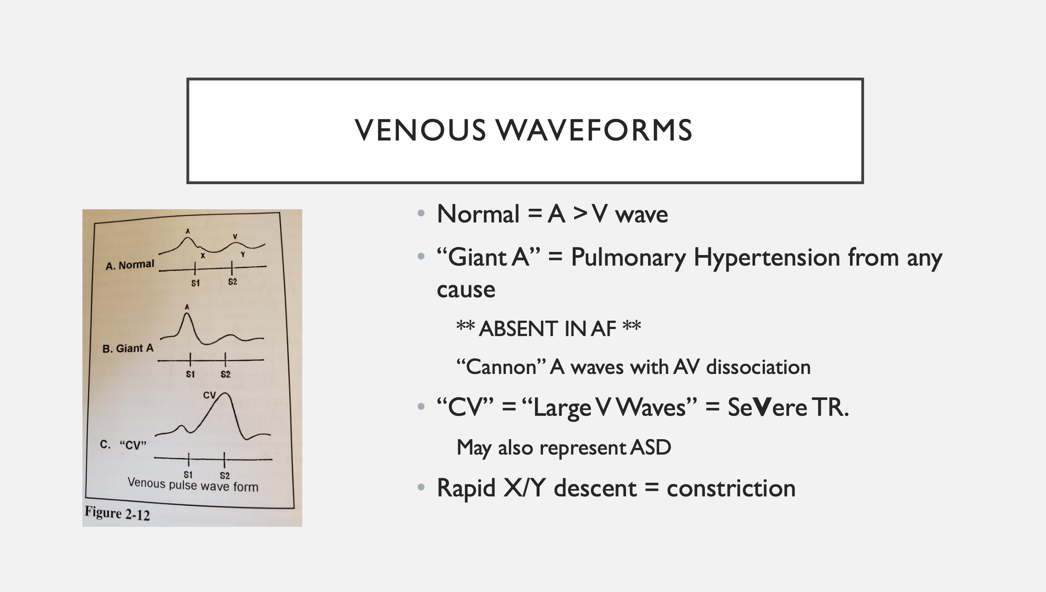

Slide 14
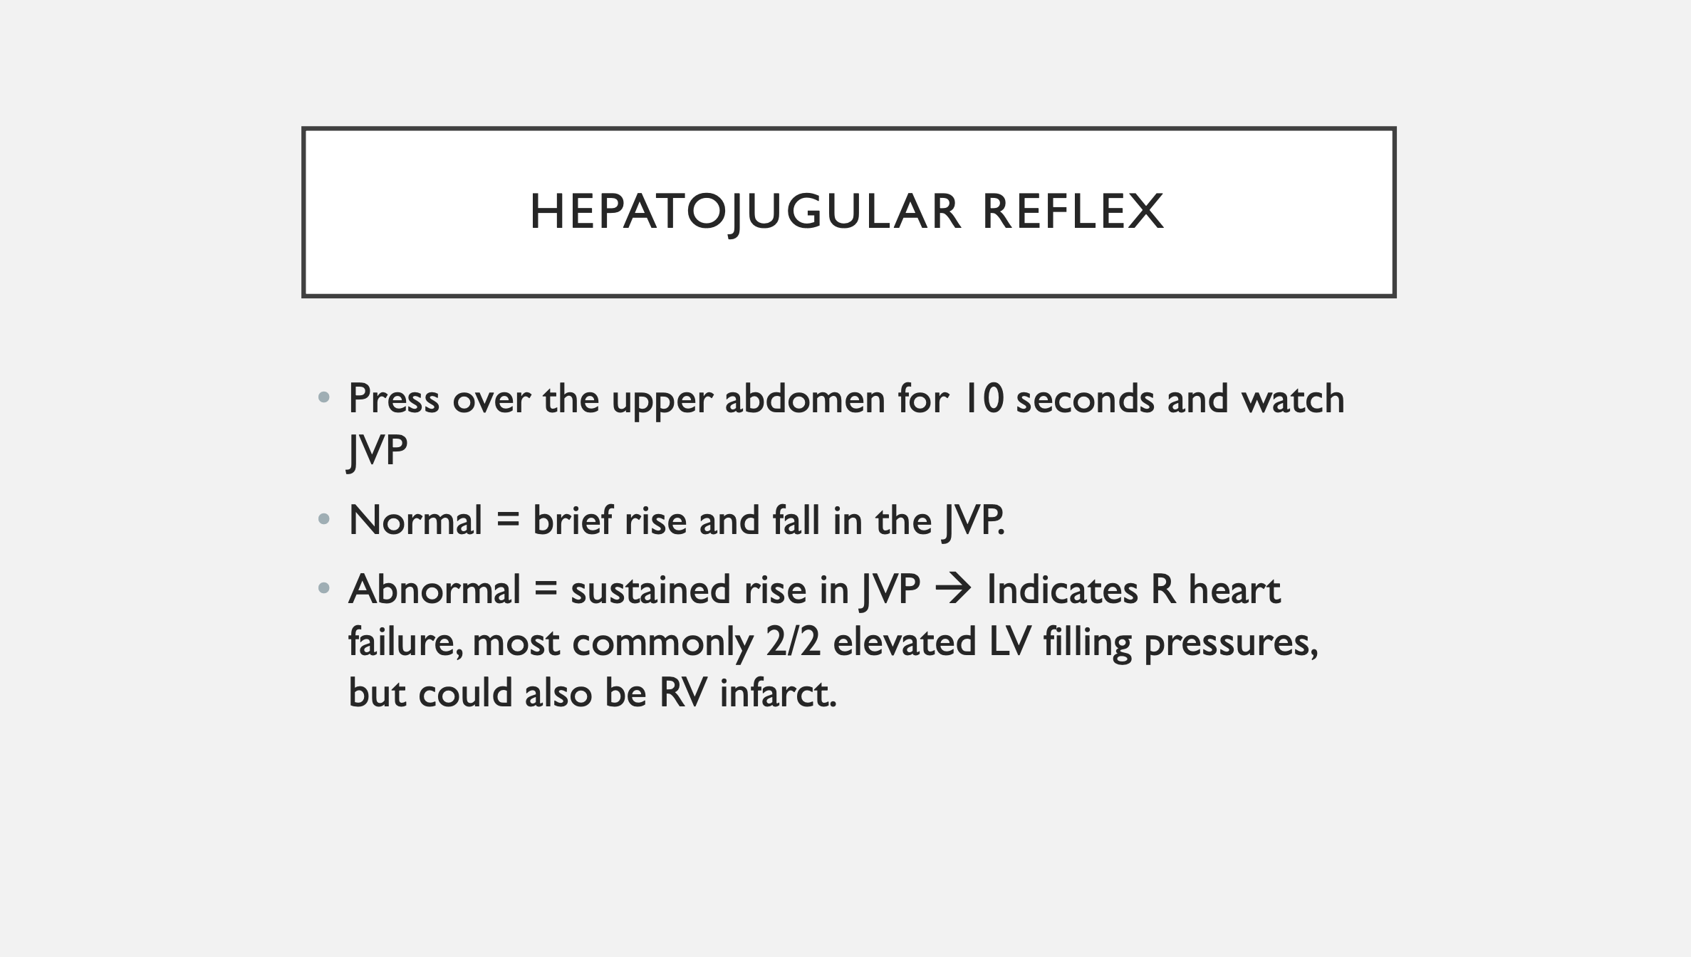

Slide 15
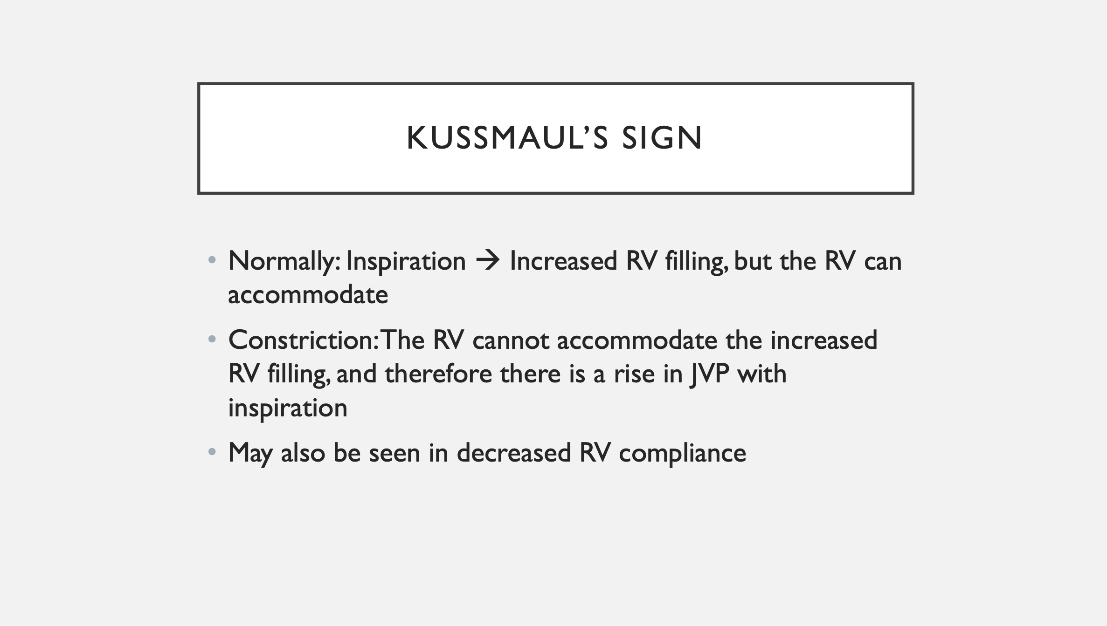

Slide 16
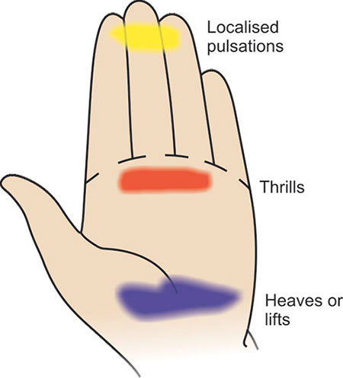
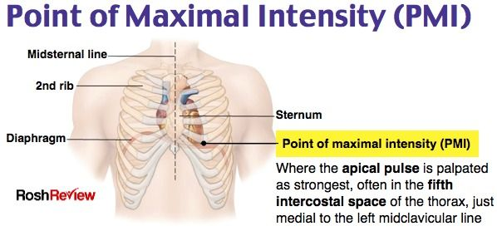
Palpation
Pulses
Heaves
Thrills
PMI

Slide 17
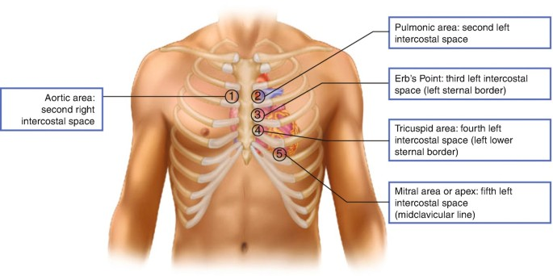
Auscultation

Slide 18
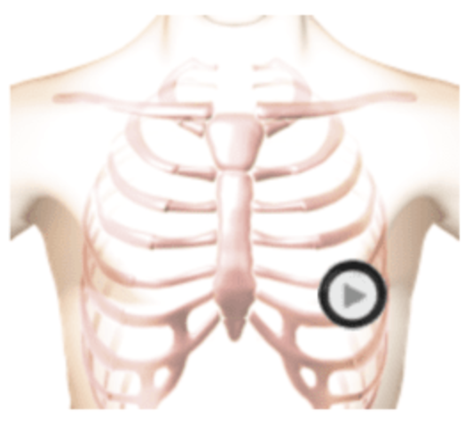
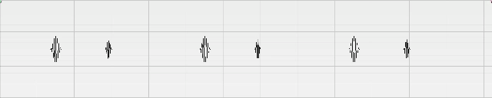
Normal S1/S2
Systole
Diastole
S1
S2
S1
S2
S1
S2
https://www.easyauscultation.com/cases/8

Slide 19
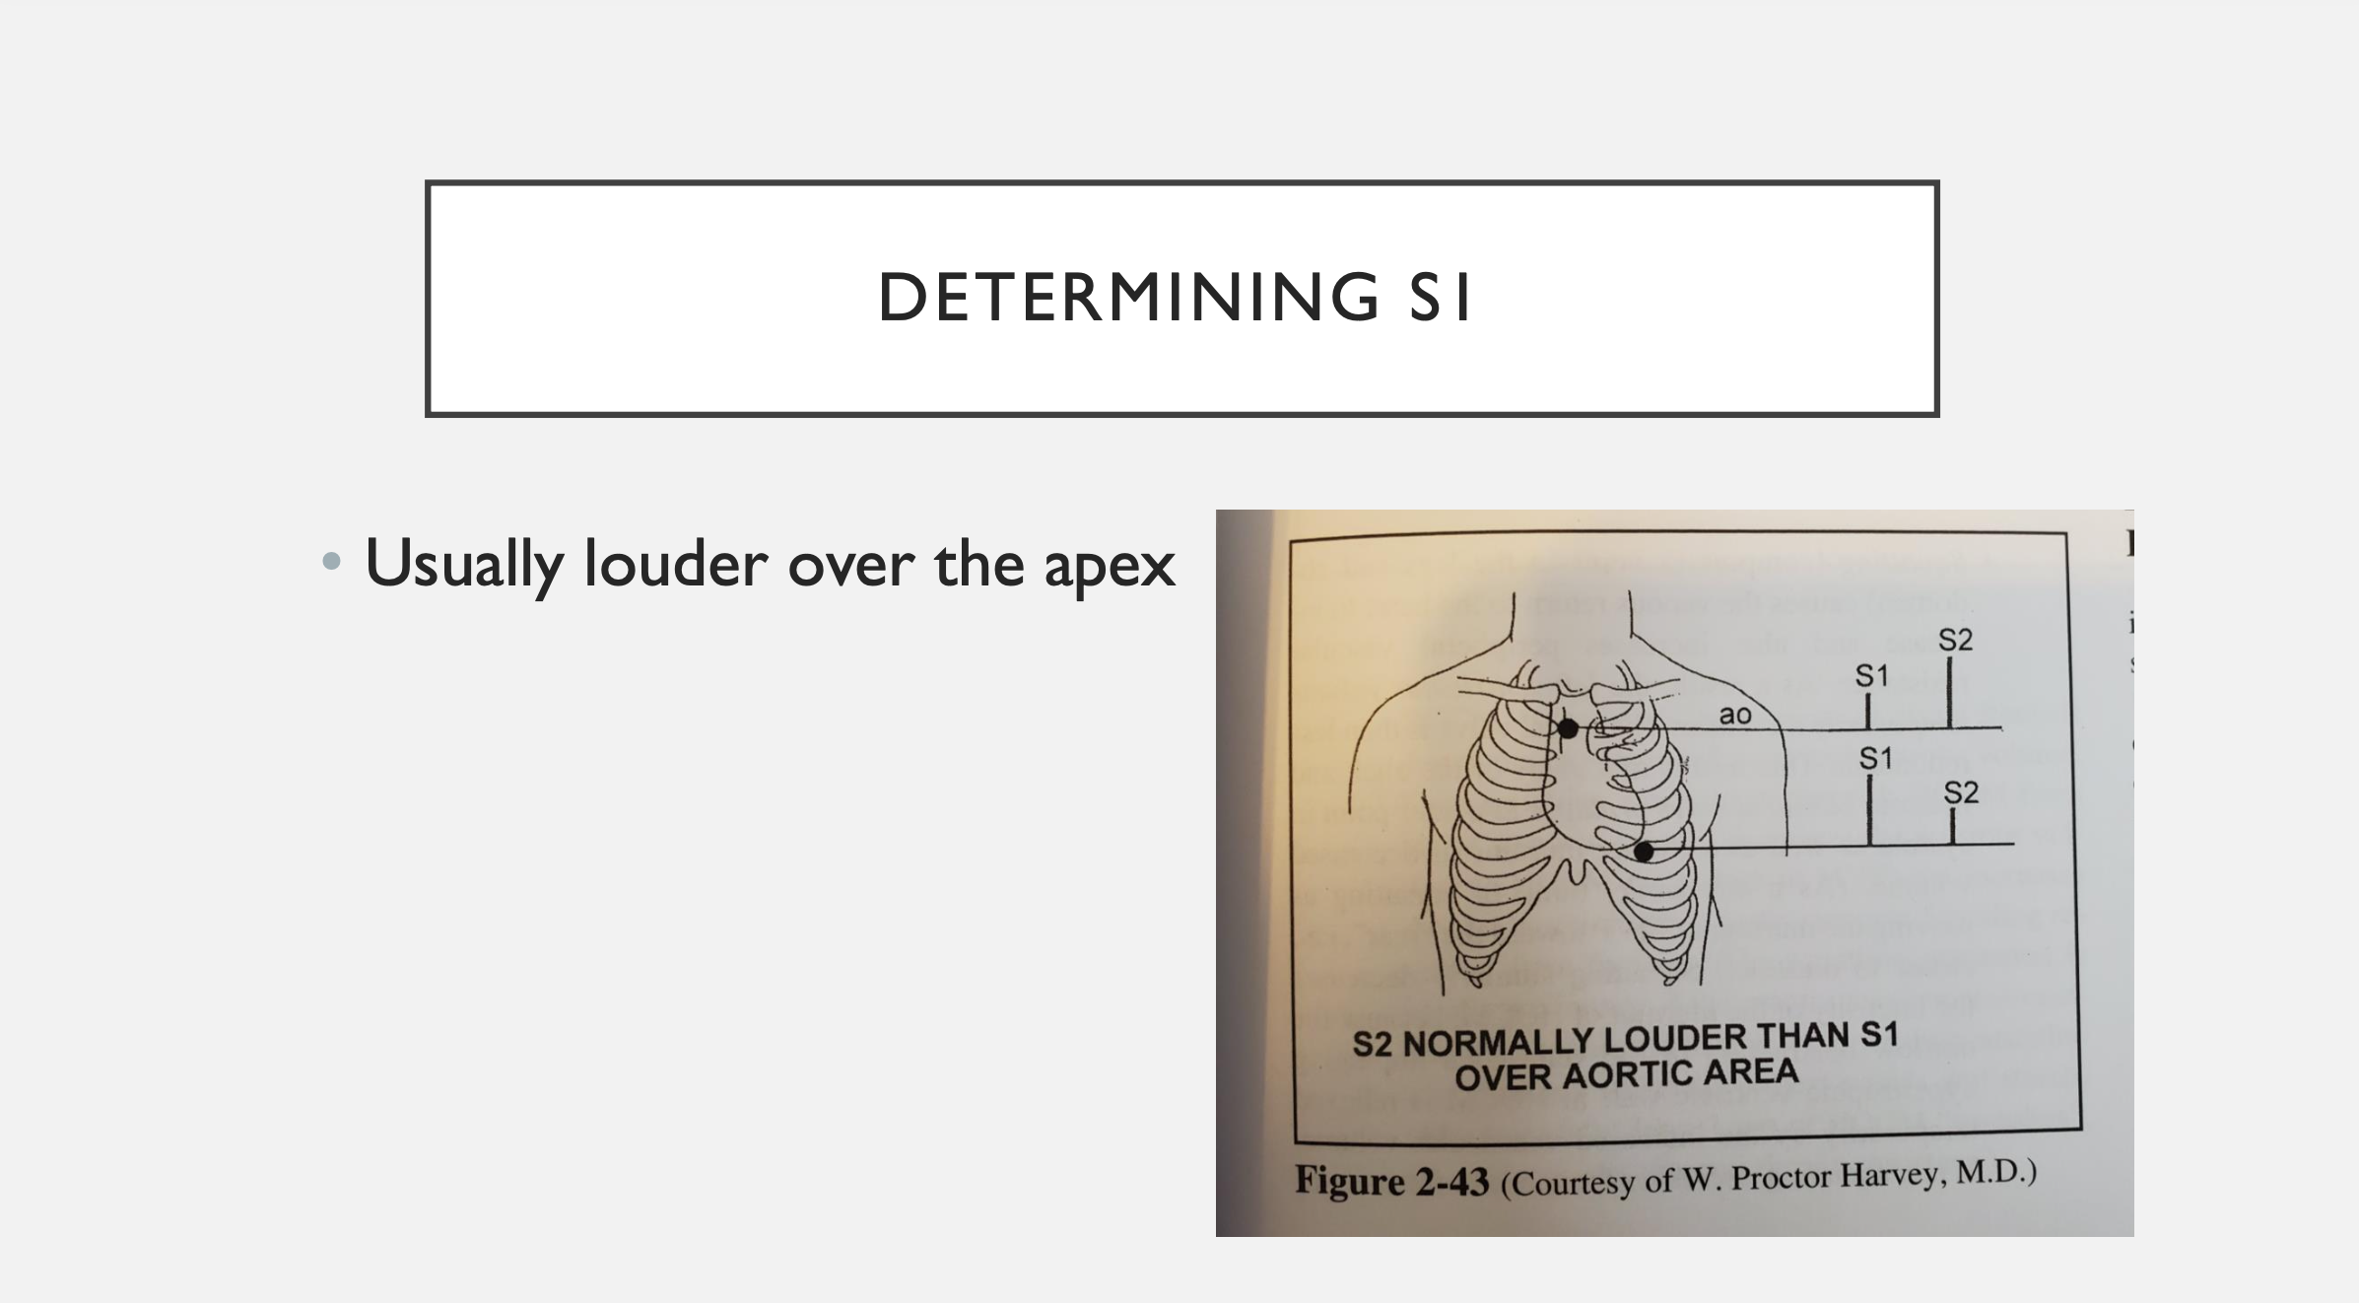

Slide 20
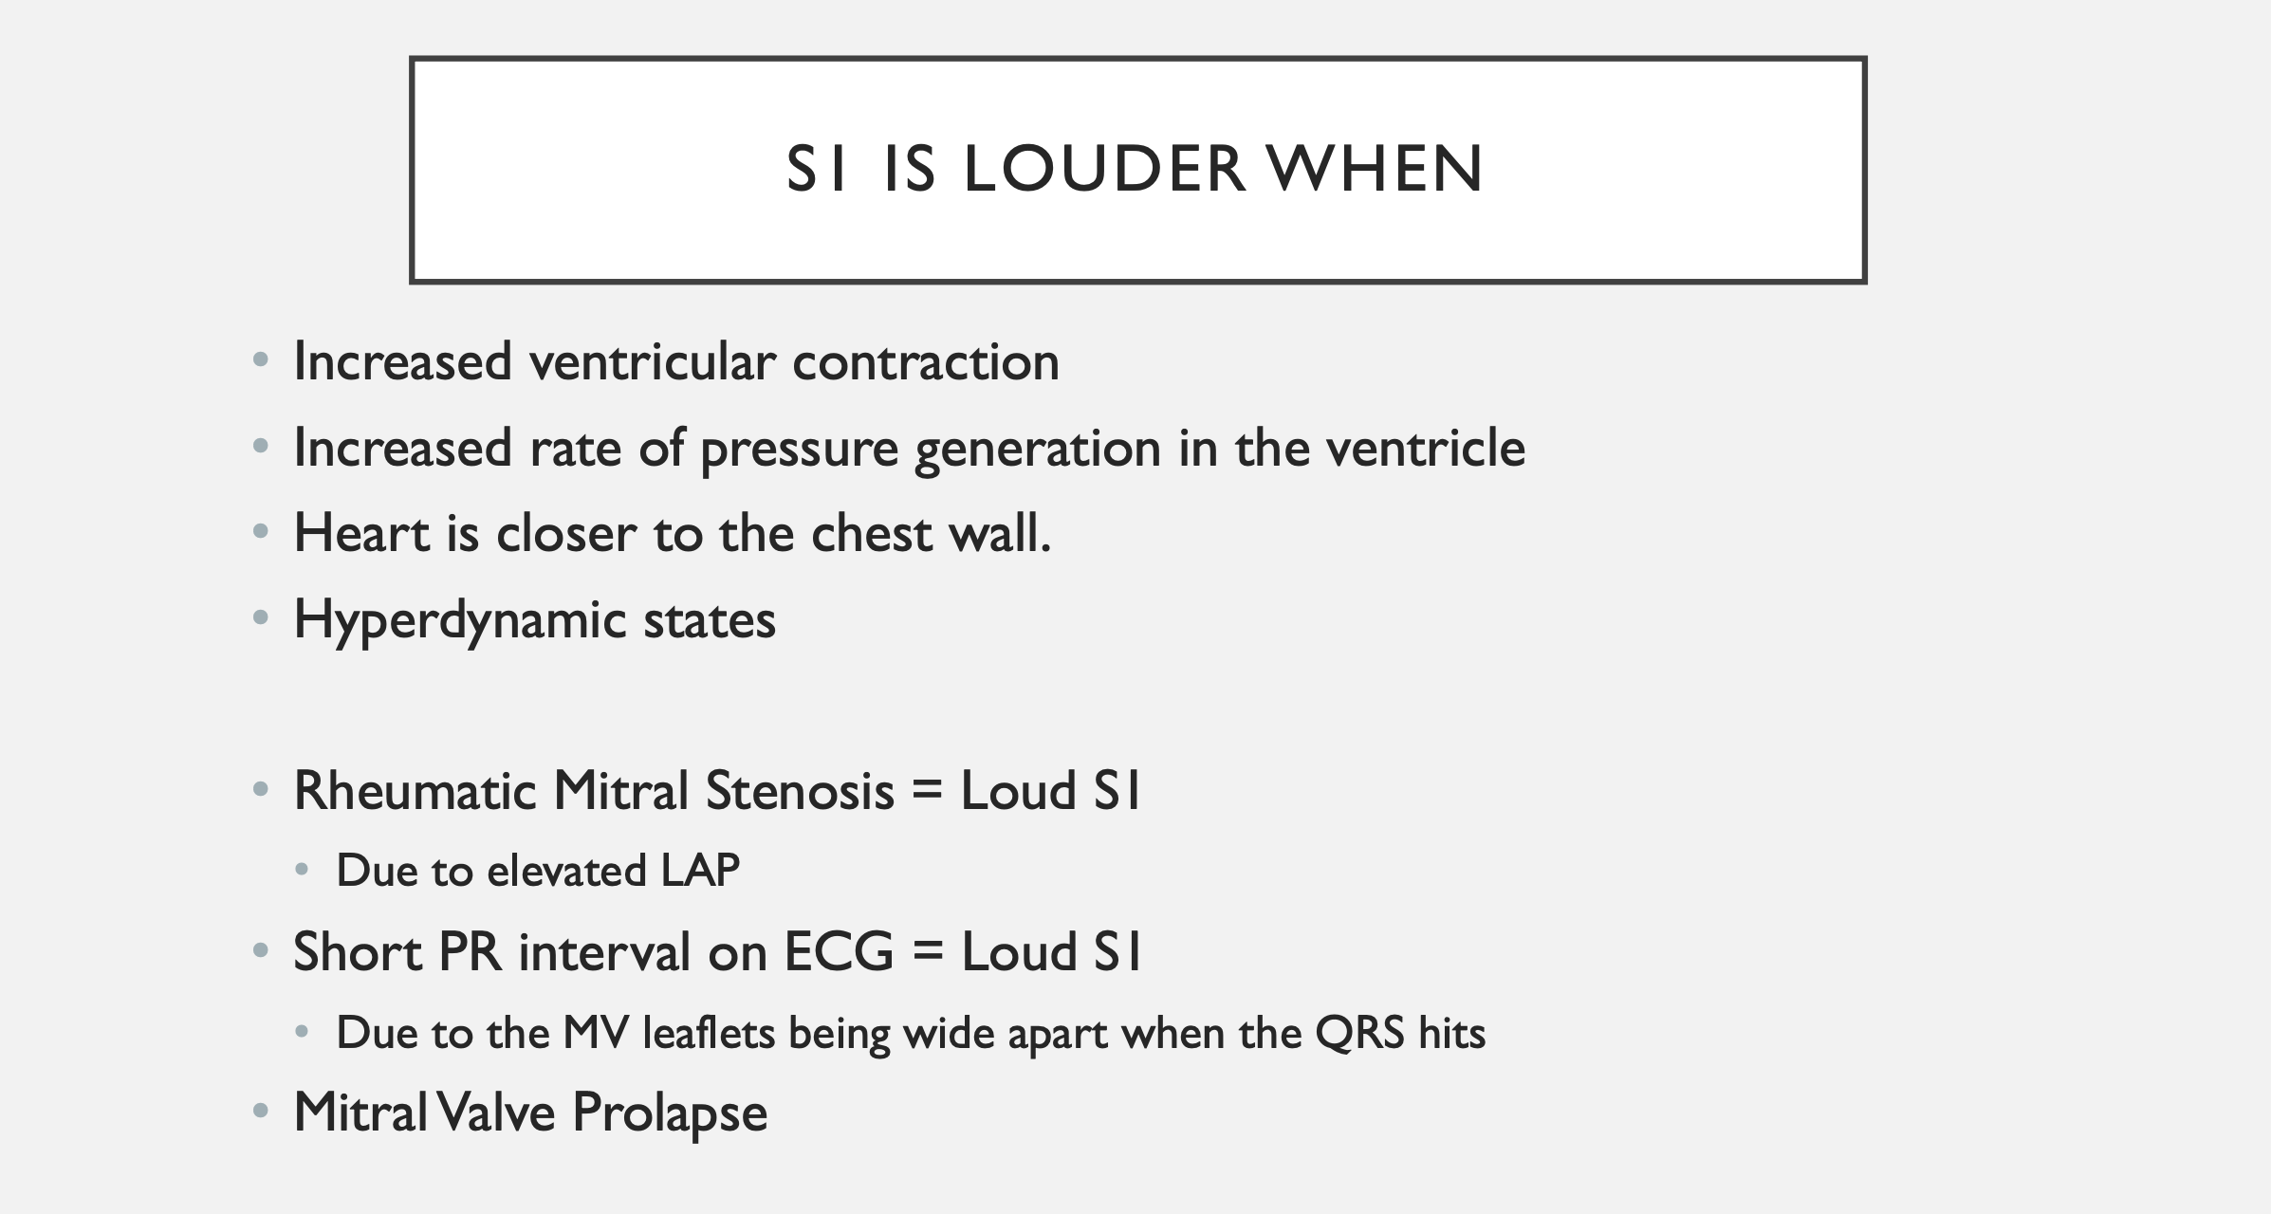

Slide 21
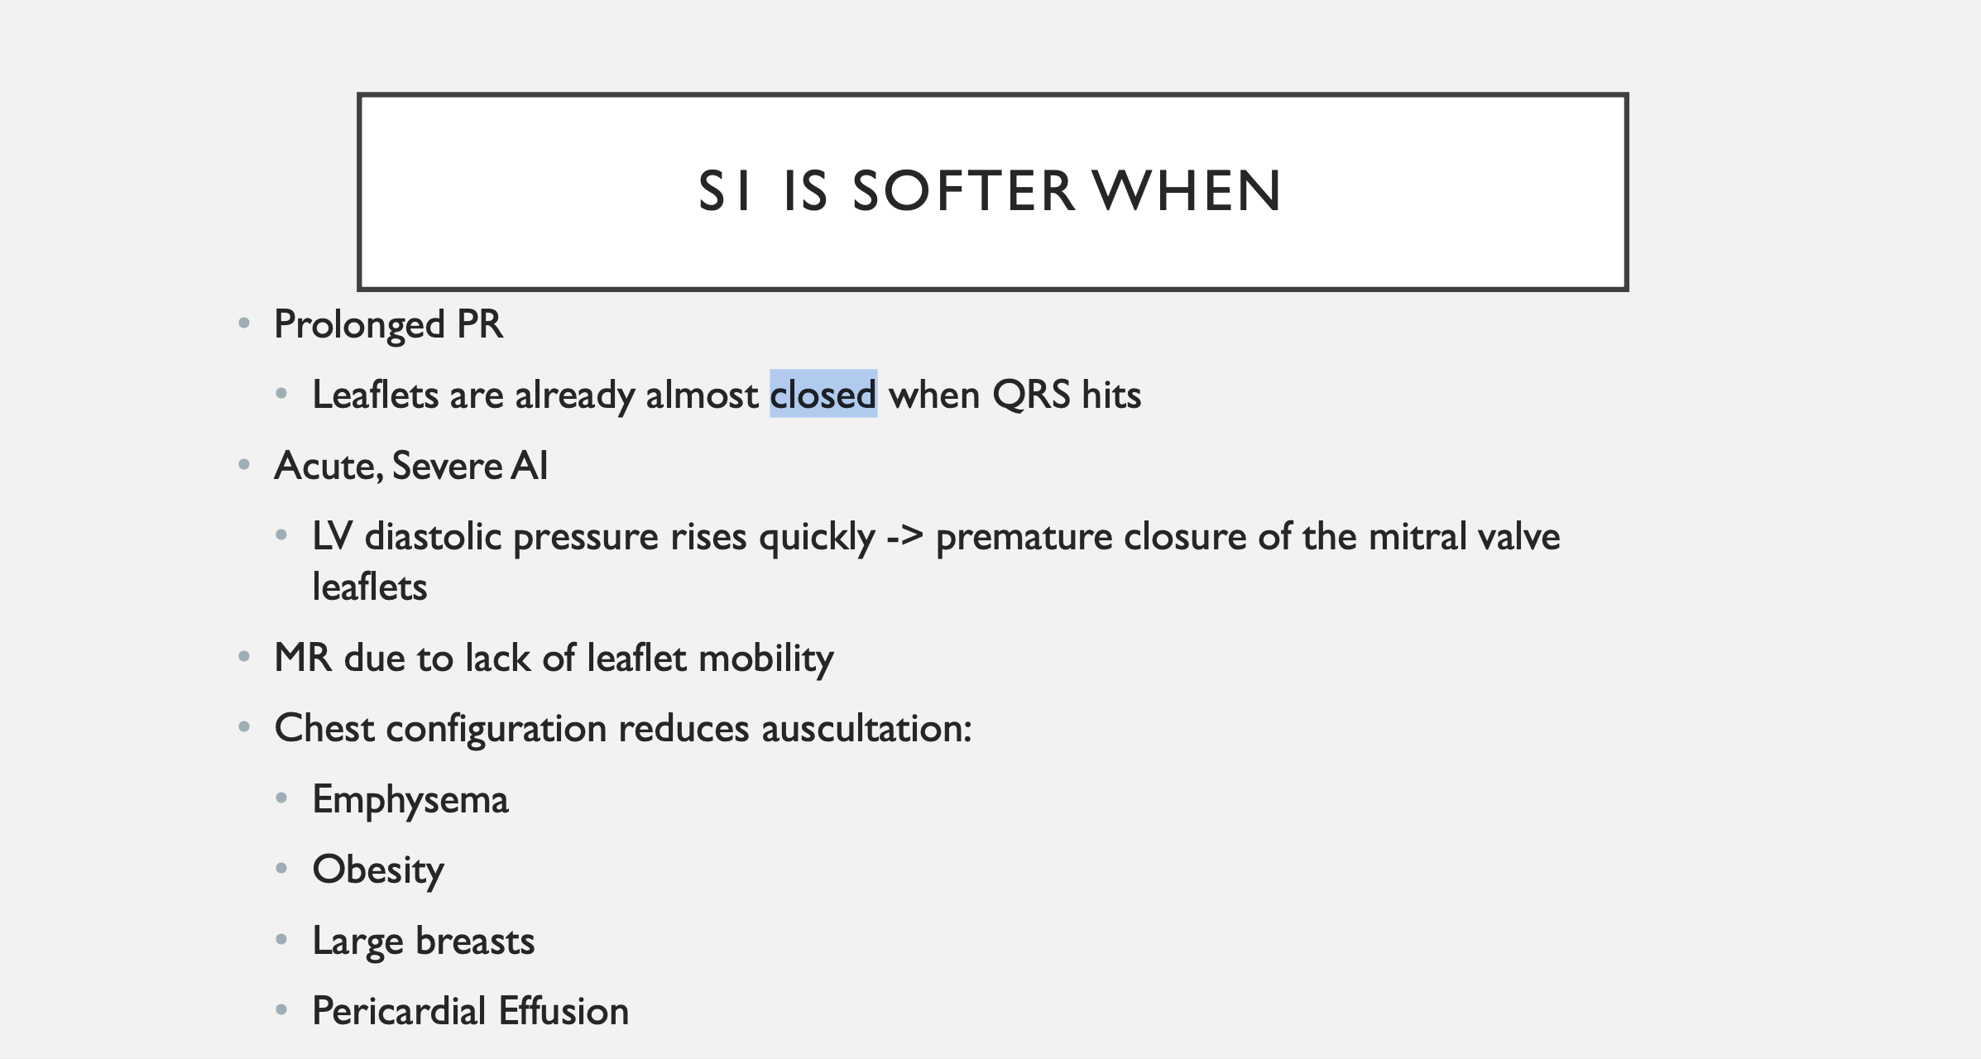

Slide 22
S2
LoUder S2
SoFter S2
Loud A2- hypertension
Loud P2- pulmonary HTN
Soft A2 (aortic stenosis )
Soft P2 (pulmonic stenosis)

Slide 23
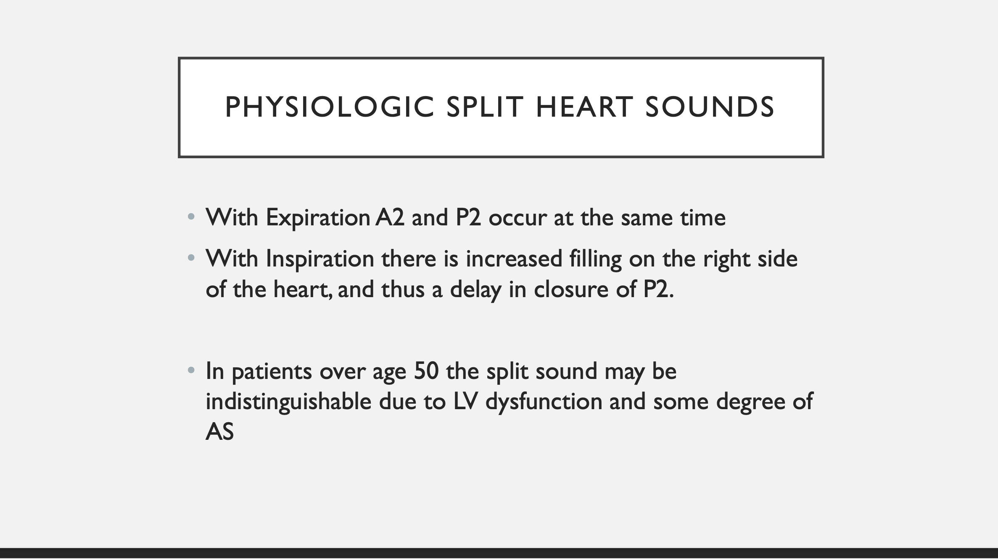

Slide 24
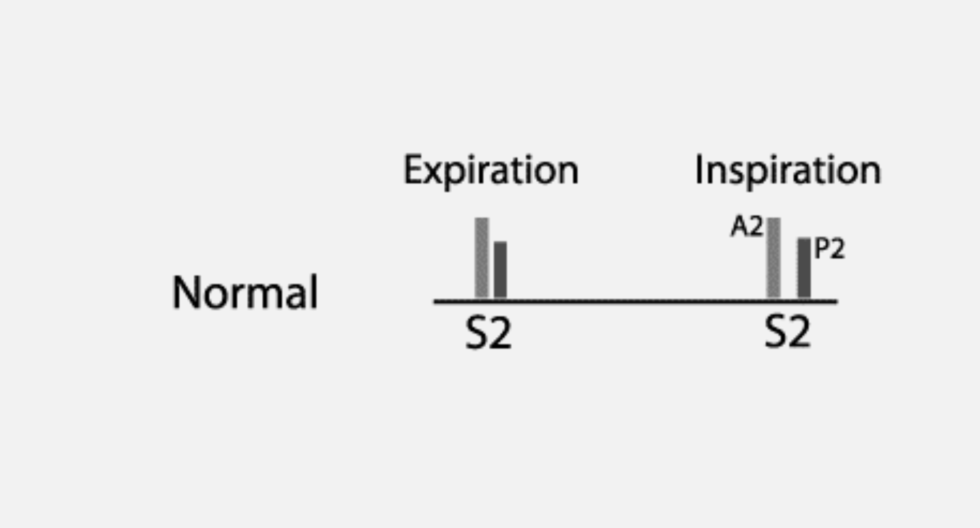

Slide 25
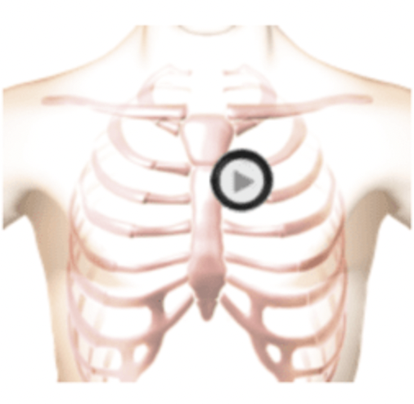
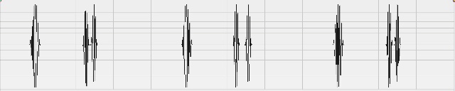
Normal S1/S2 with Physiologic Splitting of S2 (During INSPIRATION)
S1
S2
S1
S2
S1
S2
https://www.easyauscultation.com/cases/9/second-heart-sound---physiologically-split-#1

Slide 26
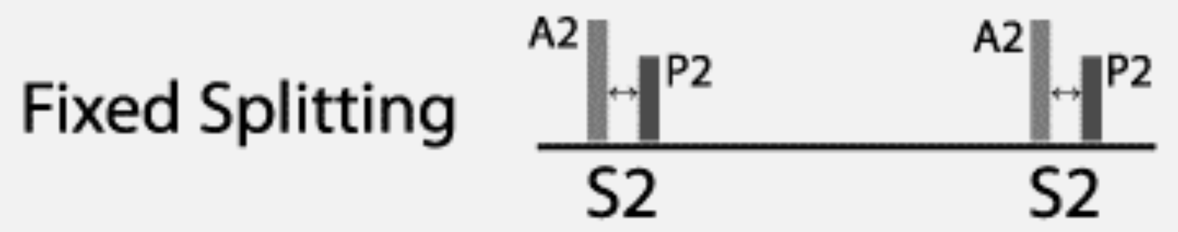
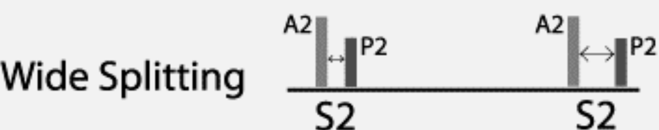
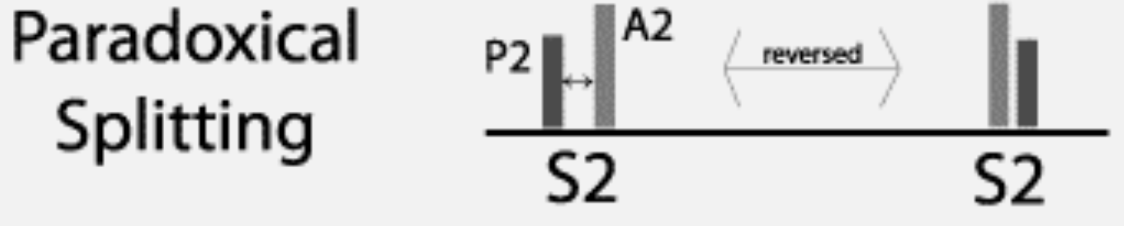
Variations of S2 SplITTING
Fixed Splitting of S2
Exaggerated inspiratory splitting of S2
Paradoxical (expiratory splitting of S2)

Slide 27
S3
Early diastolic sound that happens after S2 due to rapid early filling of a ventricle
  Can be seen in normal healthy people
  “Sloshing In “
  RV S3 (tricuspid position) and LV S3 (mitral position)
  Can also be seen in pathology
    Mitral regurgitation, dilated cardiomyopathy/heart failure , pregnancy/hyperthyroid

Slide 28
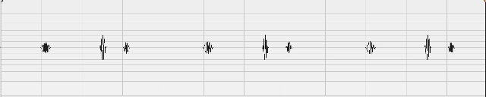
s3
S3
S1
S2
https://www.easyauscultation.com/cases/37

Slide 29
s4
Always pathologic
Late diastolic sound
Atrial contraction against a stiff ventricle
“Tennessee”

Slide 30
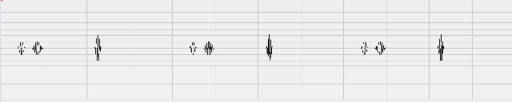
s4
S4
S1
S2
https://www.easyauscultation.com/cases/35/fourth-heart-sound-gallop

Slide 31
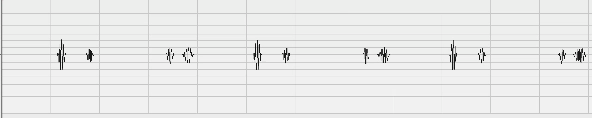
S3 & S4
S3
S4
S3
S4
S3
S4
S2
S1
S2
S1
S2
S1
https://www.easyauscultation.com/cases/36/third-and-fourth-heart-sound-gallop

Slide 32
MURMURS
Turbulent or abnormal flow typically through valves or through the heart
Right side murmurs louder with inspiration – more right sided filling
Systolic flow murmurs can be normal – typical short crescendo decrescendo murmur in RUSB/LUSB with normal rest of the exam < grade 3
  RUSB- aortic stenosis LUSB- pulmonic stenosis, LLSB- tricuspid regurgitation, Apex- mitral regurgitation
  Sternal border- HCM, VSD
Diastolic murmurs always abnormal
  RUSB- aortic regurgitation LUSB- pulmonic regurgitation, LLSB- tricuspid stenosis, Apex- mitral stenosis

Slide 33
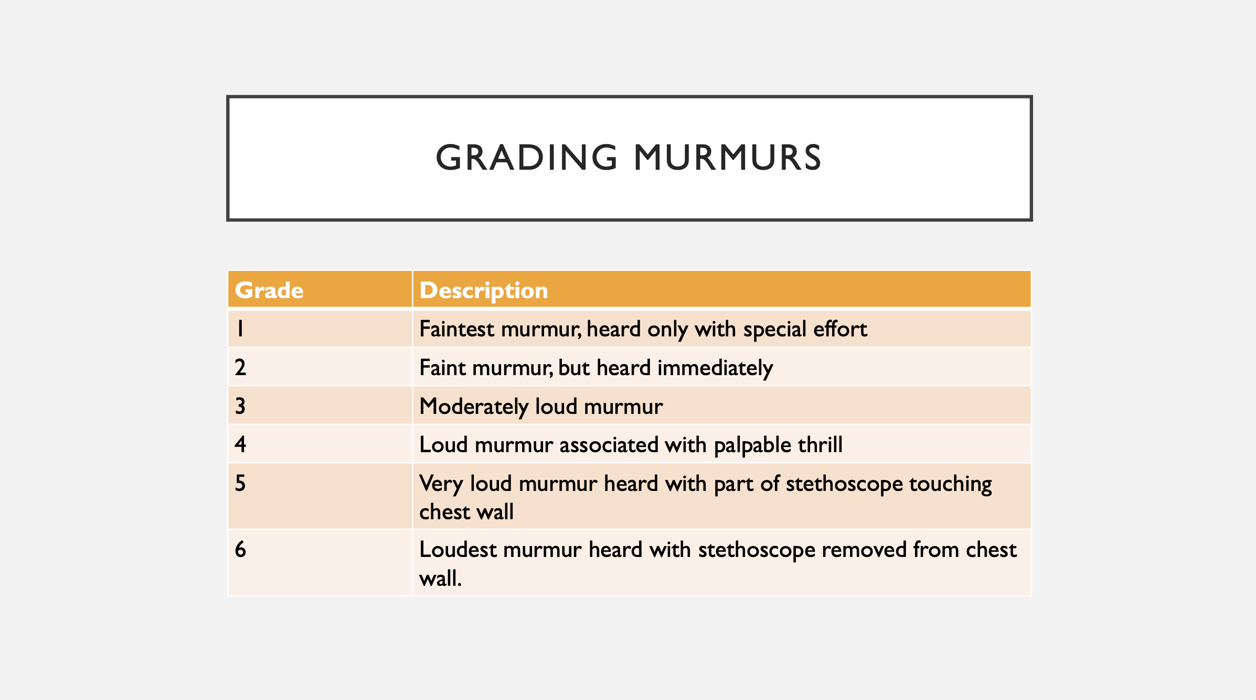

Slide 34
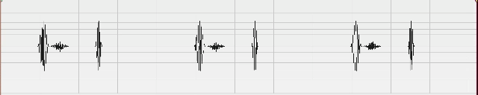
Innocent Flow Murmur
S1
S2
S1
S2
S1
S2

Slide 35
Pathologic Murmurs

Slide 36
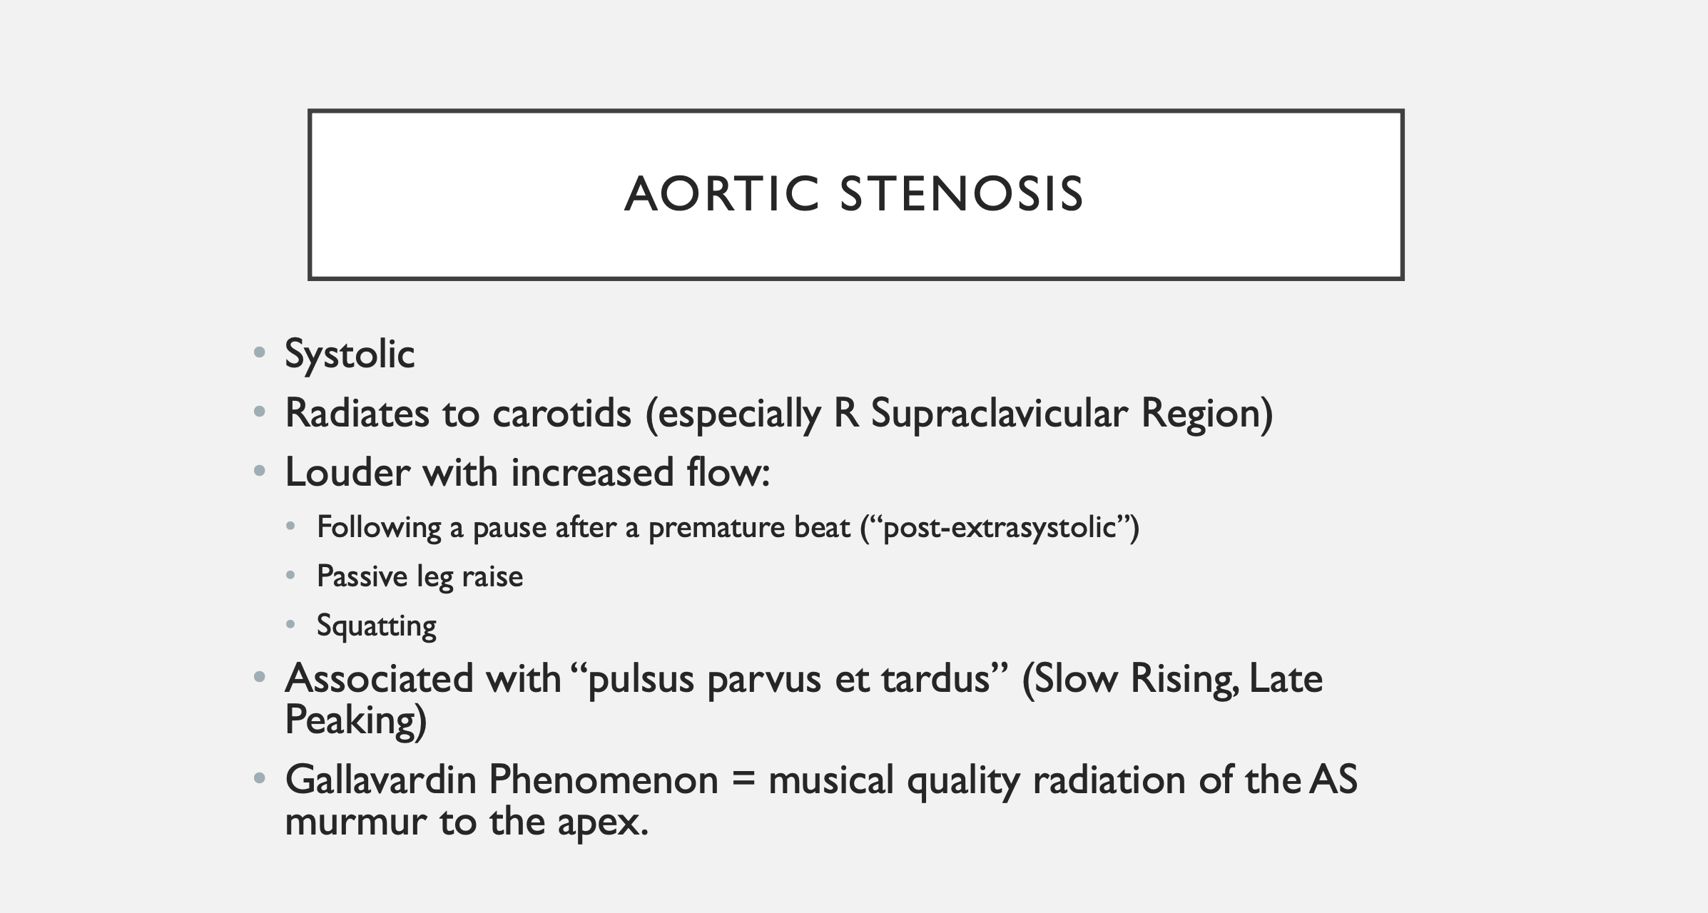

Slide 37
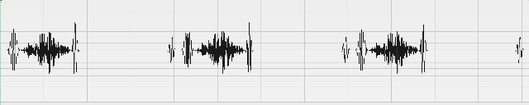
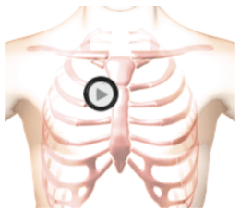
Aortic Stenosis
S1
S2
S4

Slide 38
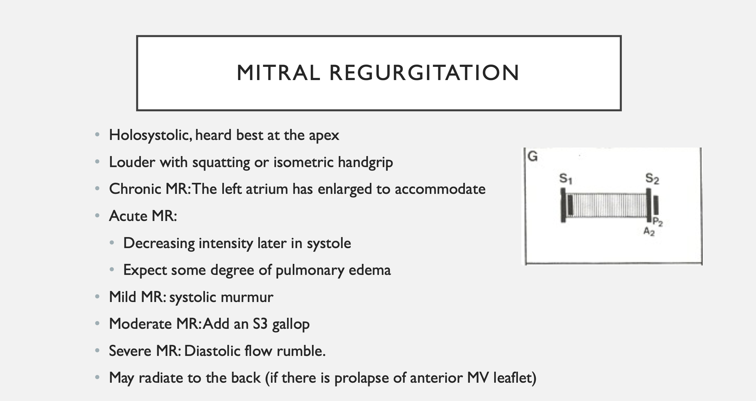

Slide 39
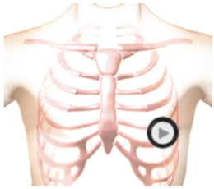
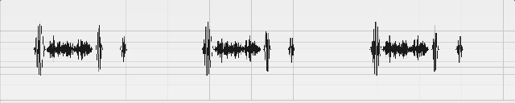
Mitral Regurgitation
S1
S2
S3

Slide 40
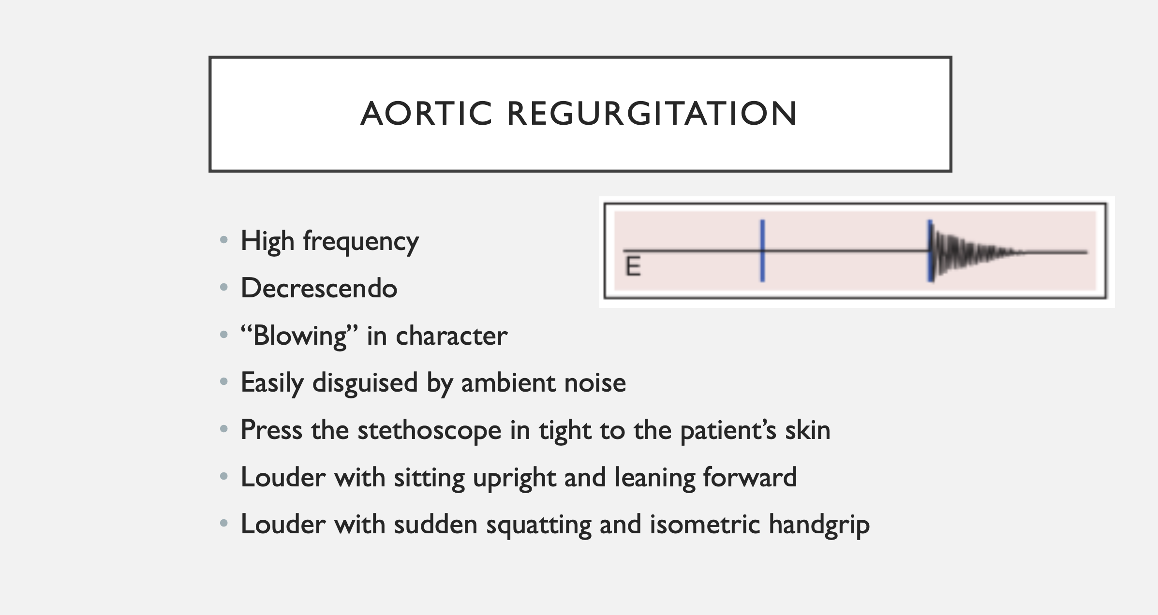
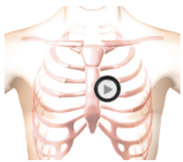

Slide 41
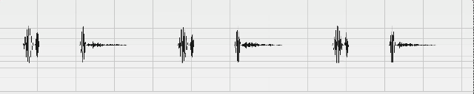
Aortic regurgitation
S1
S2
EC

Slide 42
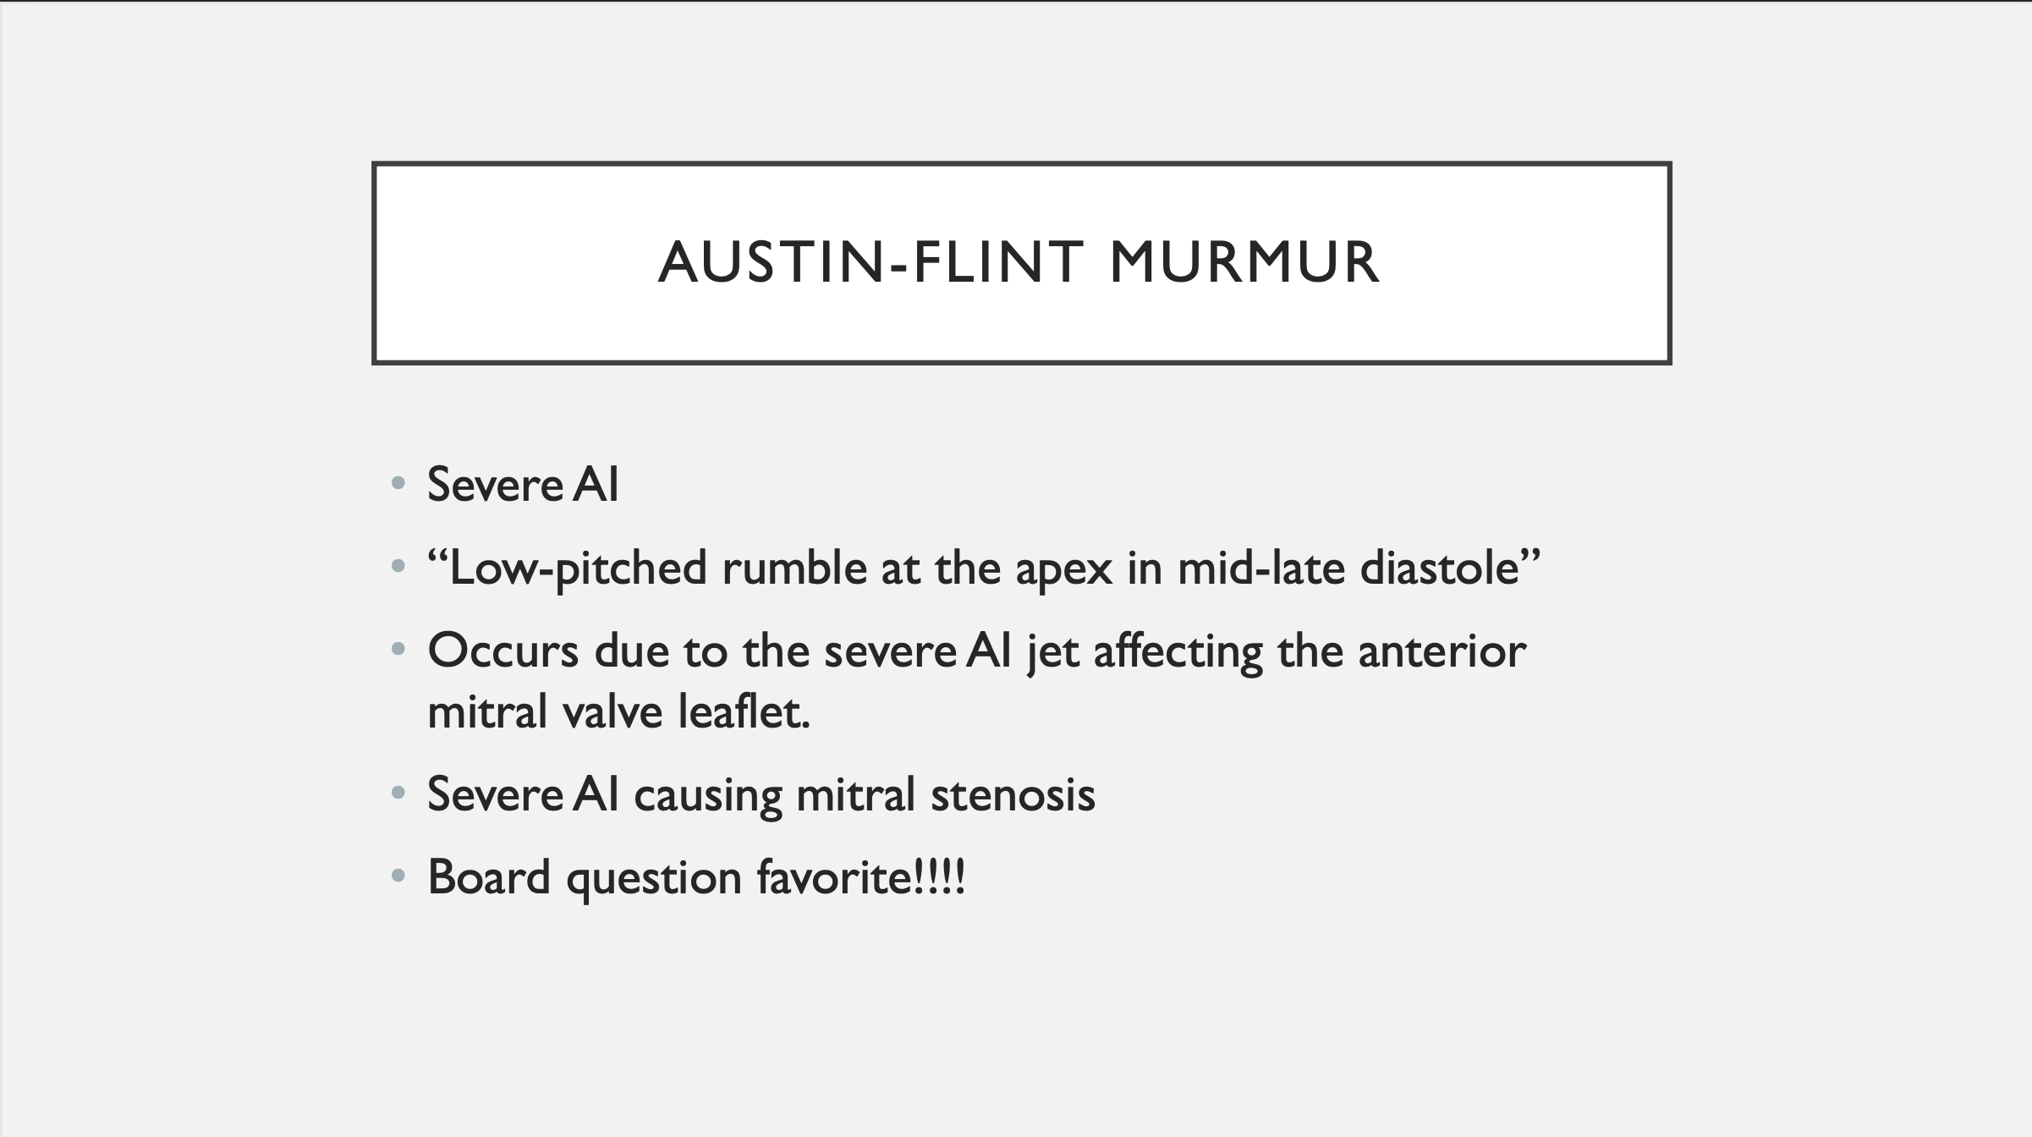

Slide 43
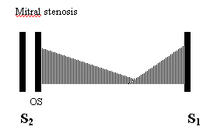
Mitral stenosis
Best heard when patient in left lateral decubitus position
Can sometimes hear an opening snap after S2 due to tensing of the MV leaflets after opening
More severe the mitral stenosis the earlier the opening snap

Slide 44
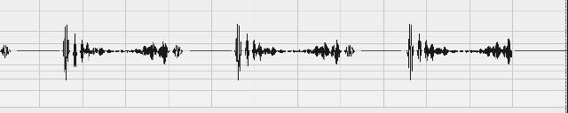
Mitral Stenosis
S1
S2

Slide 45
TrIcuspid Regurgitation
Louder with inspiration
Large V wave in JVP exam
Can sometimes feel pulsatile liver
Like mitral regurgitation if severe can get an RV S3 and diastolic rumble

Slide 46
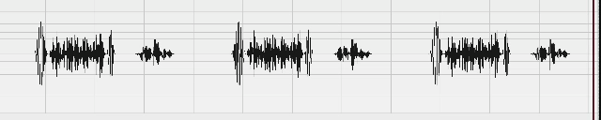
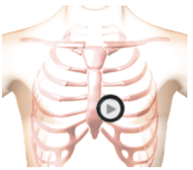
Tricuspid Regurgitation
S1
S2

Slide 47
VenTricular Septal Defect
Can be congenital or acquired (post- MI)
Leads to shunting from LV to RV (initially)– can reverse with development of eisenmengers syndrome/pulmonary HTN
Blood initially goes from LV to RV then through pulmonary artery/lungs back to LVC and lead to LV dilatation/CHF over time
Can get a diastolic mitral flow murmur from this increased flow
Loud harsh murmur across precordium (small VSDs have louder murmurs, large VSDs can have softer murmurs)

Slide 48
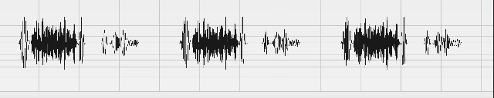
VSD
S1
S2

Slide 49
Atrial Septal Defect
Shunting from Left atrium to Right atrium (various sub-types)
Causes increased flow on right side of heart across tricuspid valve and pulmonary artery (flow murmur in diastole across tricuspid valve and in systole across pulmonic valve)
Fixed splitting of S2
Can get RV volume and eventually pressure overload – RV heave

Slide 50
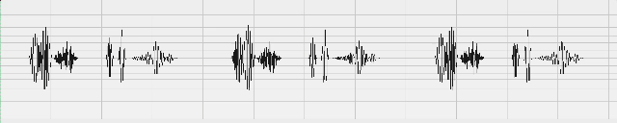
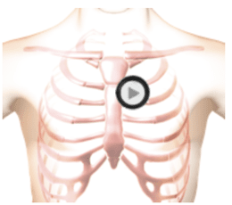
ASD
S1
S2

