Slide 1

Liver Disease and Portal Hypertension
MS3
Internal Medicine Clerkship
Updated, 2026
Natasha von Roenn, MD

Slide 2
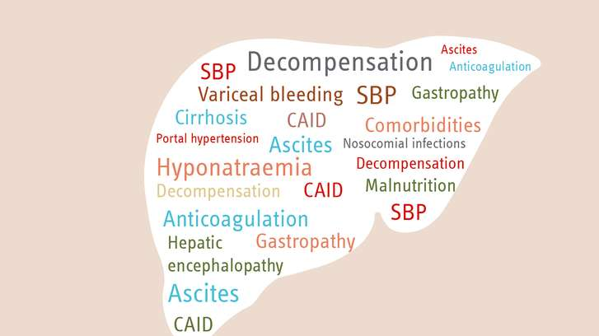

Overview
Laboratory Assessment of Liver Disease
  Patterns of Liver Injury
Diagnosis of Cirrhosis
Inpatient Complications
  Fluid Overload / Ascites / Hyponatremia
  Hepatic Encephalopathy
  Portal Hypertension related GI bleeding
  Spontaneous Bacterial Peritonitis

Slide 3
Laboratory Assessment of the Liver
Provide a noninvasive method to screen for liver disease
Markers of Hepatocellular Damage
Serum Transaminases
ALT (Alanine aminotransferase)
AST (Asparate aminotransferase)
Markers of Cholestasis
Alkaline Phosphatase
Gamma Glutamyl Transpeptidase
Bilirubin
Tests of Liver Function
Prothrombin time
Albumin
Cholesterol
Bilirubin

Slide 4
Liver Injury Tests can be classified by Type, Duration or Magnitude
Type
  Hepatocellular Injury (ALT/AST elevation)
  Cholestatic Injury (Alk Phos / T.bili elevation)
Acute or chronic depending on their duration
  Acute : abrupt onset, < 6 months but usually < 1 month
  Chronic > 6 months (arbitrary)
Magnitude
  Mild AST/ALT elevations <200 IU
  Moderate AST/ALT elevations 200-600 U
  Severe AST/ALT elevations > 600

Slide 5
Liver Function Tests
Reflect the liver’s synthetic or excretory capacity
  Albumin
  Prothrombin time / INR
  Serum Bilirubin

Slide 6
Patterns of Liver Injury
Acute Hepatitis
  Temporary or new onset inflammation of the liver tissue
  May or may not be symptomatic
  Can resolve or become chronic
Acute Liver Failure (Fulminant Liver Failure)
  Sudden loss of hepatic function in the absence of pre-existing liver disease
  Can lead to multi-organ failure and death or recovery, depending on the cause
  Results in severe liver dysfunction and may require liver transplantation
Chronic Hepatitis → Cirrhosis
  Inflammation of the liver tissue that lasts at least 6 months
  Often without symptoms
  Can progress to cirrhosis
Notes:
Acute liver failure (encephalopathy within 6 months after diagnosis)

Slide 7
Assessing the Severity of Liver Disease
Laboratory Testing
Tests of Liver Function (PT/INR, T.bilirubin, Albumin)
Liver dysfunction present – either ALI/ALF or Cirrhosis
MELD Score / Child’s Pugh
Prognostic score in Cirrhosis to determine mortality
Non-invasive measures of fibrosis
Determines if advanced fibrosis / cirrhosis is present in the setting of chronic hepatitis
Liver Biopsy
Determine etiology of liver disease
Determine degree of fibrosis
Measure portal pressures
Outpatient Management

Slide 8
MELD Score
Estimates the probability of dying over time in patients with chronic liver disease
Accessible
Validated measure of liver disease severity
Objective
Reproducible

Slide 9
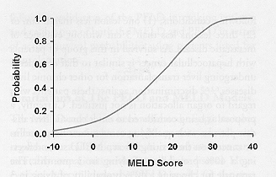
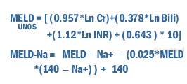
MELD Score
z
Malinchoc M, et al. Hepatology 2000;31:864-71

Slide 10
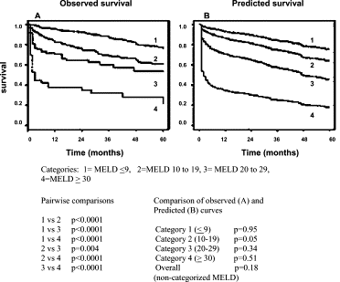
MELD Score Predicts Mortality
z

Slide 11
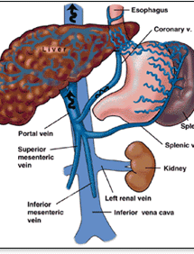
Portal Hypertension
Increase in the porto-systemic pressure gradient
Pre-hepatic
    Portal / Splenic Vein thrombosis
Post-hepatic
    Budd-Chiari Syndrome
Intra-hepatic non-cirrhotic
    Schistosomiasis
    Sinusoidal Obstruction Syndrome
Cirrhosis

Slide 12
Portal Hypertension
z
Wedged hepatic venous pressure – Free hepatic venous pressure = Hepatic Venous pressure gradient (HVPG)
Normal HVPG = 3-5 mmHG
Portal Hypertension > 5mmHG
Clinically significant PH >10mmHG
Reduction in HVPG to < 12mmHG or by 20% from baseline leads to a significant reduction in complications and death

Slide 13

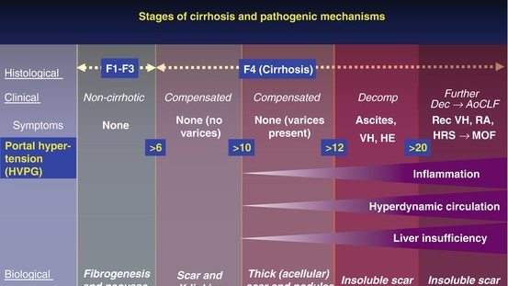

Slide 14
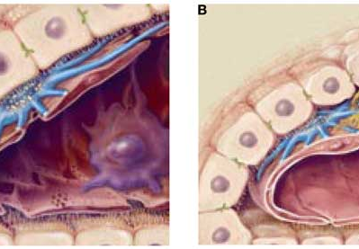
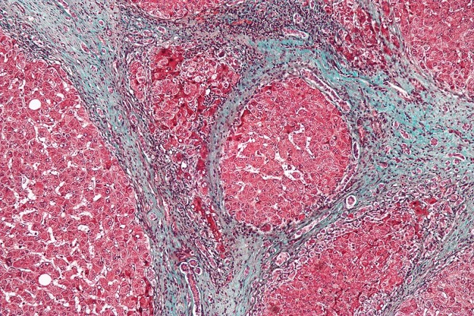
Pathophysiology
Increased vascular resistance
  Distortion of vascular architecture
  Increase in vascular tone
    Contraction of myofibroblasts around hepatic sinusoids
    Increased production of vasoconstrictors (endothelin-1)
    Reduced release of vasodilators (NO)

Slide 15
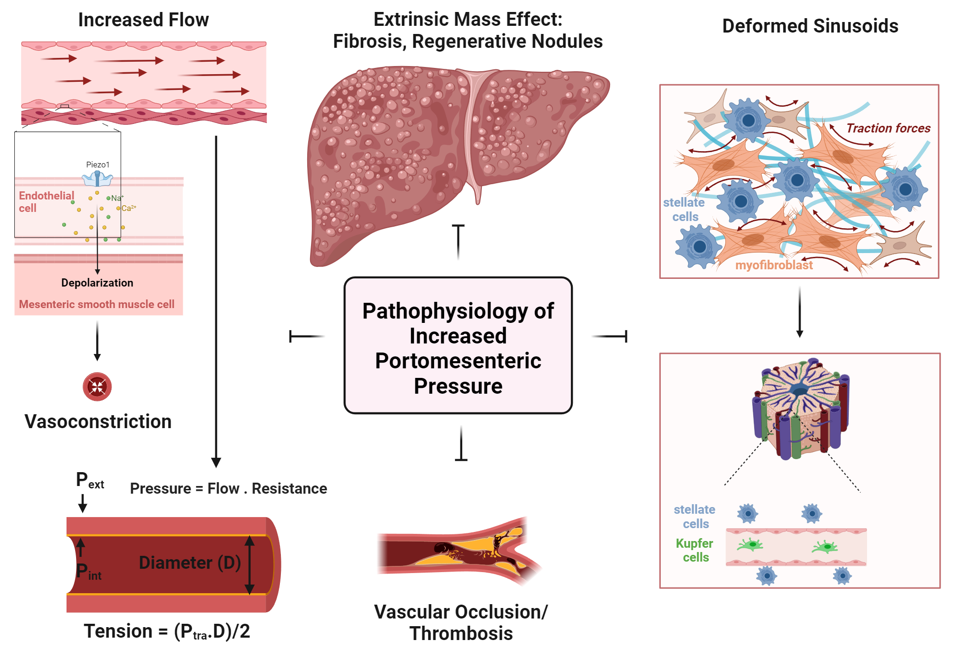

Slide 16
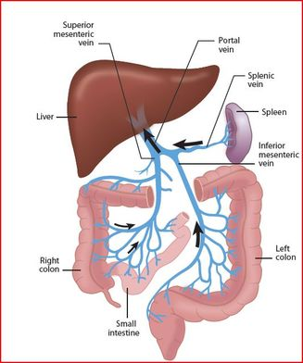
Pathophysiology
Increased Portal inflow
  Splanchnic Vasodilation
    Increased NO production
  VEG-F dependent angiogenesis
Δ Pressure = Resistance x Flow

Slide 17
Complications of Cirrhosis
Related to portal hypertension and hepatic dysfunction:
Ascites
Variceal bleeding
Hepatic encephalopathy
Hepatorenal syndrome
Unrelated to portal HTN:
Hepatocellular carcinoma

Slide 18
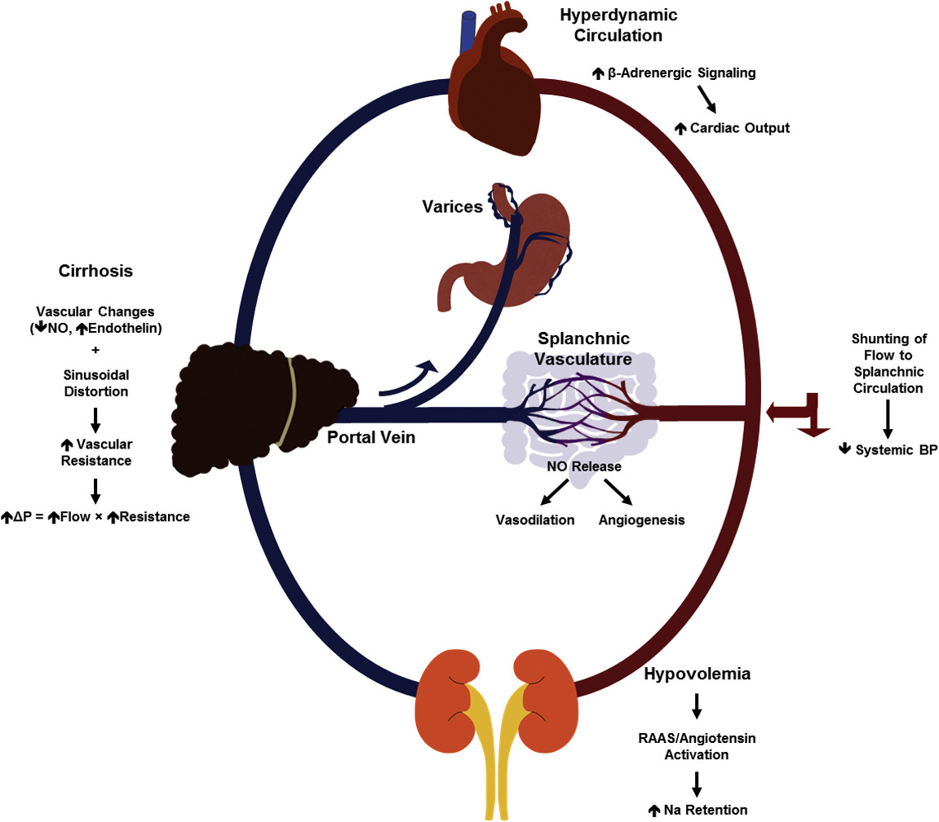
Systemic Effects of Portal Hypertension

Slide 19
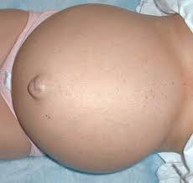
Ascites
Bulging Flanks
Bulging Flanks
Occurs when the weight of ascites is sufficient to push the flanks outwards
Difficult to distinguish from obesity
Sensitivity 72-93%
Specificity 44-70%

Slide 20
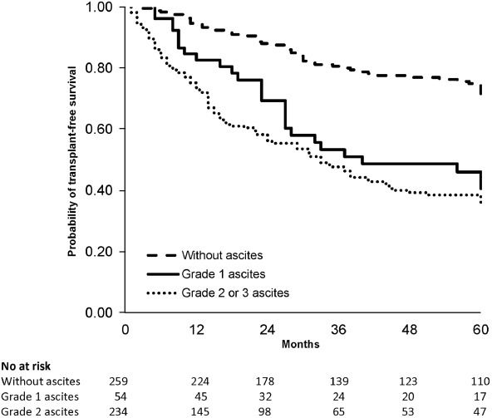
Impact of Ascites on Mortality
Tonon, et al. Clin Gastro and Hepatology, 2020
z

Slide 21
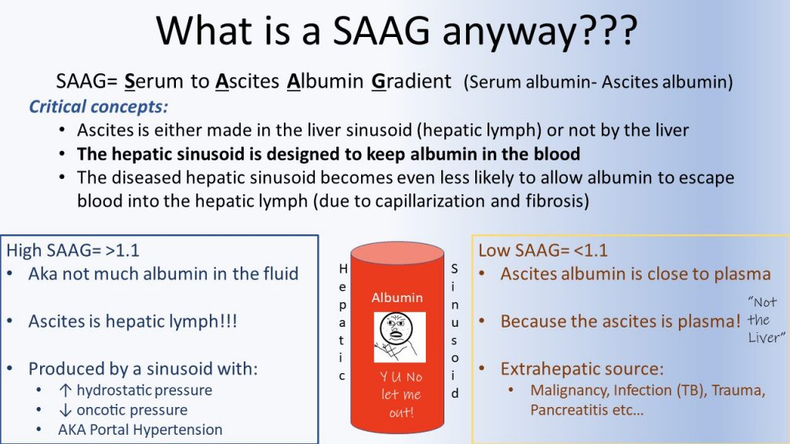

Slide 22
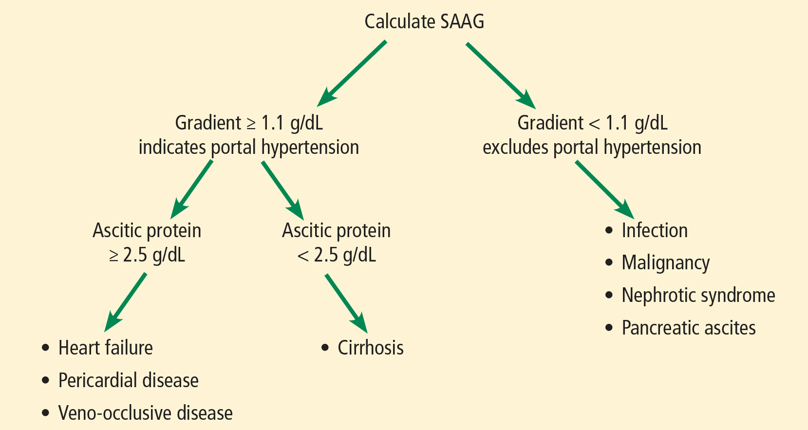
Ascites: SAAG
Total protein >2.5 g/dL suggests cardiac ascites

Slide 23
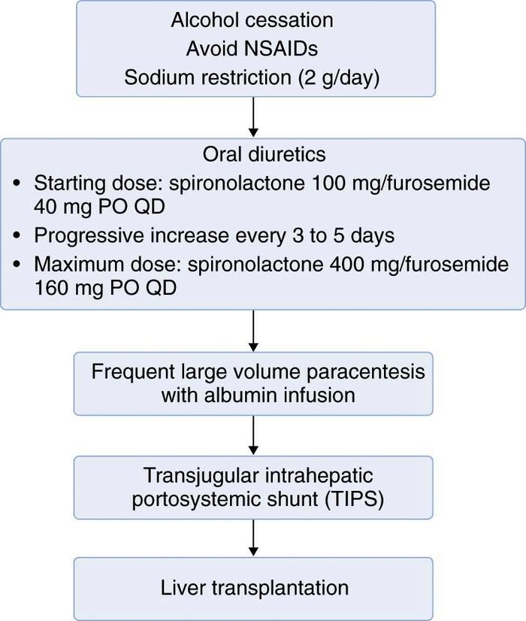
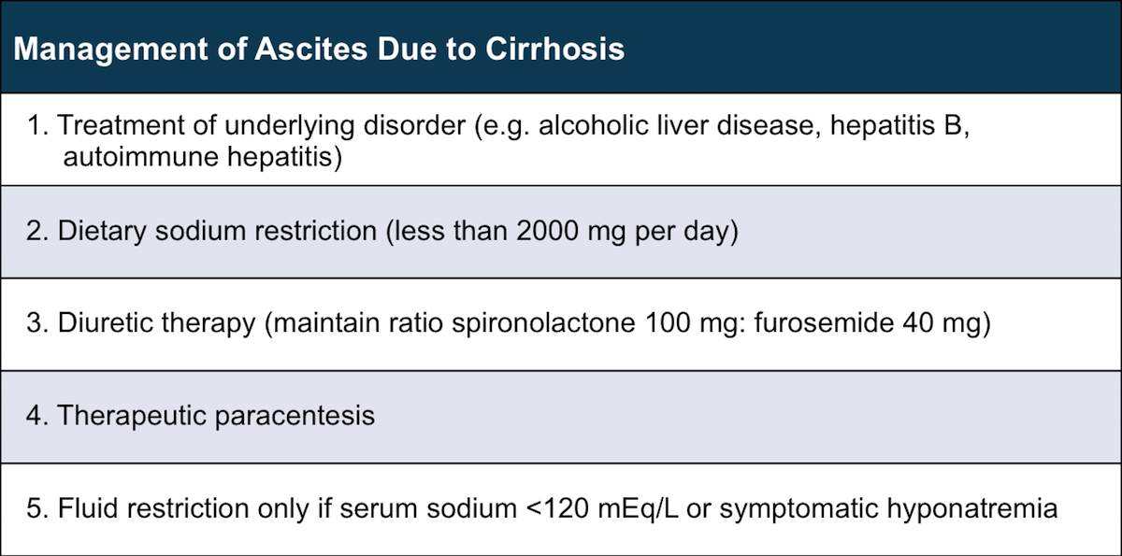

Slide 24
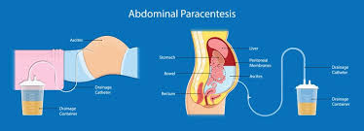
Paracentesis should be performed:
Every patient with new-onset ascites
Every patient with ascites admitted to hospital
Therapeutic measure in refractory ascites
SBP?

Slide 25
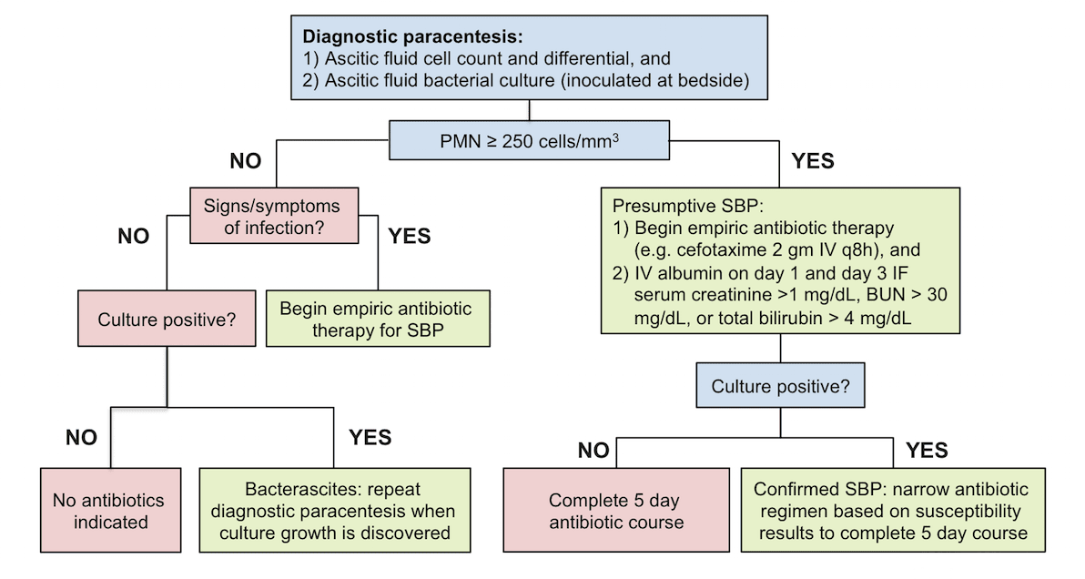
Peritonitis

Slide 26
Treatment for SBP
Gut bacteria (E.coli and Klebsiella)​
3rd Generation cephalopsporin
Higher rate of resolution of infection (85 vs 56%) compared with Ampicillin and Gentamicin​
Appropriate even in patients who have been receiving prophylaxis with a fluoroquinolone​
5 day course is effective as 10 day course (93 vs 91%)​
Bacteremia may extend treatment course depending on organism

Slide 27
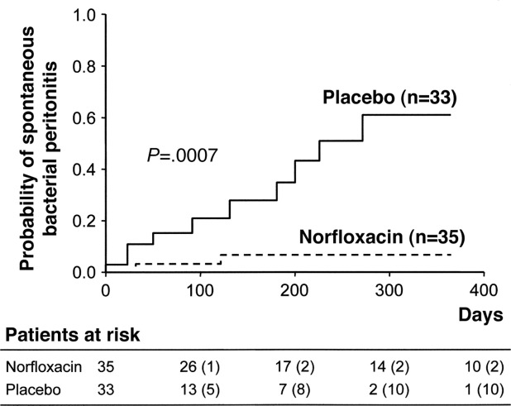
Patients who survived one SBP should receive long-term antibiotic prophylaxis with daily Norfloxacin (or trimethoprim/sulfamethoxazole)
It reduces the incidence of recurrent SBP, delays the development of hepatorenal syndrome, and improves survival
Fernandez, et al. Gastroenterology 2007

Slide 28
Therapeutic Paracentesis
Should be done under sterile conditions​
15 cm lateral to the umbilicus​
Complications occur in 1% of patients​
Rarely serious or life threatening​
No data to support the use of FFP before paracentesis​
Always send fluid for analysis, cell count and culture​
Data supports that drains left in the abdominal cavity have a higher risk of SBP​

Slide 29
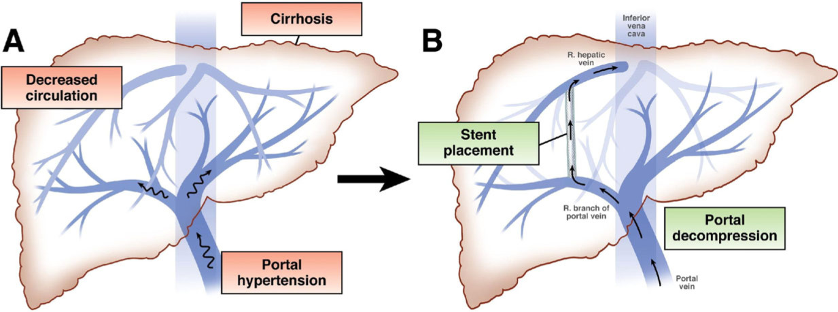
TIPS
z

Slide 30
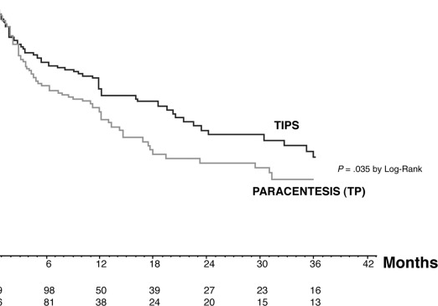
Indications for TIPS
Acute variceal hemorrhage not responsive to medical therapy
Recurrent variceal hemorrhage not responsive to medical therapy
Refractory ascites due to Cirrhosis
Refractory Hepatic Hydrothorax
Budd-Chiari Syndrome (Hepatic venous occlusion)
Salerno, et al. Gastroenterology, 2007

Slide 31
Summary Slide
If a patient has ascites, it should be tapped.
Refractory ascites should trigger an immediate referral for liver transplantation evaluation and a consideration for TIPS placement
Should have a low threshold to exclude SBP.
Treatment of SBP includes both antibiotics and albumin.
Anyone who survive an episode of SBP should be on long-term prophylactic dose antibiotics

Slide 32
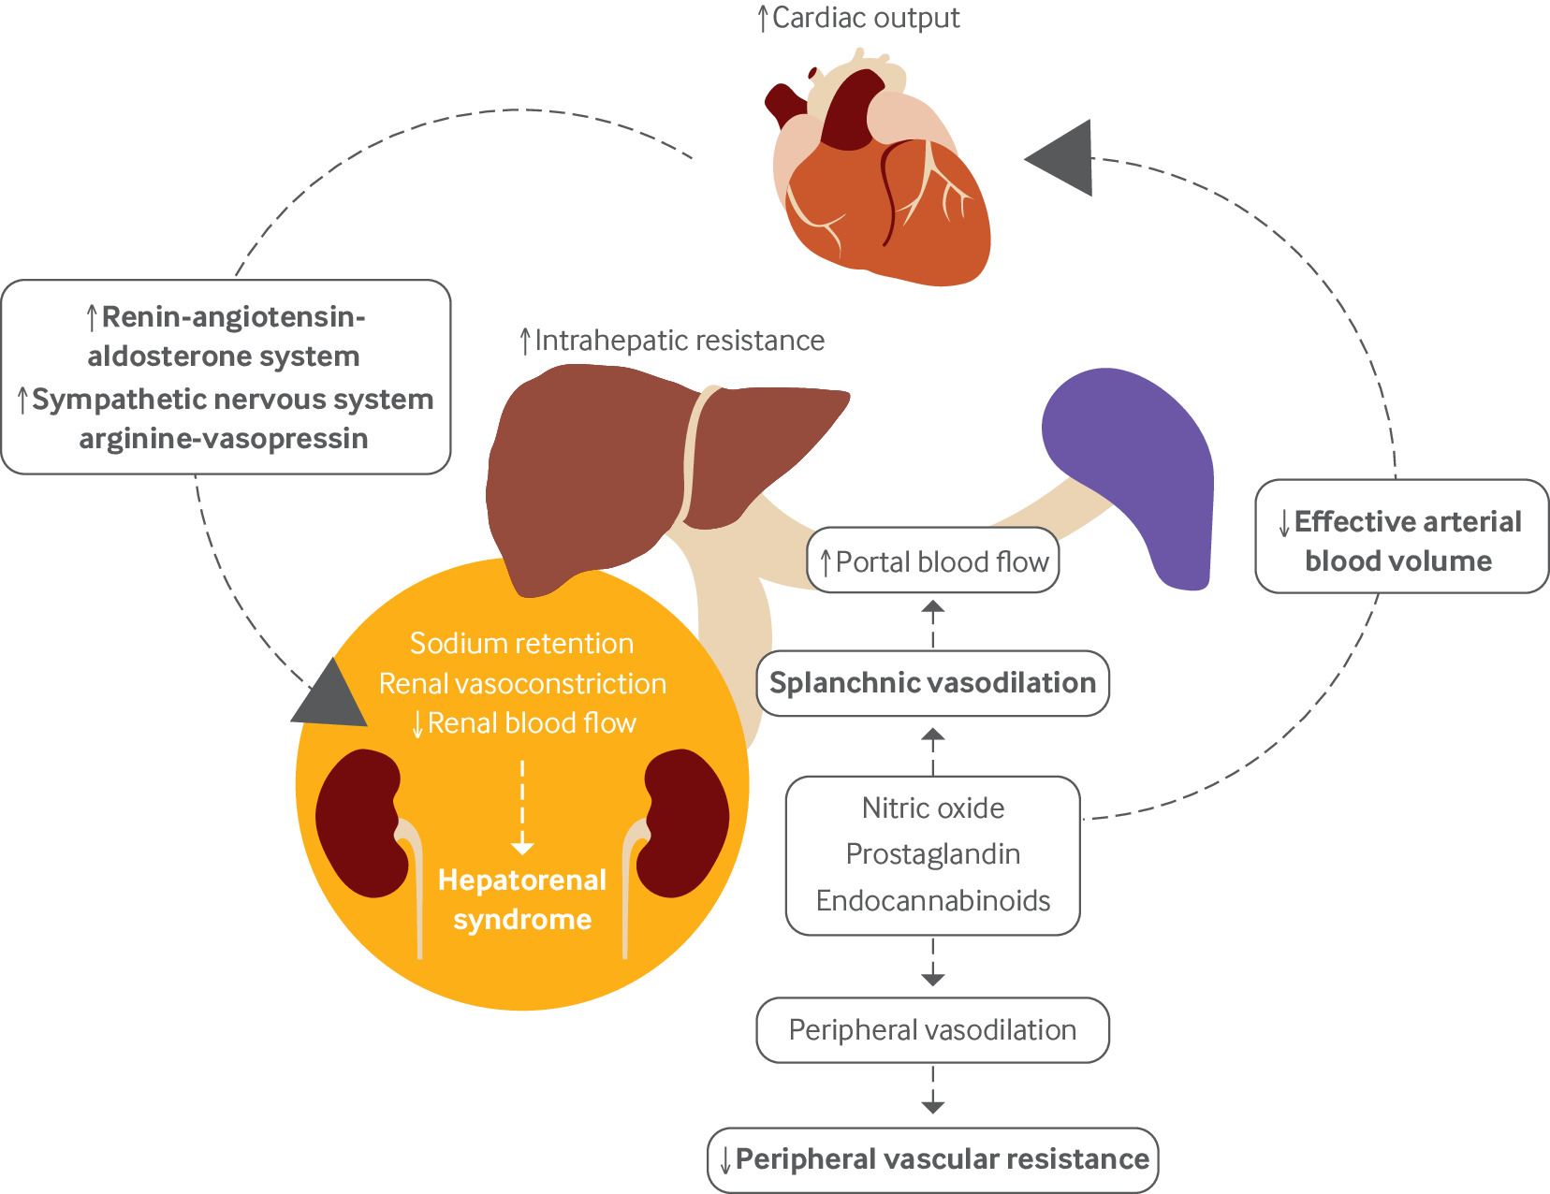
Hepatorenal Syndrome
z

Slide 33
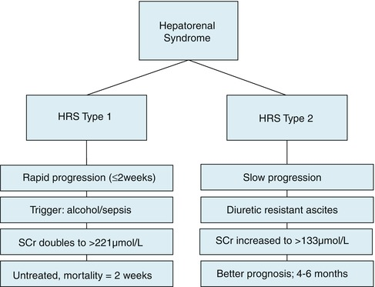
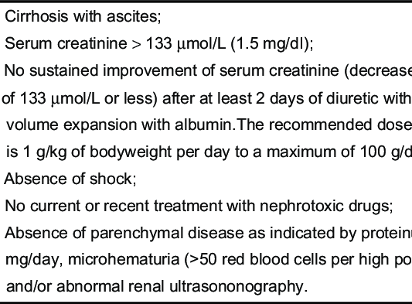
Hepatorenal Syndrome
z

Slide 34
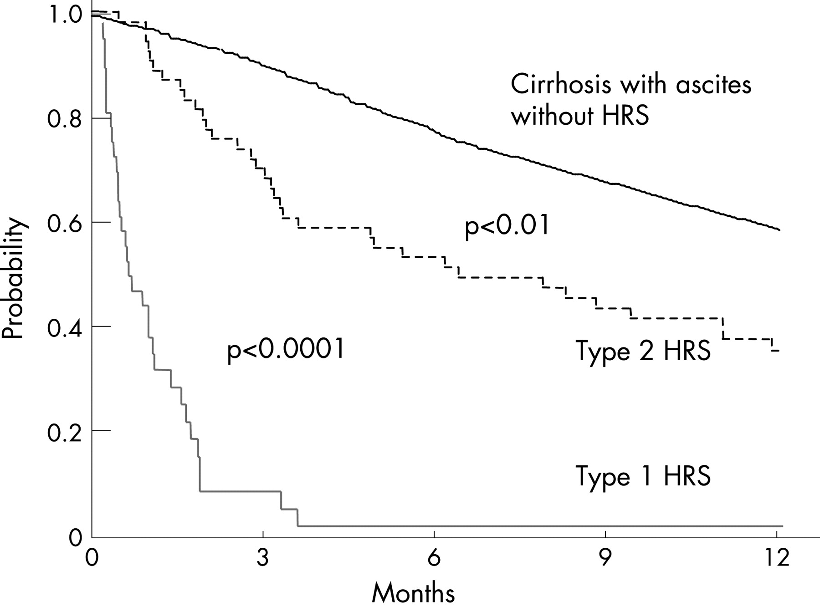
HRS Significantly Impacts Survival
z

Slide 35
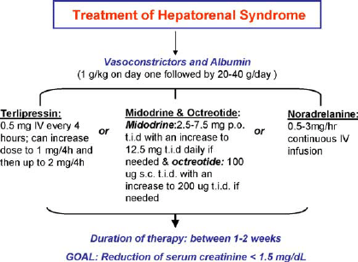
Treatment Algorithm for Hepatorenal Syndrome
z

Slide 36
Hepatic Encephalopathy
z

Slide 37
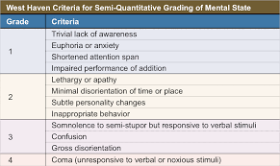
Staging of Hepatic Encephalopathy
z

Slide 38
Diagnostic Work-up Required in Cirrhotic Patients with Mental Status Changes
ETOH
Drugs (Narcotics, Benzos)
Electrolyte Imbalance
Psychiatric Disorders
Medication Non-compliance (lactulose)
Infection
Intracranial Hemorrhage
Hypovolemia (Recent diuretic increase)
Constipation
Recent TIPS

Slide 39
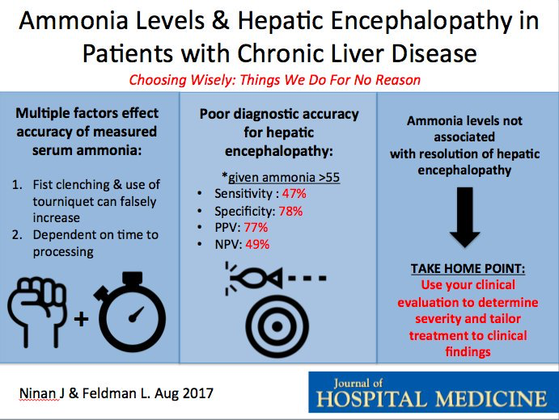
Diagnostic Value of Serum Ammonia
z

Slide 40
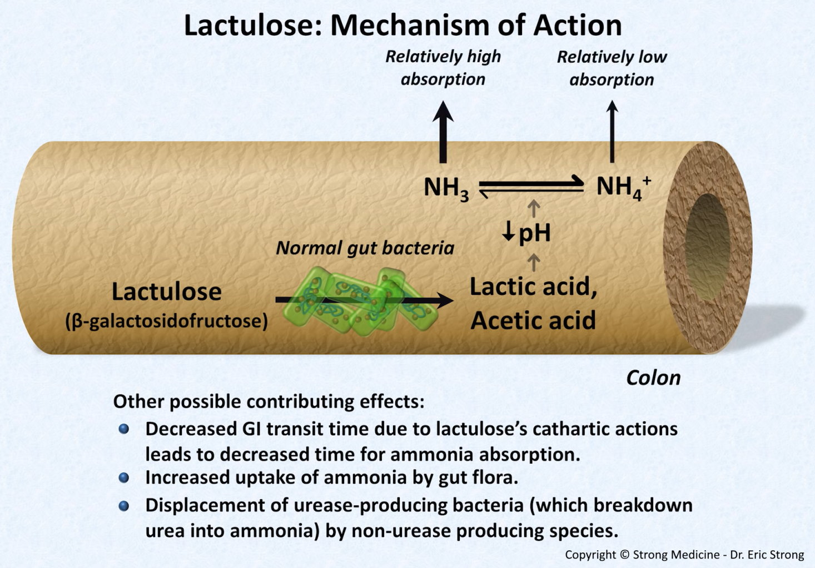
Treatment of Hepatic Encephalopathy
Nonabsorbable Disaccharides-Lactulose:
  Acts like a probiotic by enhancing growth of certain bacterial strains
  Low cost making it the preferred agent
• Rifaximin
  Nonabsorbable antibiotic
  Equivalent or slightly superior to Lactulose or Neomycine

Slide 41
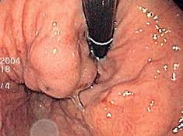
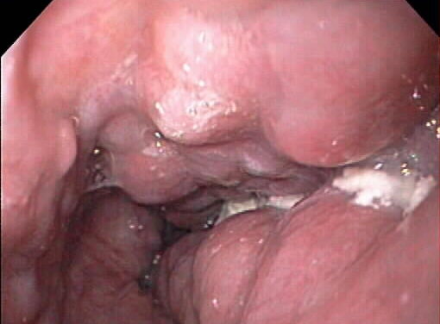
Gastroesophageal Varices
z

Slide 42
Gastroesophageal Varices
Decompress portal system and return blood to systemic circulation
Present in 50% of cirrhotic patients
30% of Compensated
60% of Decompensated
5-15% rate of bleeding per year
15-20% mortality with each bleeding event
Re-bleeding rate is 60% within 1-2 years

Slide 43
Varices: Risk Factors for Bleeding
Hepatic vein-portal vein gradient (HVPG) > 12 mm Hg (normal <5)
Indirect indicators
Large size (grade II-IV)
Endoscopic features: red whale sign, nipple sign
Decompensated cirrhosis, high MELD score
Hepatocellular Carcinoma
Previous Esophageal variceal bleeding
Notes:
Wall tension is the main factor that determines rupture

Slide 44
Treatment of Esophageal Varices
Primary Prophylaxis
Nonselective beta blocker (Carvedilol, nadolol, propranolol)
Endoscopic band ligation
Treatment of variceal bleeding
Octreotide
Endoscopic band ligation/Sclerotherapy
TIPS
Secondary prophylaxis
Endoscopic band ligation
TIPS
Notes:
Reversible increase in intrahepatic vascular tone (20-30%) of increased intrahepatic resistance. Related to reduced NO
B blockers reduce portal pressure by decreasing cardiac output and by causing splanchnic vasoconstriction through B blockade and unopposed alpha adrenergic activity.
Get reduced collateral blood flow
Pharmacologic therapy clearly beneficial in Childs A and B patients
Less so in Child’s C patients
Reduce risk of bleeding and increase survival
Up to 20-30% do not tolerate propranolol.
Meta analysis of 11 studies
Ismo-increased mortality in people over 50
Small varices, follow-up EGD 1-2 years

Slide 45
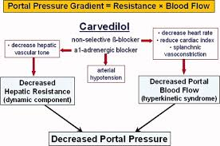
Non-selective Beta-blocker Therapy
B blockers reduce portal pressure by decreasing cardiac output and by causing splanchnic vasoconstriction through B blockade and unopposed alpha-adrenergic activity.
  Get reduced collateral blood flow
Pharmacologic therapy clearly beneficial in Childs A and B patients
  Less so in Child’s C patients
Reduce risk of bleeding and increase survival
Up to 20-30% do not tolerate propranolol.
Small varices, follow-up EGD 1-2 years

Slide 46
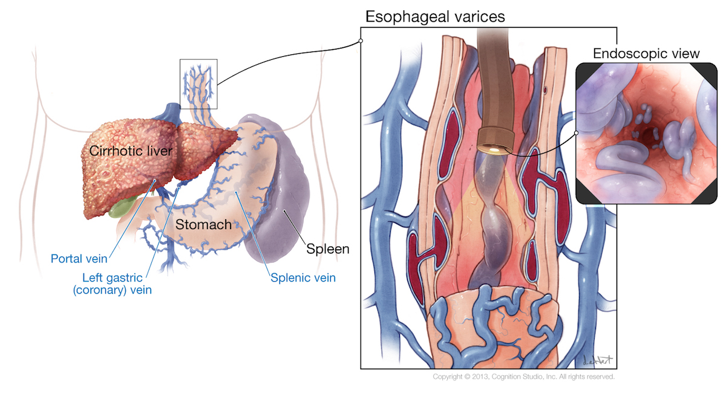

Slide 47
Grading Esophageal Varices
Grade 1
Collapse with air insufflation
Grade
2
Do not collapse, separated
Grade
3
Columns touching each other
Grade
4
Obstruction of the lumen

Slide 48
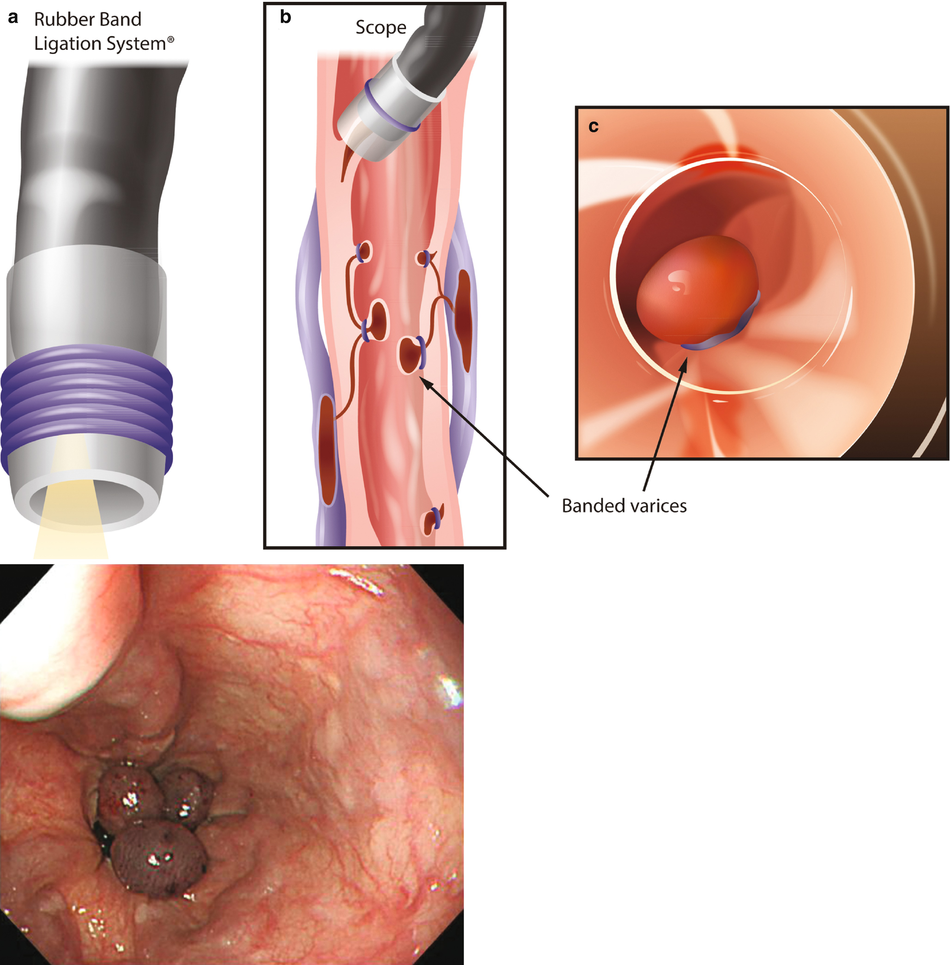

Slide 49

Liver Transplantation: Timing
MELD score > 14
Complications of cirrhosis
  Ascites/SBP
  Variceal bleeding
  Encephalopathy
  HRS
Development of hepatobiliary malignancy
MELD exception cases:
  Hepatopulmonary syndrome, hepatic hydrothorax, inherited metabolic syndromes

