Slide 1
This power point is made available as an educational
resource or study aid for your use only.
This presentation may not be duplicated for others and should not be redistributed or posted anywhere on the internet or on any personal websites.
Your use of this resource is with the acknowledgment
and acceptance of those restrictions.

Slide 2
Basal Ganglia & Cerebellum – a quick overview MHD-Neuroanatomy – Neuroscience Block
Gregory Gruener, MD, MBA, MHPE
Vice Dean for Education, SSOM
Professor, Department of Neurology
LUHS a member of Trinity Health

Slide 3
Outcomes you want to accomplish
Basal ganglia review
Define and identify the major divisions of the basal ganglia
List the major basal ganglia functional loops and roles
List the components of the basal ganglia functional “circuitry” and associated neurotransmitters
Describe the direct and indirect motor pathways and relevance/role of the substantia nigra compacta

Slide 4
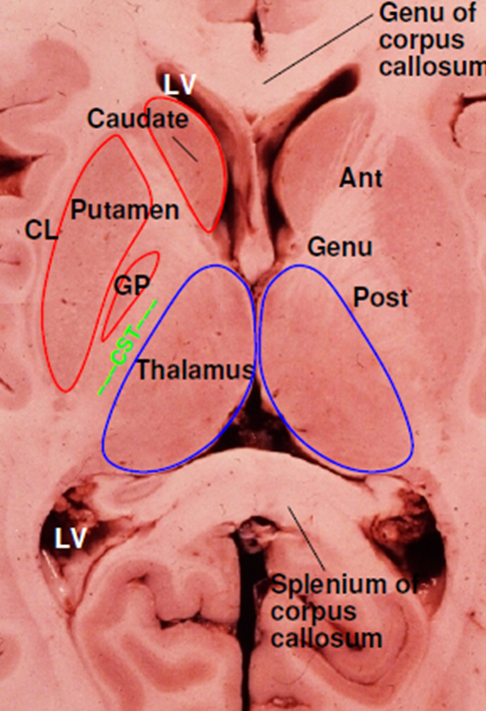
Basal Ganglia Terminology
Striatum
Caudate nucleus
Nucleus accumbens
Putamen
Globus pallidus (pallidum)
internal segment (GPi)
external segment (GPe)
Subthalamic nucleus
Substantia nigra
compact part (SNc)
reticular part (SNr)

Slide 5
Basal ganglia “circuitry”
BG have no major outputs to LMNs
Influence LMNs via the cerebral cortex
Input to striatum from cortex is excitatory
Glutamate is the neurotransmitter
Principal output from BG is via GPi + SNr
Output to thalamus, GABA is the neurotransmitter
Thalamocortical projections are excitatory
Concerned with motor “intention”
Balance of excitatory & inhibitory inputs to striatum, determine whether thalamus is suppressed

Slide 6
BG circuits are parallel loops
Motor loop
Concerned with learned movements
Cognitive loop
Concerned with motor “intention”
Limbic loop
Emotional aspects of movements
Oculomotor loop
Concerned with voluntary saccades (fast eye-movements)

Slide 7
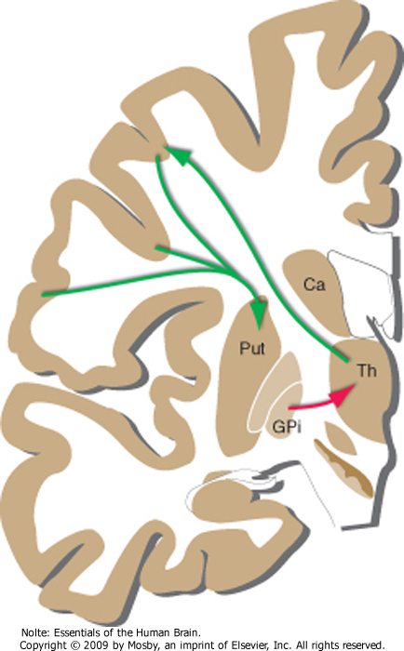
Basal ganglia “circuitry”
Striatum
GPi + SNr
Thalamus
Cortex
Nolte. Essentials of the human brain. Mosby, 2010
Muti E, Gruener G, Dockery P. Fitzgerald’s Clinical Neuroanatomy and Neuroscience, 7th ed., W. B. Saunders Elsevier 2016

Slide 8
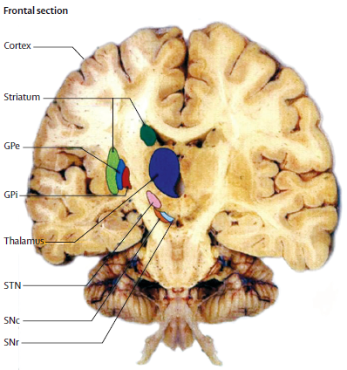
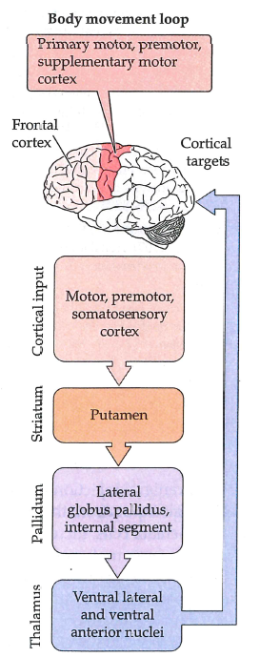
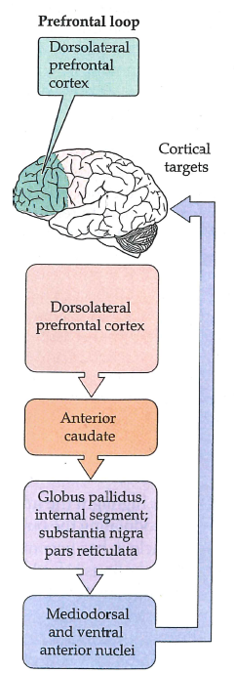
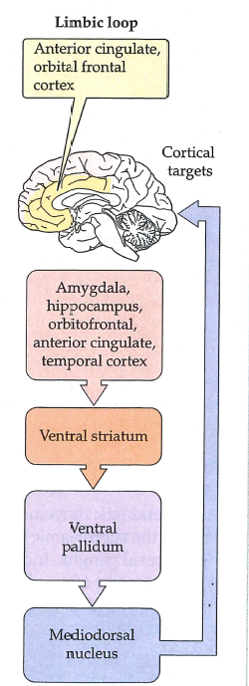
Motor Loop
Cognitive Loop
Limbic Loop
Purves D, et al. Neuroscience, 5th Ed., Sinauer Associates, 2012
Obeso JA, Rodriguez-Oroz MC, tamelou M, et al. The expanding universe of disorders of the basal ganglia. Lancet 2014; 384: 523–31

Slide 9
BG - Direct Pathway
Purves D, et al. Neuroscience, 5th Ed., Sinauer Associates, 2012

Slide 10
BG – Direct & Indirect Pathway
Purves D, et al. Neuroscience, 5th Ed., Sinauer Associates, 2012

Slide 11
Parkinson Disease
Purves D, et al. Neuroscience, 5th Ed., Sinauer Associates, 2012

Slide 12
Outcomes you want to accomplish
Cerebellum review
Identify cerebellar peduncles and the names/projections of the deep cerebellar nuclei
List afferent and efferent components of the cerebellar peduncles
Define the origins of the mossy and climbing fibers
Define the functional components of the cerebellum (e.g. How would an injury to the cerebellar hemisphere differ from one to the flocculonodular lobe?)
Describe the “wiring diagram” of the cerebellum and the different terminations of the mossy and climbing fibers

Slide 13
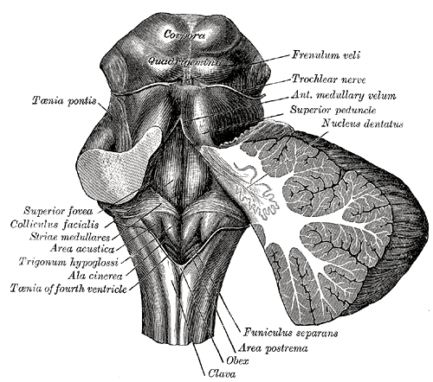
Cerebellum overview – gross anatomy
http://www.bartleby.com/107/illus702.html
Nolte J. The Human Brain, 6th ed., 2009
Muti E, Gruener G, Dockery P. Fitzgerald’s Clinical Neuroanatomy and Neuroscience, 7th ed., W. B. Saunders Elsevier 2016

Slide 14
Cerebellum overview
Inputs
Motor Systems
Vestibular nuclei
Thalamus
Red nucleus
(reticular formation)
No direct connection to the spinal cord
Cerebellar Cortex
Nuclei
Outputs
Coordination
Correction of current movements to match
those intended
Information Processing
Mossy & Climbing fibers
Enter the Cerebellar cortex
Purkinje cells
Deep nuclei
“Afferent” information
Vestibular
Proprioceptive & skin receptor information
Sensorimotor cortex
Auditory system
Visual system

Slide 15
Inferior Cerebellar Peduncle
Afferents
Inferior olivary nucleus
Vestibular nuclei
Spinal cord
Trigeminal nuclei
Reticular formation
Cerebellar efferents
Vestibular nuclei

Slide 16
Middle Cerebellar Peduncle
Afferents:
Cerebral cortex

Slide 17
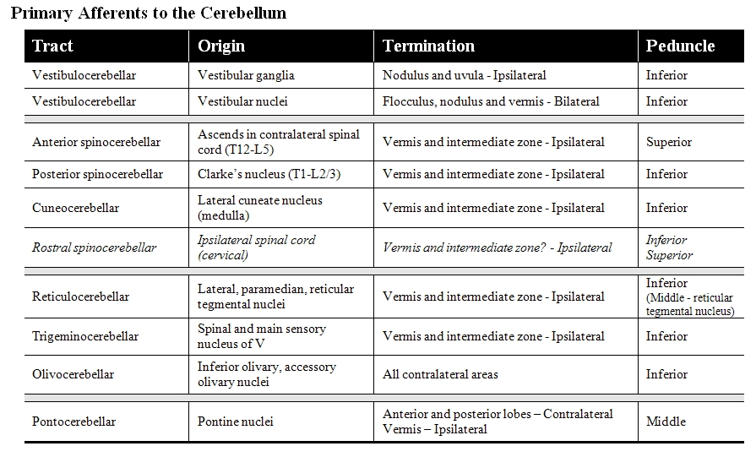
“For the detailed minded among you”

Slide 18
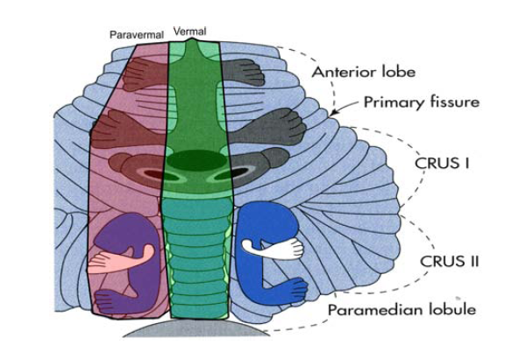
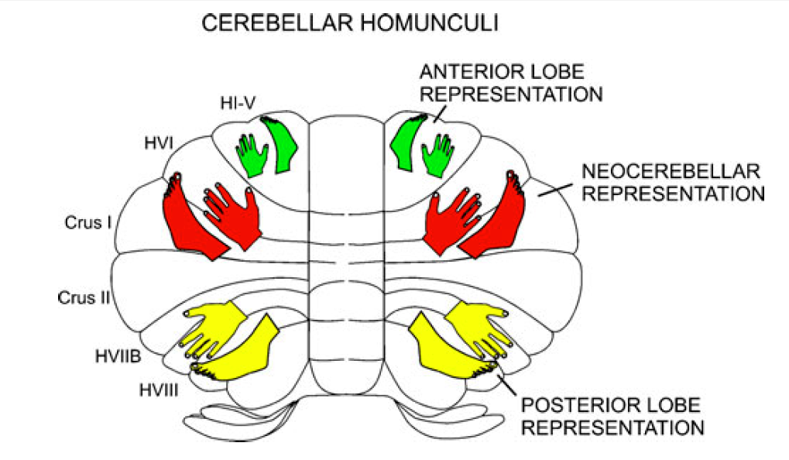
Cerebellum overview – somatotopic anatomy
One to remember
Castro, Merchut, Neafsey, Wurster; Neuroscience: An Outline Approach, 2002
Grimaldi G, Manto M. Topography of Cerebellar Deficits in Humans. Cerebellum 11:336–351, 2012

Slide 19
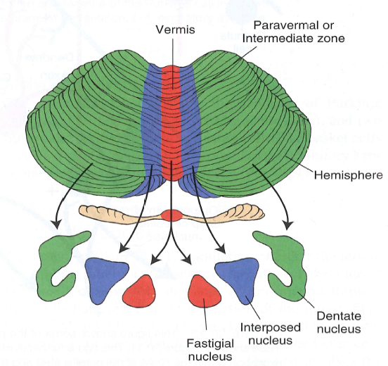
Cerebellum overview – Peduncles and deep nuclei
Nolte. Essentials of the human brain. Mosby, 2010
Siegel A, Sparu HN. Essential Neuroscience, 3rd Ed., Wolters Kluwer, 2015

Slide 20
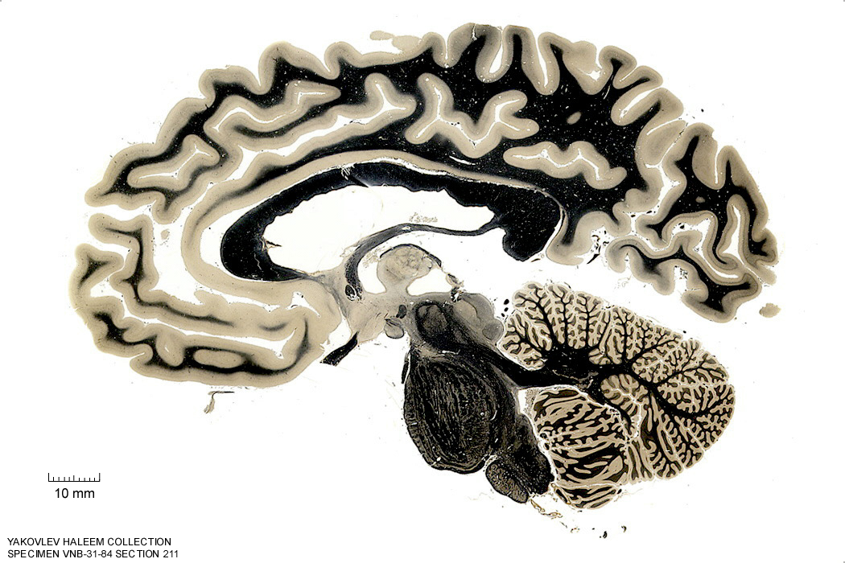
Superior Cerebellar Peduncle
Afferents:
Anterior Spinocerebellar tract
Cerebellar efferents
Originate from the deep cerebellar
nuclei

Slide 21
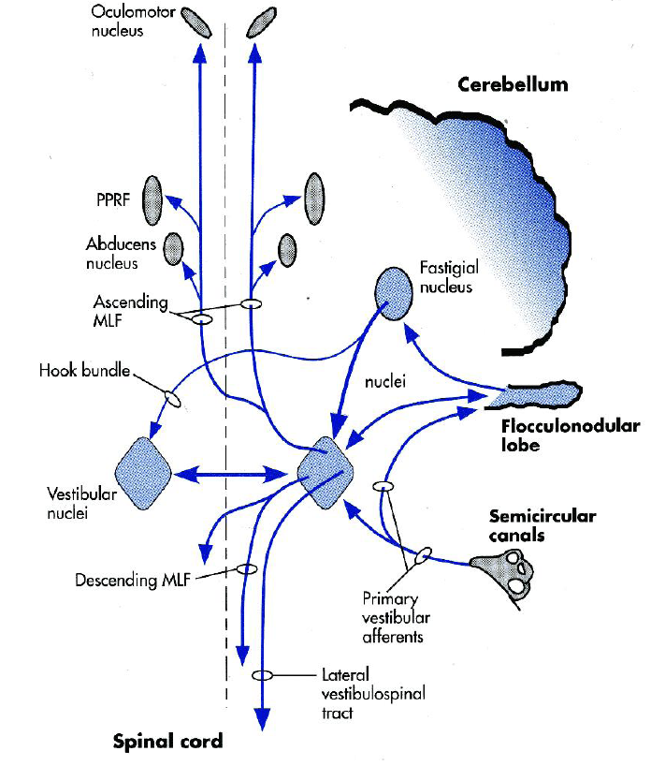
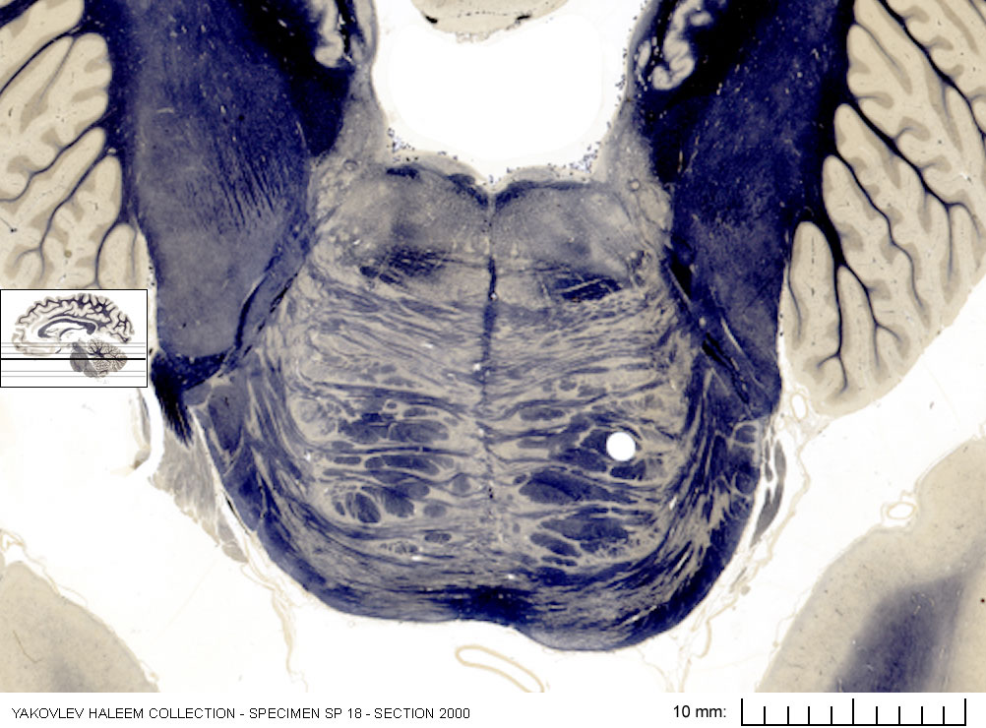
Cerebellum – flocculonodular lobe (input & output)
Inferior cerebellar peduncle
Medial Vestibulospinal Tracts
(Descending MLF)
Castro, Merchut, Neafsey, Wurster; Neuroscience: An Outline Approach, 2002

Slide 22
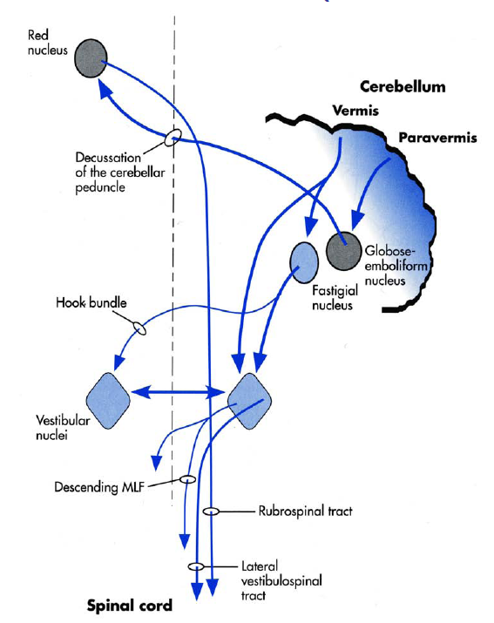
Cerebellum – vermis (input & output)
(Uncinate fasciculus)
(Interposed nucleus)
Medial Vestibulospinal Tracts
(Descending MLF)
Medial Vestibulospinal Tracts
(Descending MLF)
Castro, Merchut, Neafsey, Wurster; Neuroscience: An Outline Approach, 2002
Siegel A, Sparu HN. Essential Neuroscience, 3rd Ed., Wolters Kluwer, 2015

Slide 23
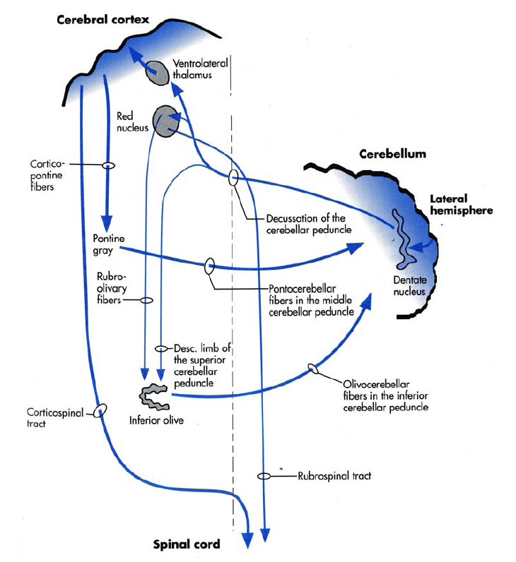
Cerebellum – hemisphere (input & output)
Castro, Merchut, Neafsey, Wurster; Neuroscience: An Outline Approach, 2002
Siegel A, Sparu HN. Essential Neuroscience, 3rd Ed., Wolters Kluwer, 2015

Slide 24
Cerebellum overview – microscopic anatomy
Molecular layer
Mainly axons and dendrites
Basket cells – axons synapse on the Purkinje cell body
Stellate cells – axons synapse on Purkinje cell dendrites
Purkinje cell layer
Purkinje cells – only axons that leave the cerebellar cortex
Granular layer
Granular cells – send their axons into the molecular layer as parallel fibers
White matter

Slide 25
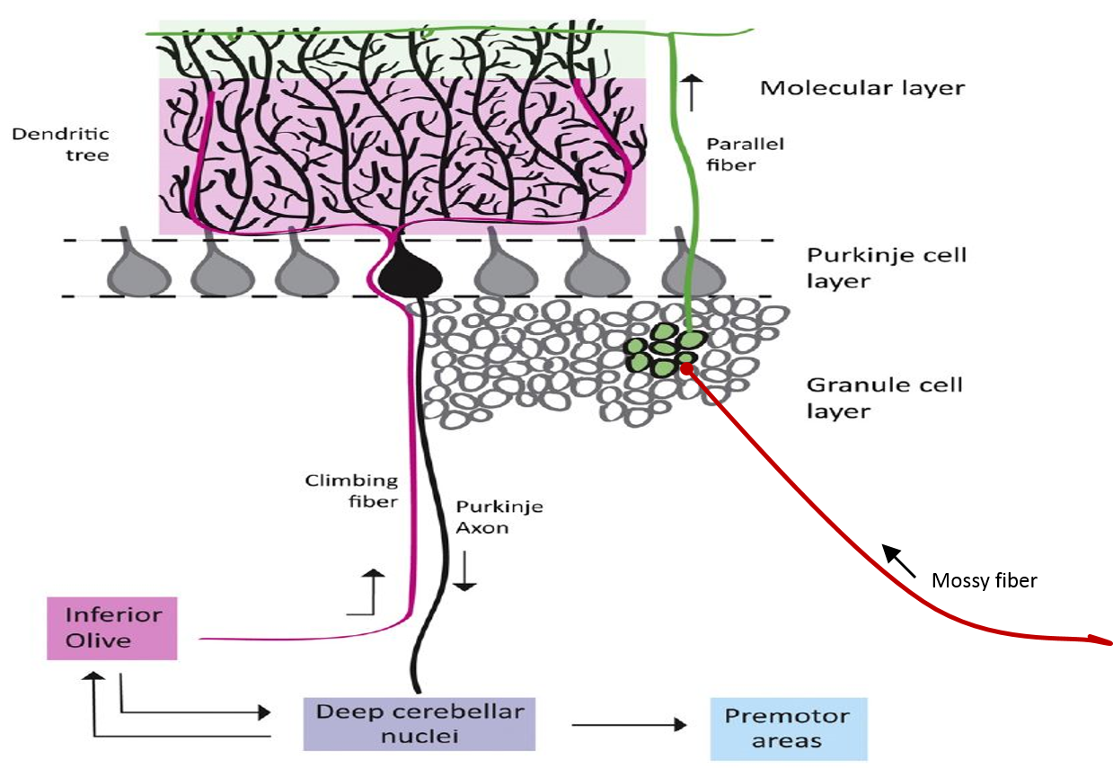
Cerebellum overview – microscopic anatomy
Neurobiology of Disease 88 (2016) 96–106
Nolte J and Sundsten. The Human Brain: An introduction to its functional anatomy. 6th edition, 2010; Mosby Elsevier

Slide 26
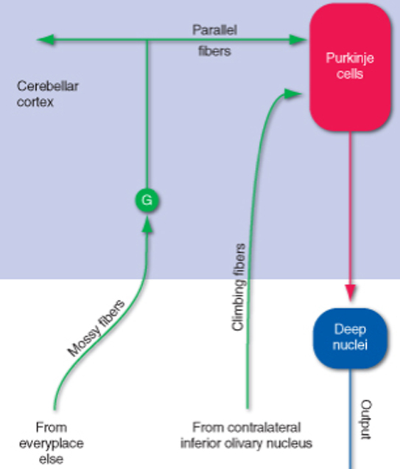
Cerebellum overview – microscopic anatomy
Nolte J and Sundsten. The Human Brain: An introduction to its functional anatomy. 6th edition, 2010; Mosby Elsevier

Slide 27
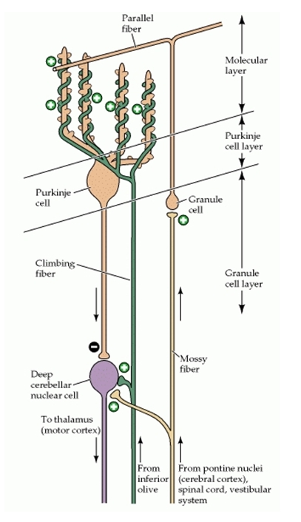
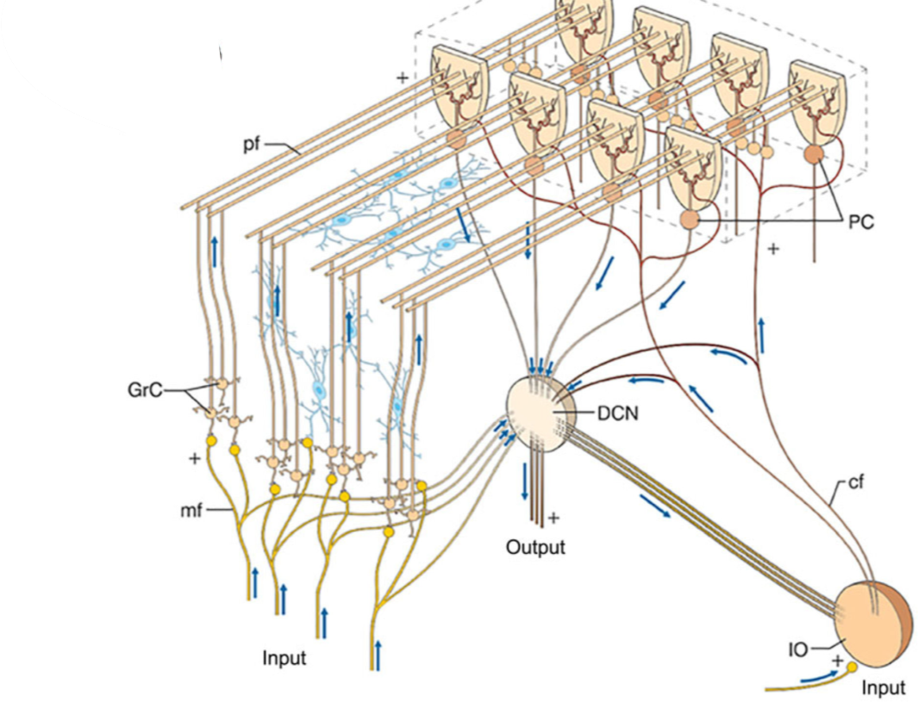
Cerebellum overview – microscopic anatomy
Parallel fibers
Purkinje
cells
Granule
cells
Deep cerebellar
nuclei
Climbing fibers
Mossy fibers
Inferior Olivary
nucleus
Neuroscience. 2nd Ed., Purves D, Augustine GJ, Fitzpatrick D, et al., editors. Sunderland (MA):Sinauer Associates\; 20012
Ann N Y Acad Sci. 2016;1369(1):154–171.

