Slide 2
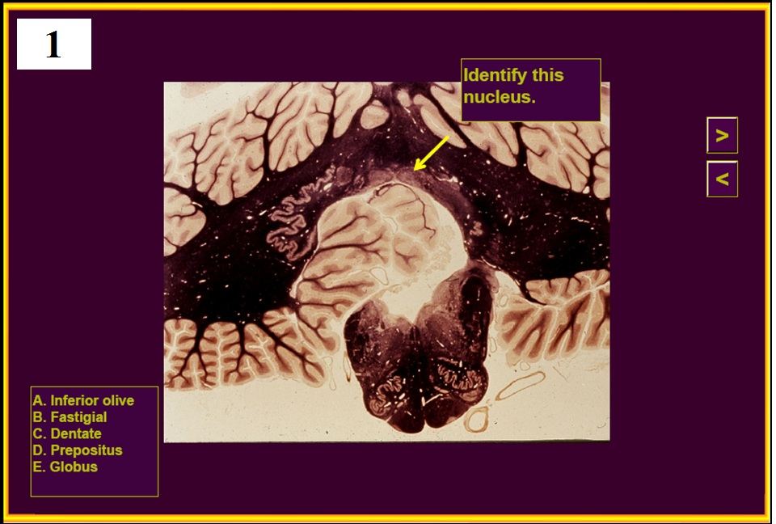

Slide 3
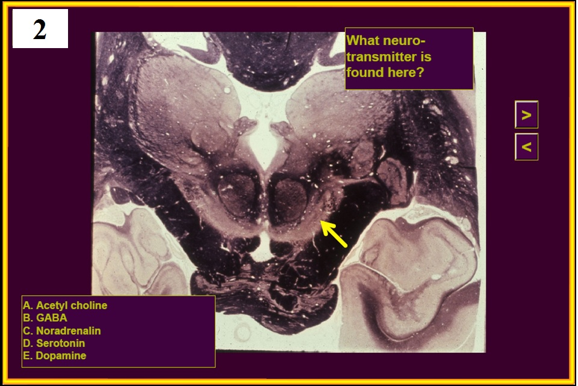

Slide 6
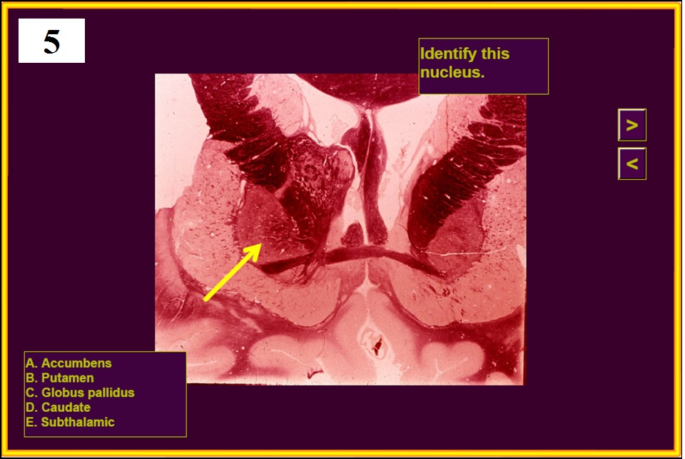

Slide 7
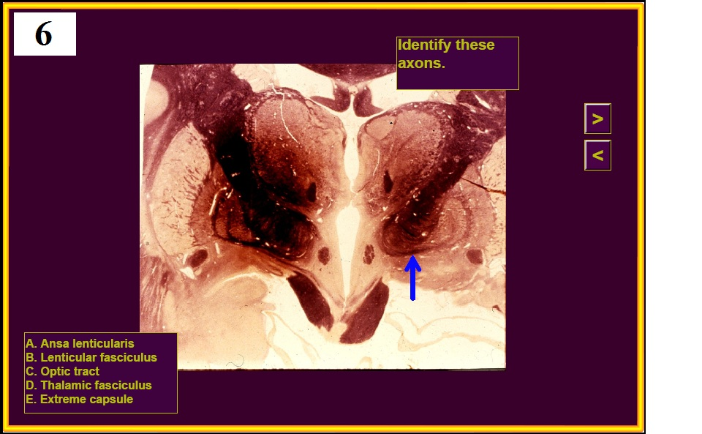
Identify these looping axons

Slide 8
(Transmits vsct)

Slide 10
9.
Which tract is the only afferent pathway to use the superior cerebellar peduncle?
A) CST
B) STT
Ventral spinocerebellar tract
Dorsal column pathway
Trigeminothalamic pathway

Slide 12
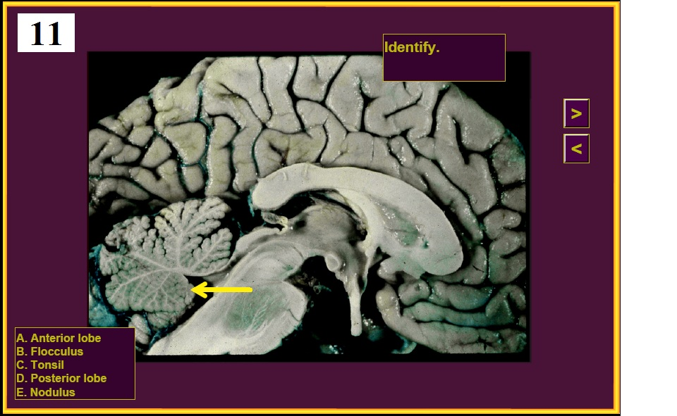

Slide 14
13.
The outflow of the purkinje cells:
A) is inhibitory.
B) goes mainly to the oculomotor nucleus.
C) has nothing to do with movement.
D) synapses on the VPL.
E) participates in the direct basal ganglia pathway.

Slide 18
17.
Which of the following gait abnormalities would indicate Parkinson’s disease?
A) A tabetic or “foot slapping” gait
B) Steppage or foot drop gait
Scissors gait, where the legs are weak, tend to cross,
with marked spasms
Slow, shuffling gait with festination
Duck waddle gait

Slide 19
18.
Which of the following would not be used for testing cerebellar function?
A) The Weber test
B) Finger nose finger
C) Heel-shin-knee
D) Rapid alternating movements
E) Rebound phenomenon

Slide 20
19.
Which one of the following is symptomatic of Huntington’s disease?
Hemiballismus
Cogwheel rigidity
Choreoathetosis
Total flaccid paralysis
Dysarthria

Slide 21
20.
Huntington’s disease is caused by degeneration of which nucleus?
Subthalamic
Globus pallidus
Substantia nigra
Caudate
VPL

Slide 22
End of Quiz #5

Slide 28
Identify these looping axons

Slide 29
(Transmits vsct)

Slide 31
9.
Which tract is the only afferent pathway to use the superior cerebellar peduncle?
A) CST
B) STT
Ventral spinocerebellar tract
Dorsal column pathway
Trigeminothalamic pathway

Slide 35
13.
The outflow of the purkinje cells:
A) is inhibitory.
B) goes mainly to the oculomotor nucleus.
C) has nothing to do with movement.
D) synapses on the VPL.
E) participates in the direct basal ganglia pathway.

Slide 39
17.
Which of the following gait abnormalities would indicate Parkinson’s disease?
A) A tabetic or “foot slapping” gait
B) Steppage or foot drop gait
C) Scissors gait, where the legs are weak, tend to cross, with marked spasms
Slow, shuffling gait with festination
Duck waddle gait

Slide 40
18.
Which of the following would not be used for testing cerebellar function?
A) The Weber test
B) Finger nose finger
C) Heel-shin-knee
D) Rapid alternating movements
E) Rebound phenomenon

Slide 41
19.
Which one of the following is symptomatic of Huntington’s disease?
Hemiballismus
Cogwheel rigidity
Choreoathetosis
Total flaccid paralysis
Dysarthria

Slide 42
20.
Huntington’s disease is caused by degeneration of which nucleus?
Subthalamic
Globus pallidus
Substantia nigra
Caudate
VPL

