Slide 6
5.
Which one of the following cells are responsible for myelination in the PNS?
A. Oligodendrocytes
B. Schwann cells
C. Microglia
D. Ependymal cells
E. Erythrocytes

Slide 7
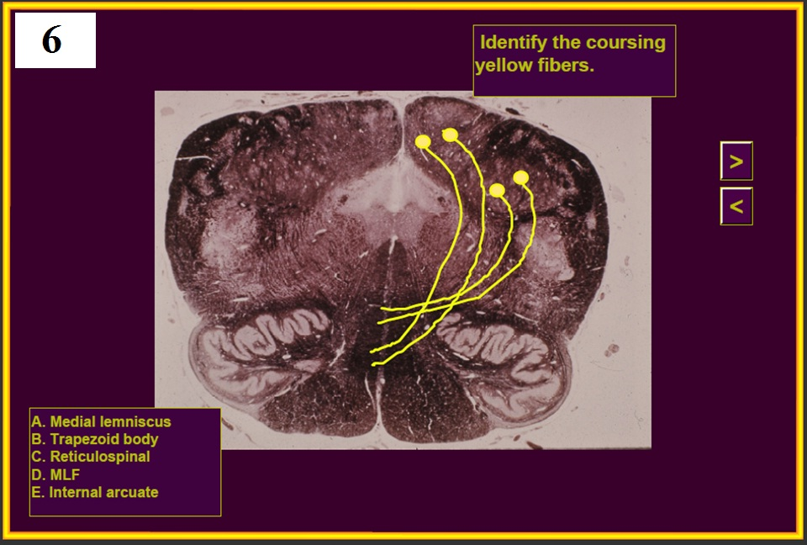

Slide 11
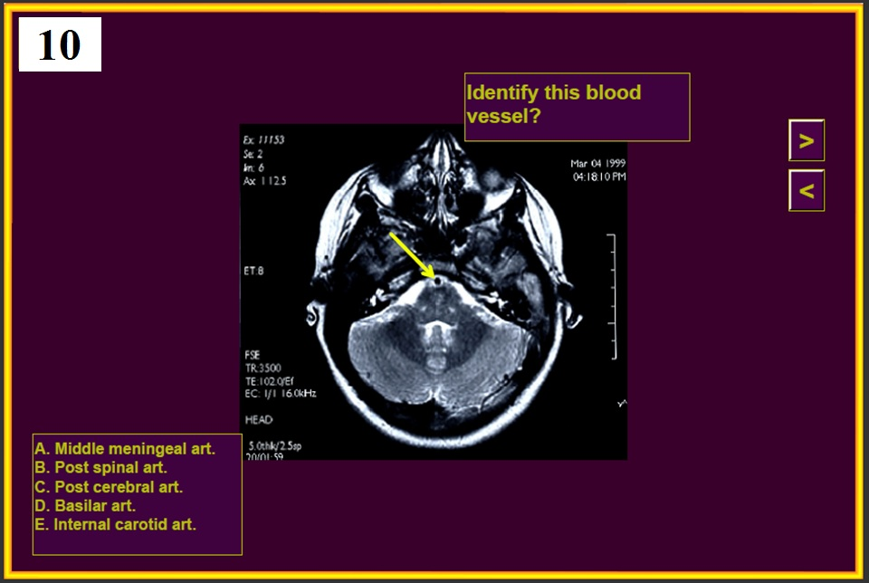

Slide 14
13.
Which one of the following is a derivative of neural crest?
A. Neurons of the cerebral cortex
B. Oligodendrocytes
C. Sensory axons in the radial nerve
D. Schwann cells
E. Anterior horn cells

Slide 16
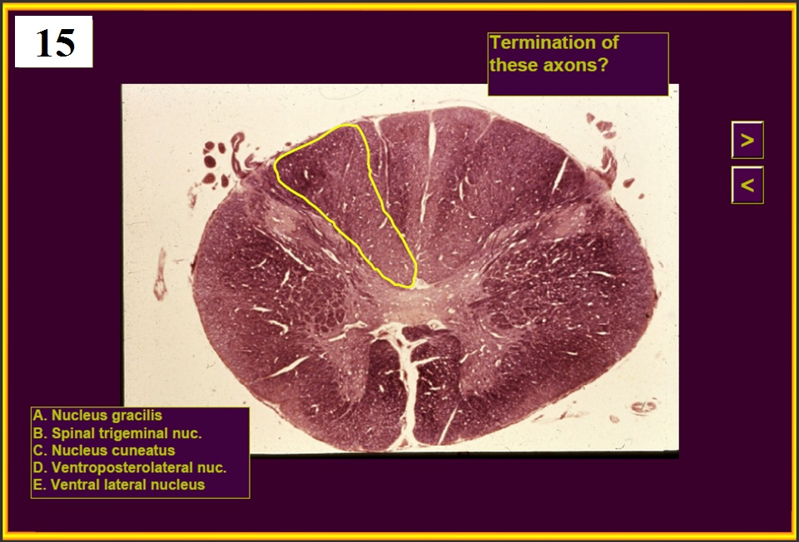

Slide 22
END OF QUIZ #1
Now, let’s review….

Slide 27
5.
Which one of the following cells are responsible for myelination in the PNS?
A. Oligodendrocytes
B. Schwann cells
C. Microglia
D. Ependymal cells
E. Erithrocytes

Slide 35
13.
Which one of the following is a derivative of neural crest?
A. Neurons of the cerebral cortex
B. Oligodendrocytes
C. Sensory axons in the radial nerve
D. Schwann cells
E. Anterior horn cells

