Slide 1
Renal PAthology
MHD I
10/31/2017

Slide 2
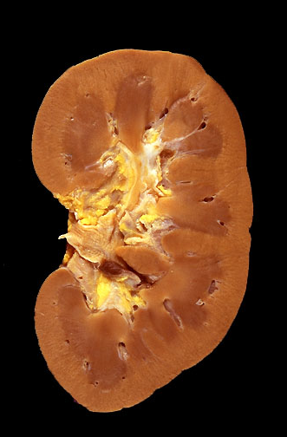
Case 1 – Summarize the normal gross kidney findings. Describe the external surface. Identify the renal cortex, medulla, major calyx, minor calyx

Slide 3
Case 1 H&E Low power – Distinguish the cortex from the medulla. What structures are each composed of?

Slide 4
Case 1 – Identify glomeruli, tubules; comment on the interstitium (H&E 20x)

Slide 5
Case 1 H&E 40x
Identify:
Bowman Space
Parietal Layer of Bowman Capsule
Glomerular Capillaries and Red Blood Cells
Identify tubular lumen, lining
epithelial cells

Slide 6
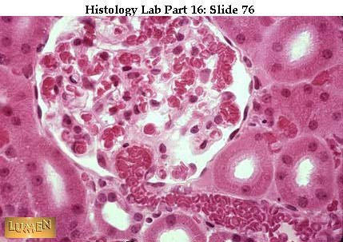
Case 1 – Identify the arteriole and glomerular capillaries. Identify the tubules, epithelial brush border

Slide 7
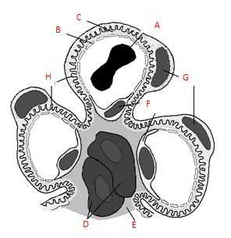
Case 1 – Identify the labels on this diagram of a normal glomerulus

Slide 8
Case 2
CHIEF COMPLAINT: “My back hurts.”
HISTORY: A 32-year-old woman presents to the emergency department with acute onset of fever, chills, and left flank pain.
She has also had nausea and vomiting and has been unable to keep any food down for the last day.
On further questioning she notes that she developed dysuria and urinary frequency several days prior.

Slide 9
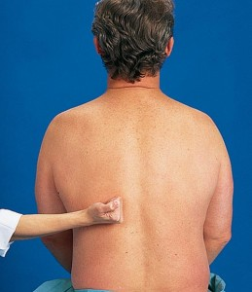
Case 2
PHYSICAL EXAMINATION:
Temp 102.1⁰ F, BP 92/56, P 112
Lungs and heart exams are normal, aside from tachycardia.
On abdominal exam there is suprapubic tenderness to palpation.
There is marked tenderness in the following area:

Slide 10
Case 2
Develop a differential diagnosis based on the history and physical exam

Slide 11
Case 2 - Urinalysis
UA w/Micro
Color Amber [YELLOW]
pH 6.0 [4.5-8.0]
Spec Gravity 1.030 [1.003-1.035]
Protein Neg [NEG]
Blood Trace [NEG]
Glucose Neg [NEG]
Ketones NEG [NEG]
Bilirubin NEG [NEG]
Urobilinogen 0.2 [0.2-1.0] eu/dl
Nitrite POS [NEG]
Leukocyte esterase POS [NEG]
RBC 2-5 [0-2] /hpf
WBC >150 [0-5] /hpf
WBC cast few

Slide 12
Case 2
What is your diagnosis?
What is your rationale? Correlate with the findings on the urinalysis.

Slide 13
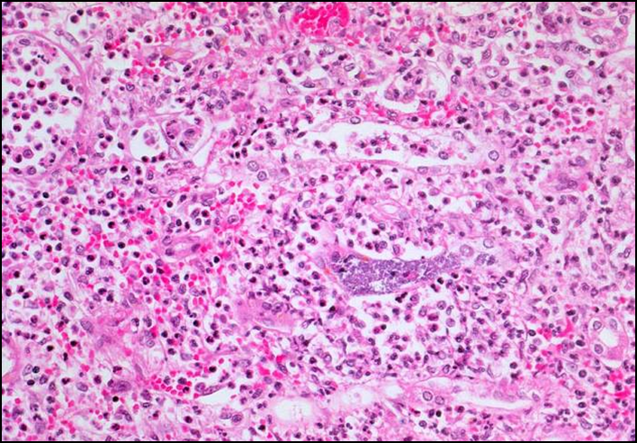
Case 2 - Normal A. Our patient B Describe the histologic findings on 20x. Compare A and B
A
B

Slide 14
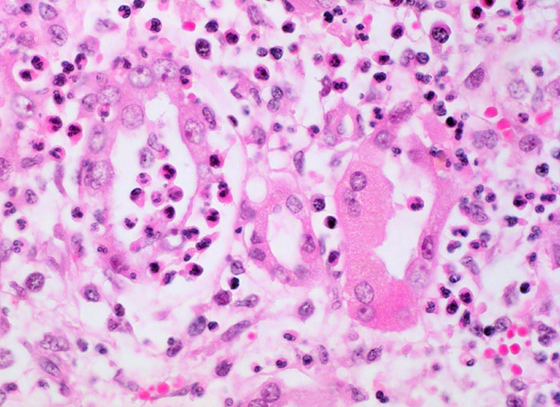
Case 2 - Patient histology. Describe the findings on the 40x image.
H&E 40x

Slide 15
Case 2
Summarize how urine microscopy (examination of urine sediment under the microscope) is performed.

Slide 16
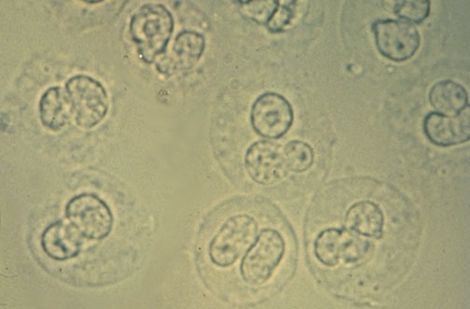
Case 2 – Which slide below represents red blood cells on microscopy? Which represents white blood cells?
A
B

Slide 17
Case 2 – What is the finding on our patient’s urine microscopy?

Slide 18
Case 2
Correlate the urine microscopy findings with the histologic findings.
Do these findings support your clinical diagnosis?

Slide 19
Case 2
The patient states that she has never felt this “lousy” before. She wants to know how and why she got this. She wants to know if there are any potential complications that could develop.
How would you answer her questions?

Slide 20
Case 3
CHIEF COMPLAINT: “I’m here for my check-up.”
HISTORY: The patient is a 69-year-old man with a history of hypertension, diabetes mellitus type 2, and coronary artery disease. He has known proteinuria and chronic kidney disease. He has no specific issues of concern during the visit.
PHYSICAL EXAMINATION: BP 150/72; Pulse 60. Heart, lung, and abdominal exams are unremarkable. He has decreased sensation and proprioception of his feet.

Slide 21
Case 3 - Laboratory
BUN 36 mg/dl
Creatinine 2.7 mg/dl
Urinalysis 3+ protein

Slide 22
Case 3
Name the most common macrovascular diseases which occur as a result of diabetes mellitus.
Name the most common microvascular diseases which occur as a result of diabetes mellitus.

Slide 23
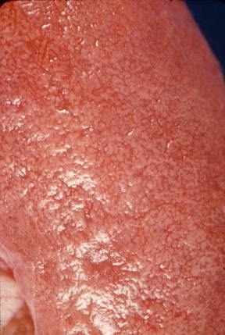
Case 3 - Contrast the gross findings of this patient’s kidney (B) vs the normal kidney (A)
B
B
A

Slide 24
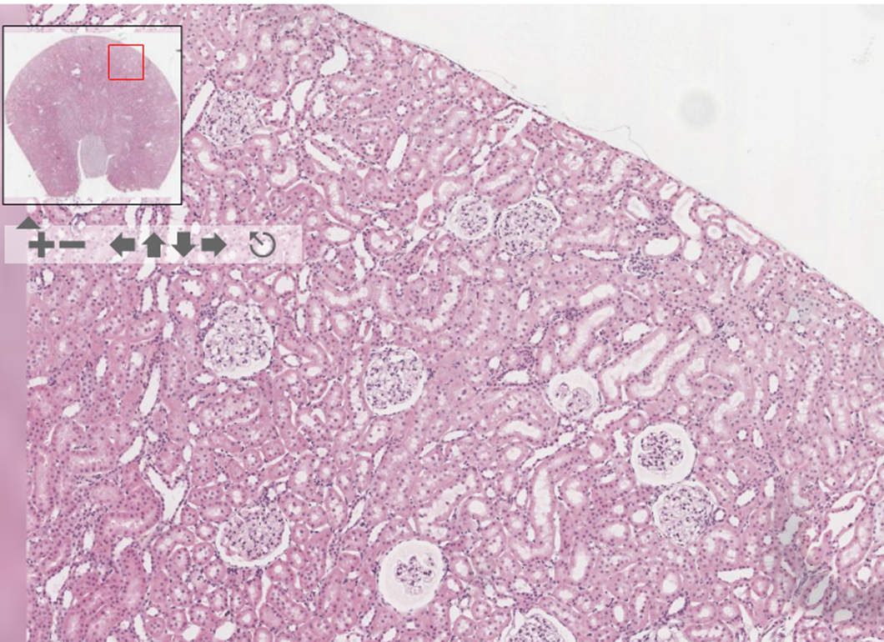
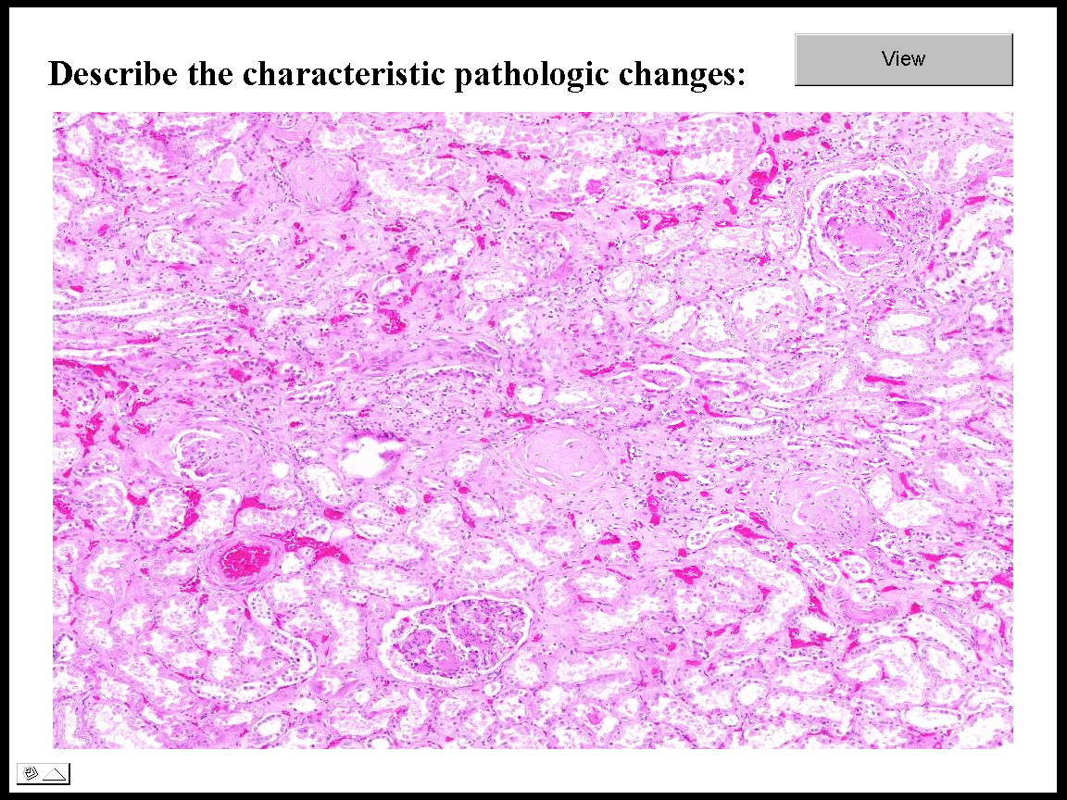
Case 3 - Compare and contrast a normal kidney in A with our patient’s in B. What does (1) represent?
1
1
A
B
H&E stain

Slide 25
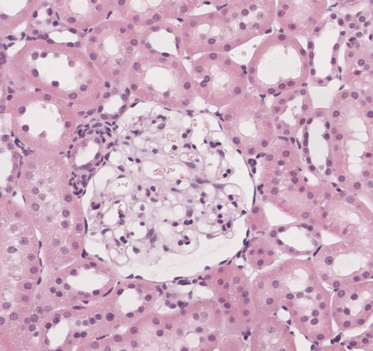
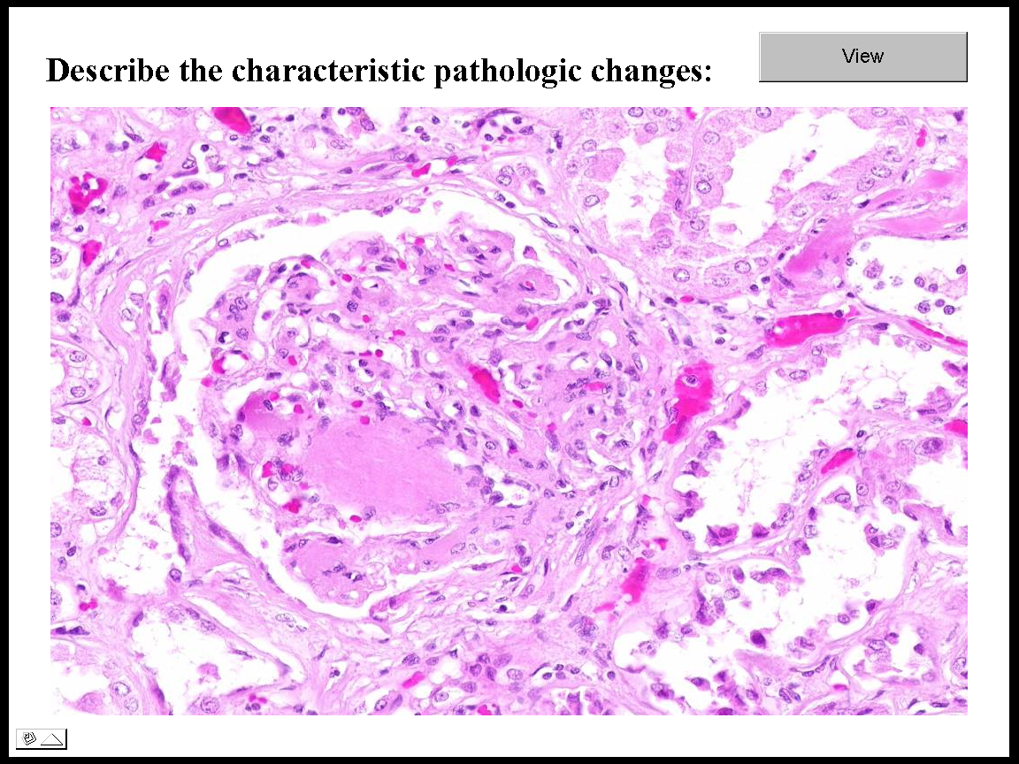
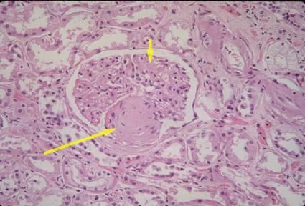
Case 3 - Describe the histologic findings. What does (2) represent? Comment on the appearance of the mesangium
normal
2
2
2
H&E stain
H&E stain

Slide 26
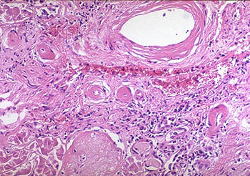
Case 3 – Identify arteriole(s) and describe their findings.
H&E stain

Slide 27
Case 3 - Describe the histologic findings on PAS stain

Slide 28
Case 3
What is your diagnosis?
Discuss ways to help slow disease progression in this patient.

Slide 29
Case 4
CHIEF COMPLAINT: “My feet and legs are swelling.”
HISTORY: A 71-year-old woman presents with concerns of foot and leg swelling gradually worsening over the past month. She also notices that she is “puffy around the eyes” after waking up in the morning.
PHYSICAL EXAMINATION: BP 140/88, Pulse 80. There is bilateral lower extremity edema extending to the thighs and bilateral hand edema. Remainder of the physical exam is unremarkable.

Slide 30
Case 4
Develop a differential diagnosis based on the information provided.

Slide 31
Case 4 – Laboratory
BUN 18 mg/dl
Creatinine 1.7 mg/dl
Albumin 1.9 mg/dl

Slide 32
Case 4 - Urinalysis
UA w/Micro
Color Yellow [YELLOW]
pH 6.0 [4.5-8.0]
Spec Gravity 1.020 [1.003-1.035]
Protein 4+ [NEG]
Blood Neg [NEG]
Glucose Neg [NEG]
Ketones Neg [NEG]
Bilirubin Neg [NEG]
Urobilinogen 0.2 [0.2-1.0] eu/dl
Nitrite Neg [NEG]
Leukocyte Neg [NEG]
RBC 0 [0-2] /hpf
WBC 0 [0-5] /hpf
+oval fat bodies
24-hour estimated
urine protein excretion:
6 grams

Slide 33
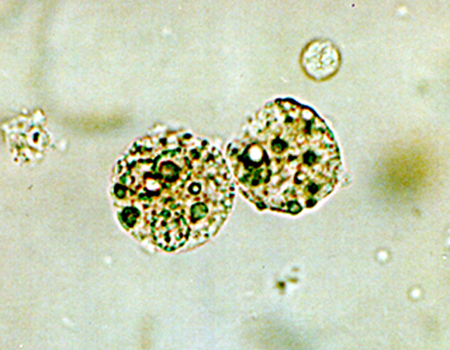
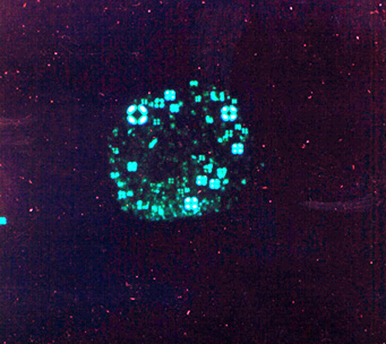
Case 4
Interpret the laboratory data. Comment on the finding of oval fat bodies (depicted in the images below) on urine microscopy.
Polarized

Slide 34
Case 4
What is your preliminary diagnosis? Explain your rationale.
What diseases are included in the differential diagnosis of this entity?

Slide 35
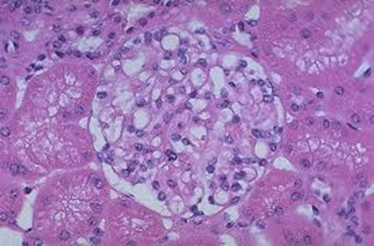
Case 4 – Kidney Biopsy
Compare and contrast a normal glomerulus in A with our patient’s in B.
A
H&E stain
A
H&E stain
B
H&E stain

Slide 36
Case 4 - Describe the findings on Congo Red Stain
Congo red stained slide viewed under normal (bright, non-polarized) light

Slide 37
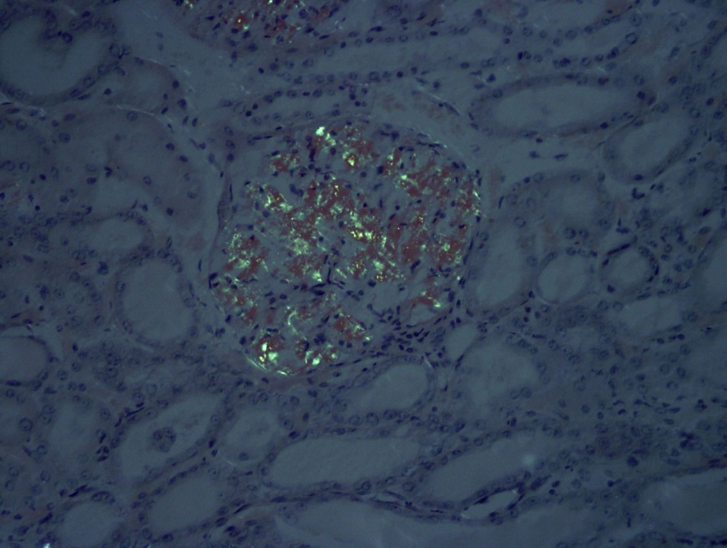
Case 4 - Describe the findings
Congo red stained slide viewed under partially polarized light

Slide 38
Case 4
What is your diagnosis?

Slide 39
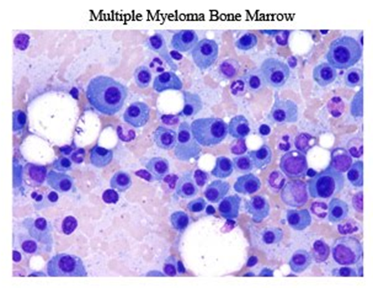
Case 4
The patient underwent further evaluation and was diagnosed with multiple myeloma.
Define multiple myeloma.

Slide 40
Case 4
How did multiple myeloma lead to the patient’s kidney pathology?

Slide 41
Case 5
CC: My urine keeps on turning red
HISTORY OF PRESENT ILLNESS
A 17-year-old male presents to his physician with the chief concern of red urine. Six months ago he developed a “cold” and 1 day later he noticed that his urine was red. The urine cleared after 2 days . He did not tell his parents. He noticed reddish urine for several days about 3 months ago but then the urine returned to a normal color. He again developed red urine 1 day ago. Now concerned, he told his parents who brought him in for evaluation.

Slide 42
Case 5
HPI cont.
He has not had any recent trauma and has not strenuously exercised during the past week. He has had no change in his urine output. He has had no gum bleeding, nose bleeds, hematochezia or melena. He has no abdominal or flank pain.
He feels well. He takes no medications.
His mother, father, and 3 siblings are all healthy.

Slide 43
Case 5
PHYSICAL EXAM
Normally developed male BP 108/62, pulse 72, afebrile
Heart and lung exams are normal.
Abdominal exam is normal; there is no suprapubic tenderness.
There is no flank mass or tenderness.
Genital exam is normal.
There are no skin rashes.

Slide 44
Case 5 - Urinalysis
Color Red [YELLOW]
pH 6.0 [4.5-8.0]
Spec Gravity 1.020 [1.003-1.035]
Protein 1+ [NEG]
Blood Large [NEG]
Glucose Neg [NEG]
Ketones Neg [NEG]
Bilirubin Neg [NEG]
Urobilinogen 0.2 [0.2-1.0] eu/dl
Nitrite Neg [NEG]
Leukocyte Neg [NEG]
RBC >100 [0-2] /hpf
WBC 2-5 [0-5] /hpf

Slide 45
Case 5 - Laboratory
BUN 12 mg/dl
Creatinine 0.8 mg/dl
CBC, PT, PTT normal

Slide 46
Case 5
What is the main clinical problem?
Develop a differential diagnosis for the most common causes of this problem in a 17-year old male.

Slide 47
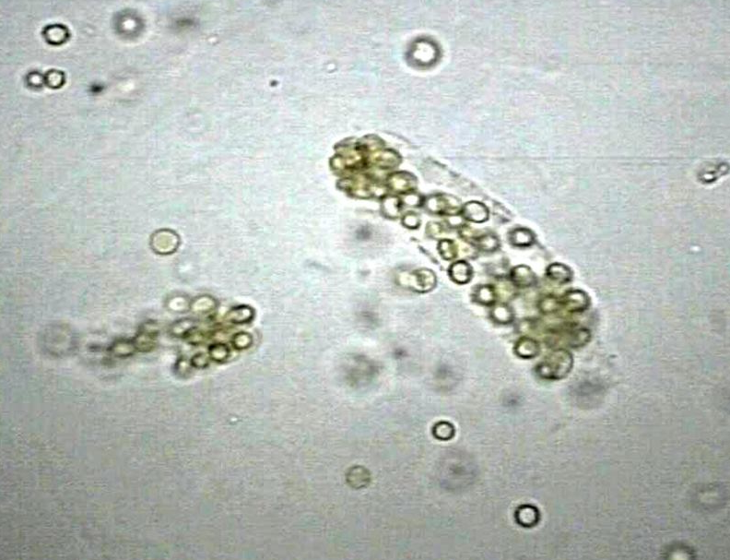
Case 5
A urinalysis is repeated and immediately brought to the lab for performance of urine microscopy. What is the finding?

Slide 48
Case 5
What does this finding imply?

Slide 49
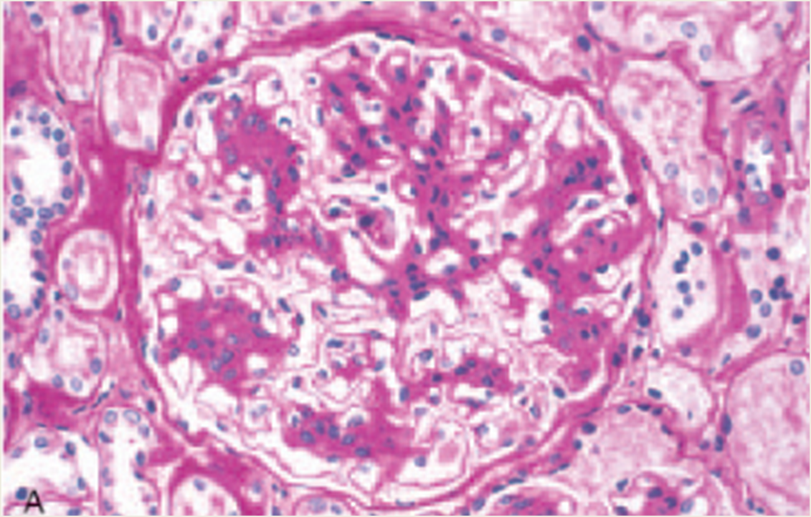
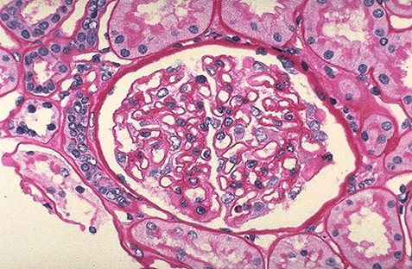
Case 5
On the biopsy, the pathologist notes “mesangial proliferation”. Point out this finding on the PAS stained glomerulus:
normal

Slide 50
Case 5 - Immunofluorescence, IgA . Describe the findings

Slide 51
Case 5
Correlate the clinical data and the pathology findings. What is your diagnosis?
The patient and his parents want to know his prognosis. What will you tell them?

Slide 52
Case 5 – Point out on this diagram where the primary pathologic changes in this disease process are found

Slide 53
Case 6
CHIEF COMPLAINT: “I’m having pain in my side for the past 3 months.”
HISTORY: A 63-year-old man presents with right flank pain that has been ongoing for the past several months. He has felt more tired than usual, but otherwise feels “ok”. He has a 30-pack year smoking history and he currently smokes. He has no known chronic medical problems
PHYSICAL EXAMINATION: The abdomen is soft and non-tender. He has right costovertebral tenderness on palpation. There is no vertebral tenderness.

Slide 54
Case 6 - Urinalysis
UA w/Micro
Color Yellow [YELLOW]
pH 6.0 [4.5-8.0]
Spec Gravity 1.020 [1.003-1.035]
Protein Neg [NEG]
Blood Mod [NEG]
Glucose Neg [NEG]
Ketones Neg [NEG]
Bilirubin Neg [NEG]
Urobilinogen 0.2 [0.2-1.0] eu/dl
Nitrite Neg [NEG]
Leukocyte Neg [NEG]
RBC 25-50 [0-2] /hpf
WBC 2-5 [0-5] /hpf
Serum BUN and creatinine are normal.

Slide 55
Case 6
Interpret the urinalysis.
Develop a differential diagnosis integrating the clinical findings and those on urinalysis.

Slide 56
Case 6
An ultrasound of the kidneys and bladder is performed which shows a mass of the right kidney.
The patient undergoes nephrectomy.

Slide 57
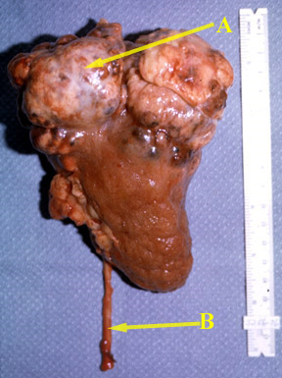
Case 6 - Describe the gross findings. What do “A? and “B” represent?

Slide 58
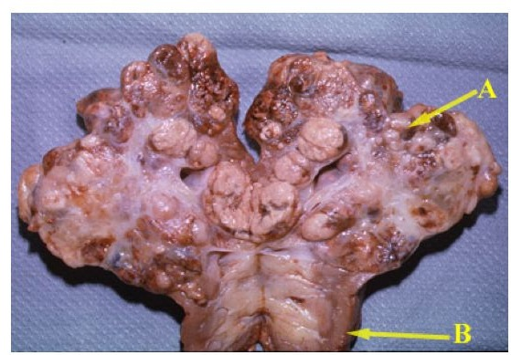
Case 6- Nephrectomy specimen bisected. Describe the gross findings. What do “A” and “B” represent?

Slide 59
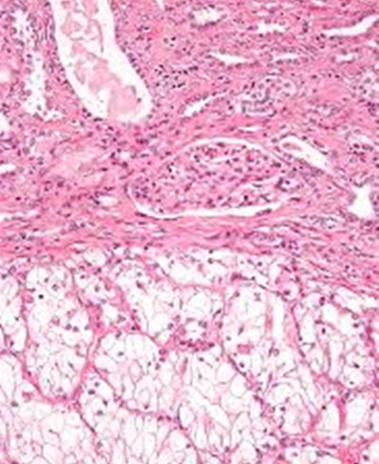
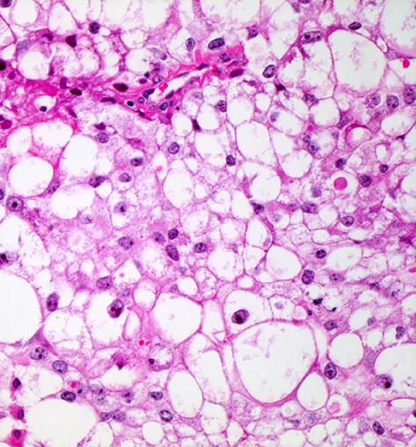
Case 6 - Describe the histologic findings. From what part of the gross specimen was the section likely obtained?
20x, H&E stain
40x, H&E stain

Slide 60
Case 6
What is your pathologic diagnosis?
Correlate the pathologic findings with the clinical findings.
What is the characteristic triad with respect to presentation of this disease process?

Slide 61
Case 6
Interpret the patient’s CBC. Relate the findings to the disease process.
WBC 11.3 [4.0-10.0] k/ul
Hgb 17.1 [12.0-16.0] gm/dl
Hct 51.4 [34.0-48.0] %
Plt Count 305 [150-400] k/ul

