Slide 1
MHD Ultrasound Lab
Pulmonary Pathology
November 27, 2017

Slide 2
Point of Care Ultrasound
The following Cases are building upon the normal ULTRASOUND anatomy of the lung learned in the SHB course.
The students will go through the cases with their ultrasound facilitators, Dr. Amy Kule in room 360 and Dr. Brian Barbas in room 460, during the pulmonary pathology US lab.
Students should review the cases prior to their session and be prepared to answer questions regarding the history, PE, lab data, CXR findings, clinical correlates, as well as the US scan during the lab session.
Drs. Kule and Barbas will discuss the Point of Care Ultrasound findings with you during the session.

Slide 3
Ultrasound Videos
Normal Pulmonary Ultrasound (review from last year)
www.youtube.com/watch?v=dQTTVQ60WsI
Abnormal Pulmonary Ultrasound (watch video to 5:53)
https://youtu.be/WOlz8-km6hE?list=PLGEKJJ3ekUkya3wejrC1DzxcTXNF1Tlk8
Pneumonia on Ultrasound (3:22)
https://www.youtube.com/watch?v=21yJm6IDuRA

Slide 4
Case 1 – History
A 22-year old Male arrives to the Emergency Department by EMS after being stabbed by a knife during an altercation at a party. He reports feeling pain to his left upper back and shortness of breath.
His PMHx and SurgHx are both negative.
He denies any taking medications or having any drug allergies.

Slide 5
Case 1 – Physical Exam
Vitals
Temp 37.1 BP 108/73 HR 114 RR 24 O2 sat 94% on RA
Physical exam
Constitutional: Moderate distress
Cardiac: Tachycardic, regular rhythm, no murmurs
Pulmonary: Absent breath sounds on left, hyperresonance on percussion; clear breath sounds on right. Tachypneic, mild respiratory distress
Skin: 2 cm linear wound to left mid-upper back

Slide 6
Case 1 – Workup
What radiographic studies would you order on this patient?

Slide 7
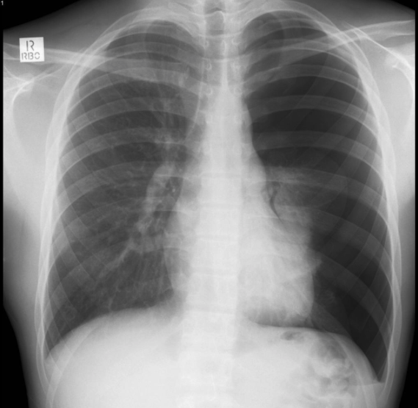
Case 1 – CXR
Describe the CXR findings in this patient.
https://radiopaedia.org/cases/pneumothorax-6

Slide 8
Case 1 – CXR
What is your suspected diagnosis?

Slide 9
Case 1 – CXR
Explain the cause behind these findings.

Slide 10
Case 1 – Lung Ultrasound
As part of your eFAST (Extended Focused Assessment with Sonography in Trauma) exam, you obtain these findings.
Right Lung
Left Lung

Slide 11
Case 1 – Lung Ultrasound
Describe and demonstrate how to perform a complete eFAST exam on the mannequin and state what you would be looking for.
Right Lung
Left Lung

Slide 12
Case 1 – Ultrasound
What are the ultrasound findings of a normal lung?

Slide 13
Case 1 – Ultrasound
What are the ultrasound findings of a pneumothorax?

Slide 14
Case 1 – Reassessment
The nurse calls you back to reassess the patient as he appears to have deteriorated.
New vitals
HR 142
BP 74/43
PE
Neck: Right tracheal deviation, distended neck veins

Slide 15
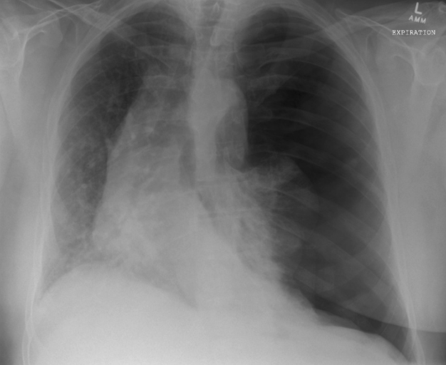
Case 1 – CXR
Describe the CXR findings.

Slide 16
Case 1 – CXR
Explain the cause of this patient’s deteriorated condition.

Slide 17
Case 1 – CXR
How would you manage this patient?

Slide 18
Case 2 – History
A 52-year old male arrives by EMS to the ED after falling 10 feet from to top of a ladder. He states the ladder slid out from underneath him. He landed with his right upper back across the rungs of the ladder. His complaints include right sided chest and back pain, as well as shortness of breath.
His PMH includes HTN and he is currently on lisinopril.
He has no PSurgHx.

Slide 19
Case 2 – Physical Exam
Vitals
Temp 36.4 BP 123/78 HR 134 RR 29 O2 sat 92% on RA
Physical exam
Constitutional: Moderate distress
Cardiac: Tachycardic, regular rhythm, no murmurs
Pulmonary: Diminished breath sounds on the right, dullness to percussion; normal breath sounds on left
Chest: Subcutaneous emphysema on right

Slide 20
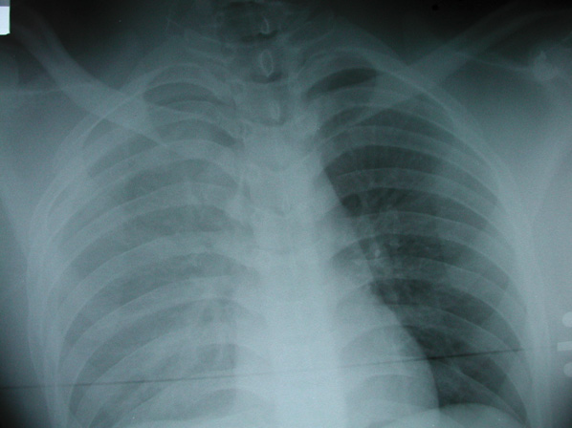
Case 2 – CXR
Describe the CXR findings in this supine patient.

Slide 21
Case 2 – CXR
What can cause these physical exam findings?
Vitals
Temp 36.4 BP 123/78
HR 134 RR 29
O2 sat 92% on RA
Cardiac:
Tachycardic, regular rhythm, no murmurs
Pulmonary:
Diminished breath sounds on the right, dullness to percussion; normal breath sounds on left
Chest:
Subcutaneous emphysema on right

Slide 22
Case 2 – CXR
How would this finding appear on ultrasound?

Slide 23
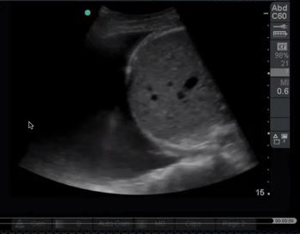
Case 2 – Ultrasound
Describe and demonstrate how to assess for intrathoracic fluid using ultrasound.

Slide 24
Case 2 – Management
What is the appropriate management for this patient?

Slide 25
Case 3 – History
An 83-year old patient presents to the ED with altered mental status.
She lives in a nursing home.
The patient is moaning and is unable to provide any information. EMS conveys that the nursing home staff noticed a change from baseline yesterday, but did not comment on anything specific.
Reviewing the nursing home records reveals a PMH including stroke with residual dysarthria, dementia, hypertension and diabetes mellitus.

Slide 26
Case 3 – Physical Exam
Vitals
Temp 39.4 C BP 93/69 HR 113 RR 34 O2 sat 89% on room air
Physical Exam
Constitutional: Cachectic, somnolent in moderate distress
Cardiac: Tachycardic, regular rhythm, normal S1 and S2, no murmur
Pulmonary: Tachypneic, rhonchi right lung field; no rhonchi, rales or wheezing to left lung field
Abdomen: Normal bowel sounds, soft, non-tender, non-distended
Neurology: AAOx0
Extremity: Contractured upper extremities

Slide 27
Case 3 – Workup
What is your differential diagnosis?
What radiologic studies would you order or perform on this patient?

Slide 28
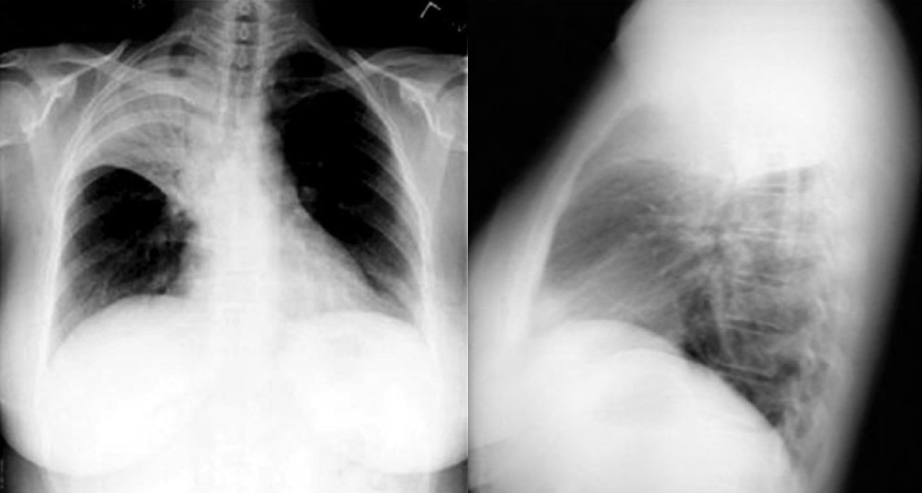
Case 3 – CXR
Describe the CXR findings performed on this patient.

Slide 29
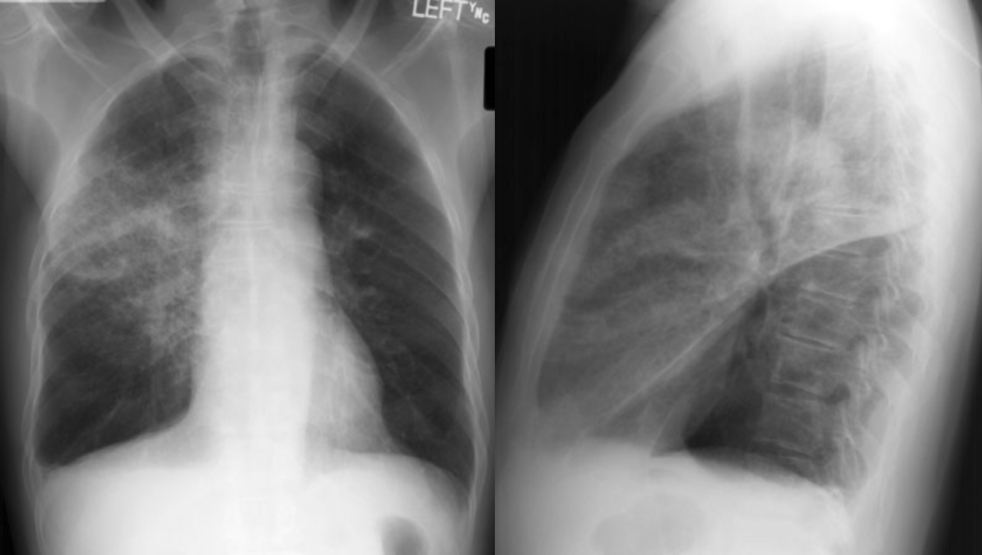
Case 3 – CXR
What is your suspected diagnosis?

Slide 30
Case 3 - CXR
Explain the pathology behind these CXR findings.

Slide 31
Case 3 – Ultrasound
As you read about this diagnosis, you find that X-ray is found to have a sensitivity ranging from 46-77%, while US has a sensitivity ranging from 93-100% (using CT scan as the gold standard).
Armed with this information, you decide to perform a lung US.

Slide 32
Case 3 – Ultrasound (Left Lung)
Describe the findings you see on the unaffected left lung. The probe is placed at the midaxillary line at the level of T8.

Slide 33
Case 3 – Ultrasound (Right Lung)
The probe is placed on the right posterolateral lung field. Describe the findings you see on the affected right lung.

Slide 34
Case 3 – Ultrasound (Right Lung)
Explain the cause of these findings.

Slide 35
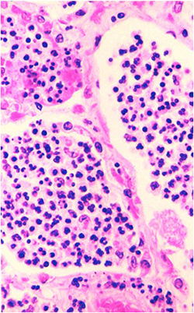
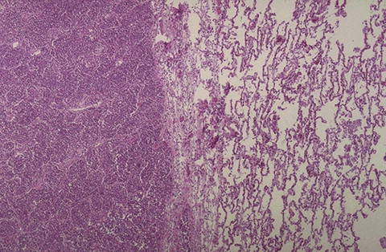
Gross Morphology Correlation: “Hepatization” of the Lung

Slide 36
Case 3 – Management
What is the most appropriate management of this patient?

Slide 37
Case 3 – Limitations
What are some limitations to using US when evaluating for pneumonia?

Slide 38
Define Point of Care Ultrasound. Summarize its Utility in Patient Care.
https://sonospot.files.wordpress.com/2012/06/img_1513.jpg

Slide 39
References
https://radiopaedia.org/cases/pneumothorax-6
https://lifeinthefastlane.com
http://www.trauma.org/index.php/main/image/1121/C11
https://vimeo.com/10081525
https://www.ultrasoundoftheweek.com
http://www.meddean.luc.edu/lumen/MedEd/medicine/pulmonar/cxr/conso.htm

