Slide 1
Pulmonary Pathology II
MHD I Laboratory
11/21/17

Slide 2
Case 1 History
A 57-year-old man develops hemoptysis. He has been smoking two packs of cigarettes per day for 30 years. He has had a chronic cough worse in the morning for 10 years. He has had mild dyspnea on exertion for the past 5 years.

Slide 3
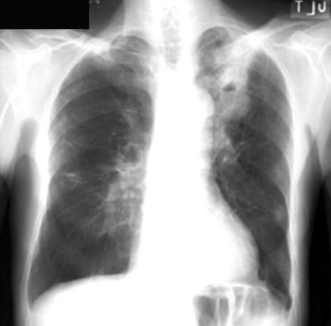
Case 1 Identify the cavitary mass

Slide 4
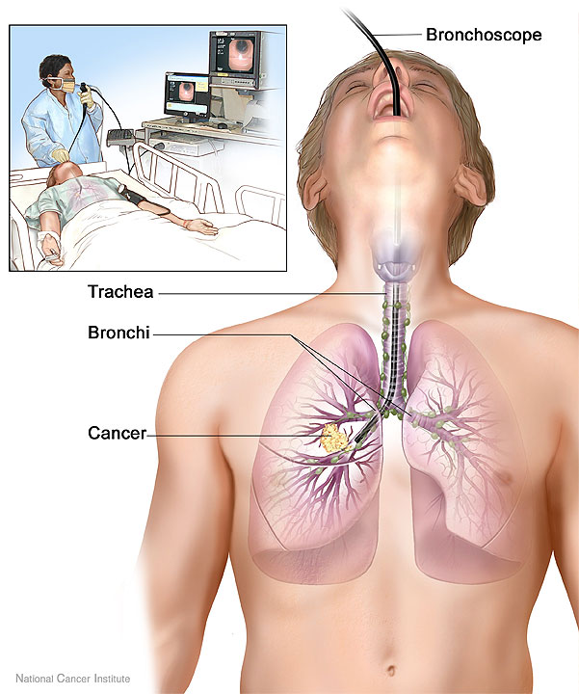
Case 1
The patient undergoes the procedure depicted in the image. Briefly describe the procedure and indication
Source: NCI Visuals Online

Slide 5
Case 1 Surgical specimen - Describe the gross findings. Correlate with the CXR

Slide 6
Case 1 Describe the low power and 20x findings

Slide 7
Case 1 Describe the high power findings

Slide 8
Case 1 Describe the histologic findings. What is the cause of the findings on this image?

Slide 9
Case 1
What is your diagnosis?
Correlate the pathology with the clinical presentation and x-ray findings.

Slide 10
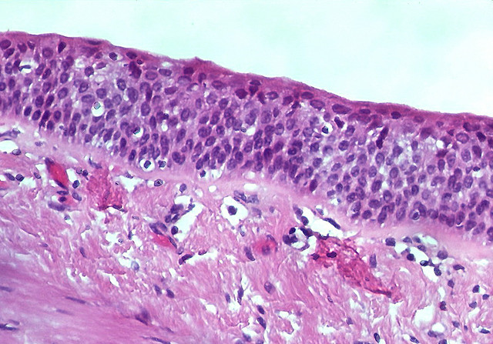
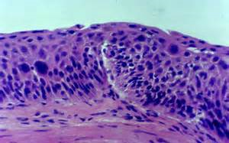
Case 1
Describe each of the 3 histologic sections
What process is depicted in the series of images? How does it relate to the
diagnosis?

Slide 11
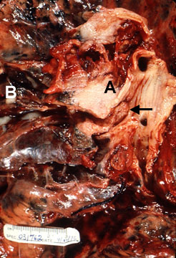
Case 1
Different patient, describe the gross findings. Why is the lesion amenable to biopsy via bronchoscopy?

Slide 12
Case 1
Na 140
K 4.0
CO2 24
Chloride 104
BUN 15
Creat 1.4
Calcium 11.5
Glucose 98
PTH <10 pg/ml
Interpret the laboratory findings and relate to the disease process

Slide 13
Case 2 History
A 69 year-old woman presents to the emergency department with chest pain.
She has no chronic medical problems. She smoked ½ pack of cigarettes per day during her first two years of college, none since. On physical exam heart, lung, abdominal exams are normal.
A chest x-ray is done and shows a peripheral 9cm mass.

Slide 14
Case 2 Describe the gross findings (note this is a bisected specimen)

Slide 15
Case 2 Describe the low power and 20x findings

Slide 16
Case 2 Describe the high power findings

Slide 17
Case 3
What is your diagnosis?

Slide 18
Case 2
The patient cannot understand why and how she got this disease. “I barely smoked, and that was years and years ago”. How will you respond to the patient?

Slide 19
Case 3 History
A 69 year-old woman presents to the emergency department with chest pain.
She has no chronic medical problems. She smoked ½ pack of cigarettes per day during her first two years of college, none since. On physical exam heart, lung, abdominal exams are normal.

Slide 20
Case 3
A chest-xray is done and shows a small peripheral nodule

Slide 21
Case 3 Describe the low power findings

Slide 22
Case 3 - Describe the findings
20x
40x

Slide 23
Case 3
The focus of pathologic changes measures 2.9 cm in greatest dimension, without findings of micro-invasion.
What is your diagnosis?
Discuss the relationship between this diagnosis and the pathology depicted in case 2. (you can ask case 2 students for assistance)

Slide 24
Case 4 History
A 71 year-old man develops progressive chest pain, dyspnea and back pain. He has had a 20 pound unintentional weight loss over 3 months. He smokes and has a 50 pack year smoking history.
Physical exam reveals hepatomegaly.
Chest X-ray shows enlarged hilar and mediastinal lymph nodes.
CT scan shows bilaterally enlarged adrenal glands and multiple masses in the liver.

Slide 25
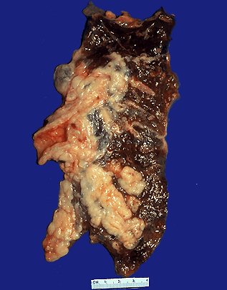
Case 4 Describe the gross findings.

Slide 26
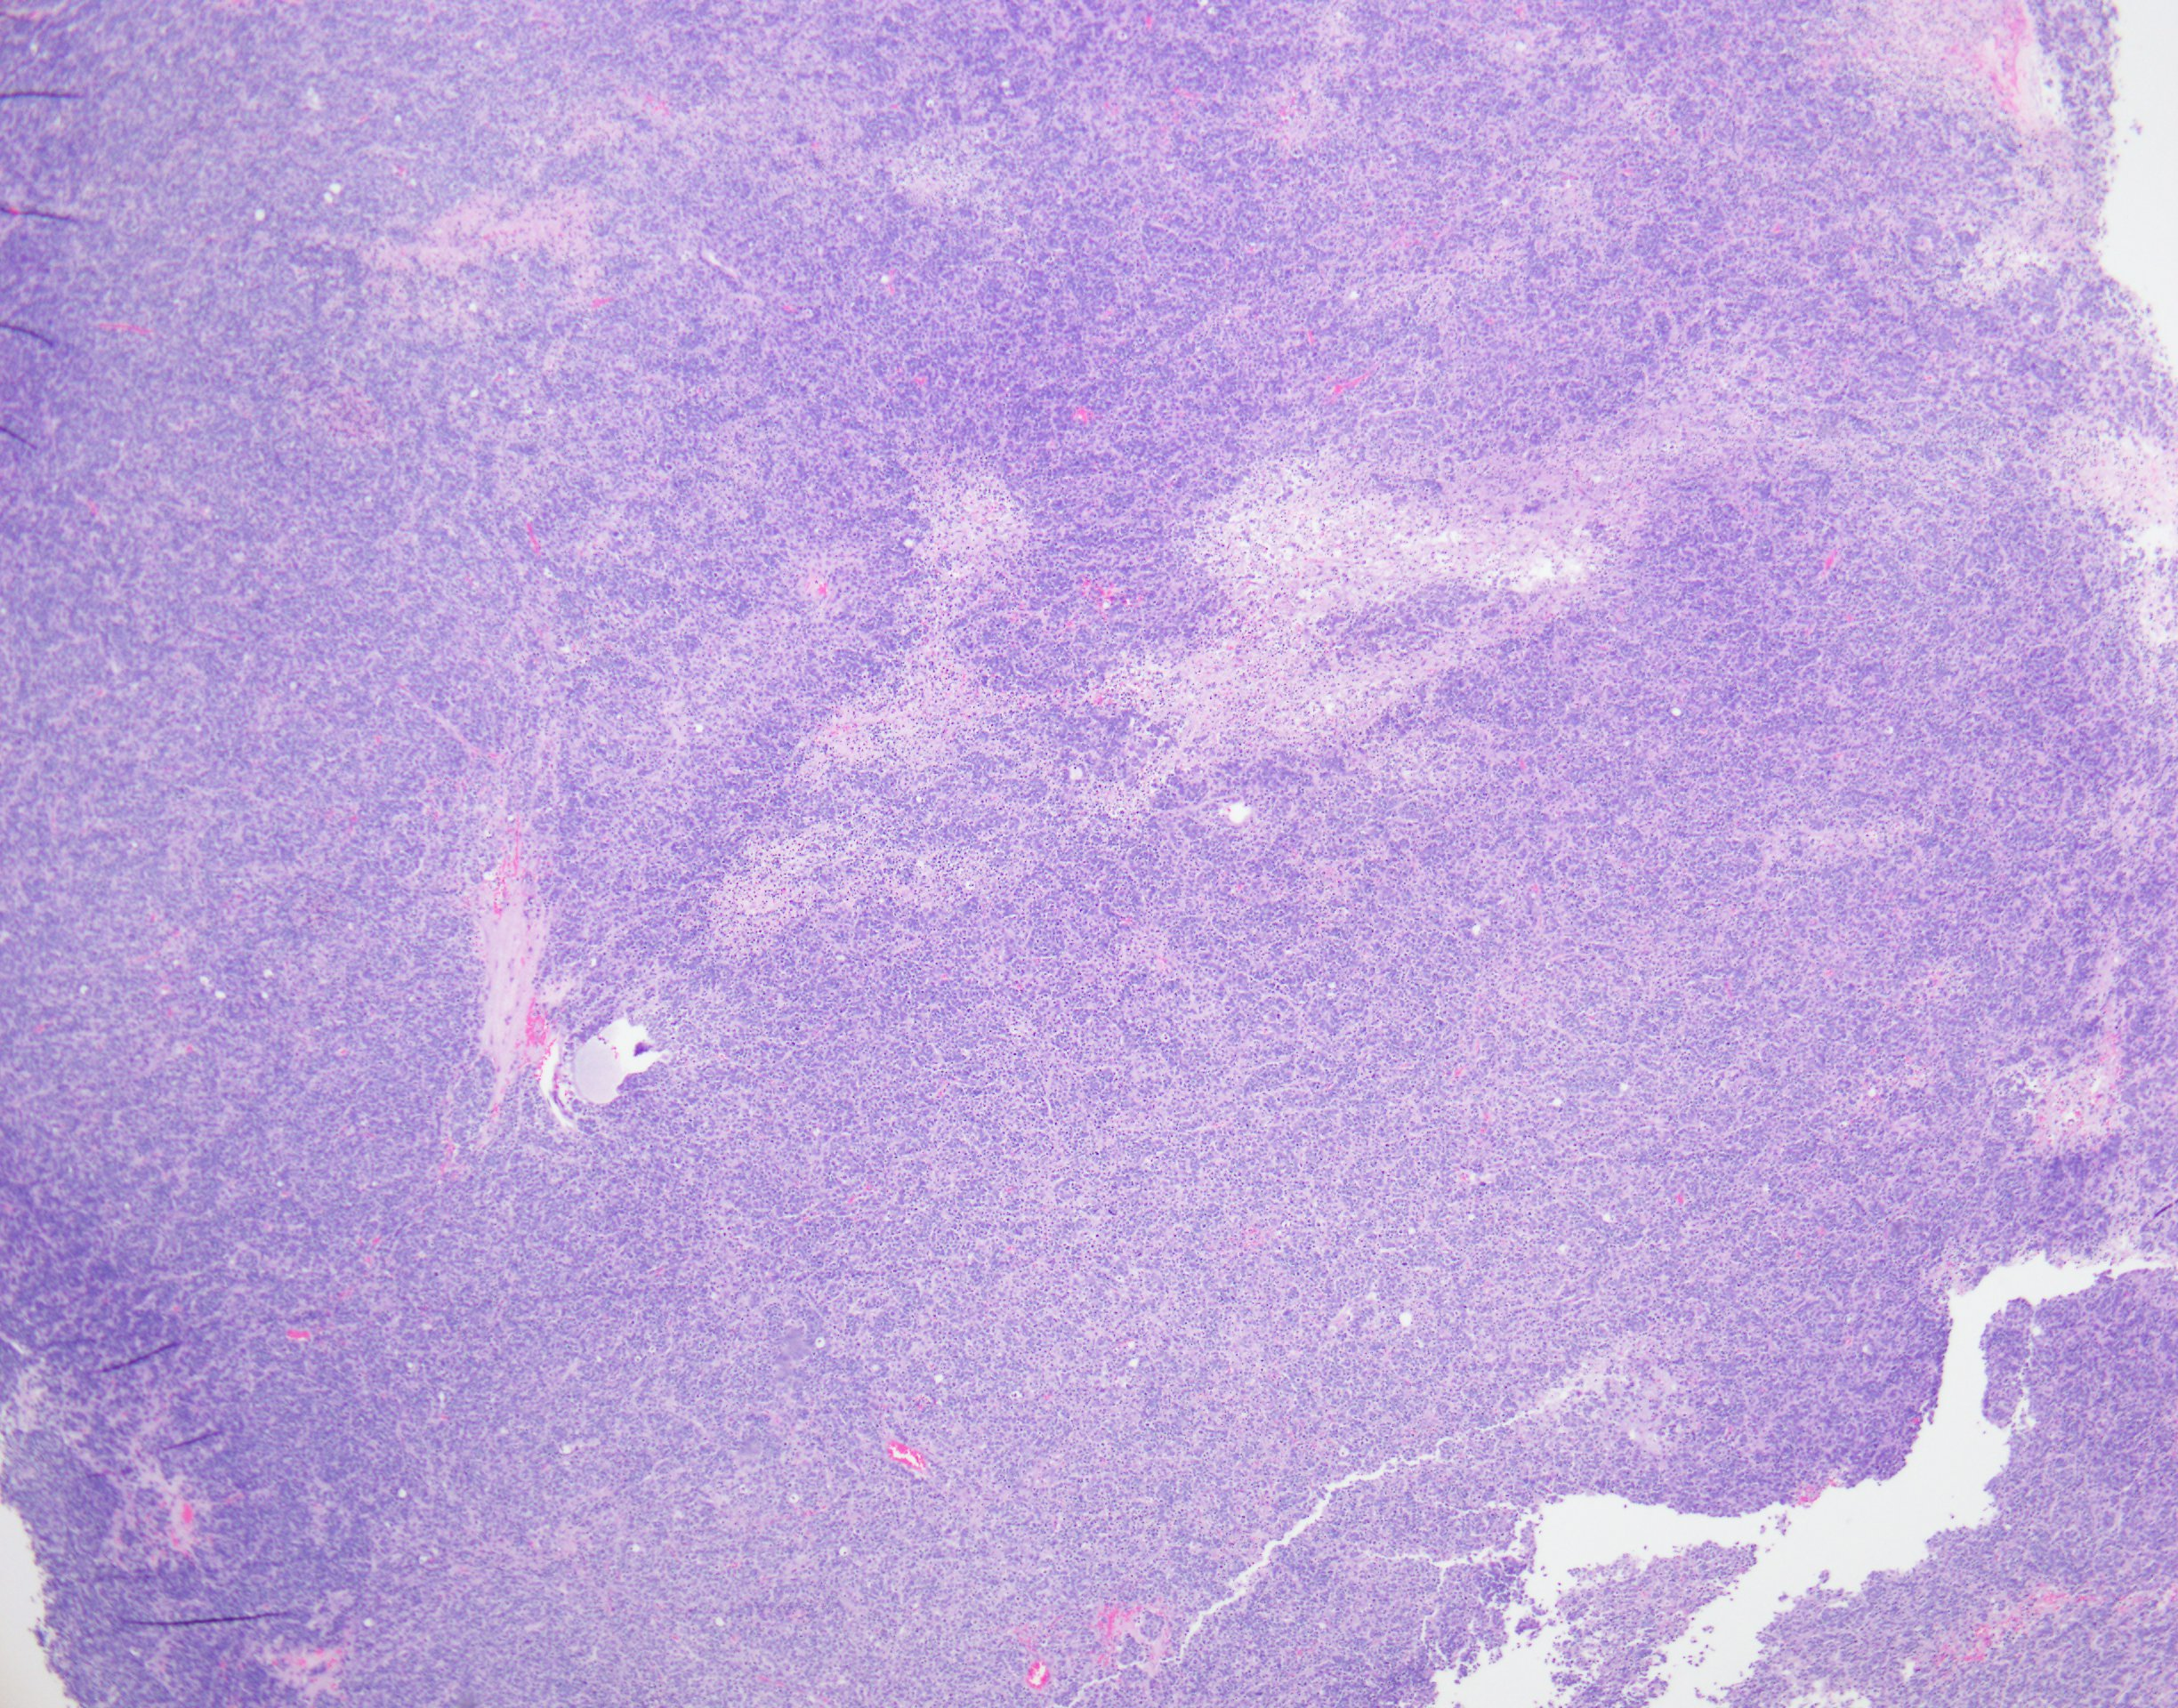
Case 4 Describe the low power findings

Slide 27
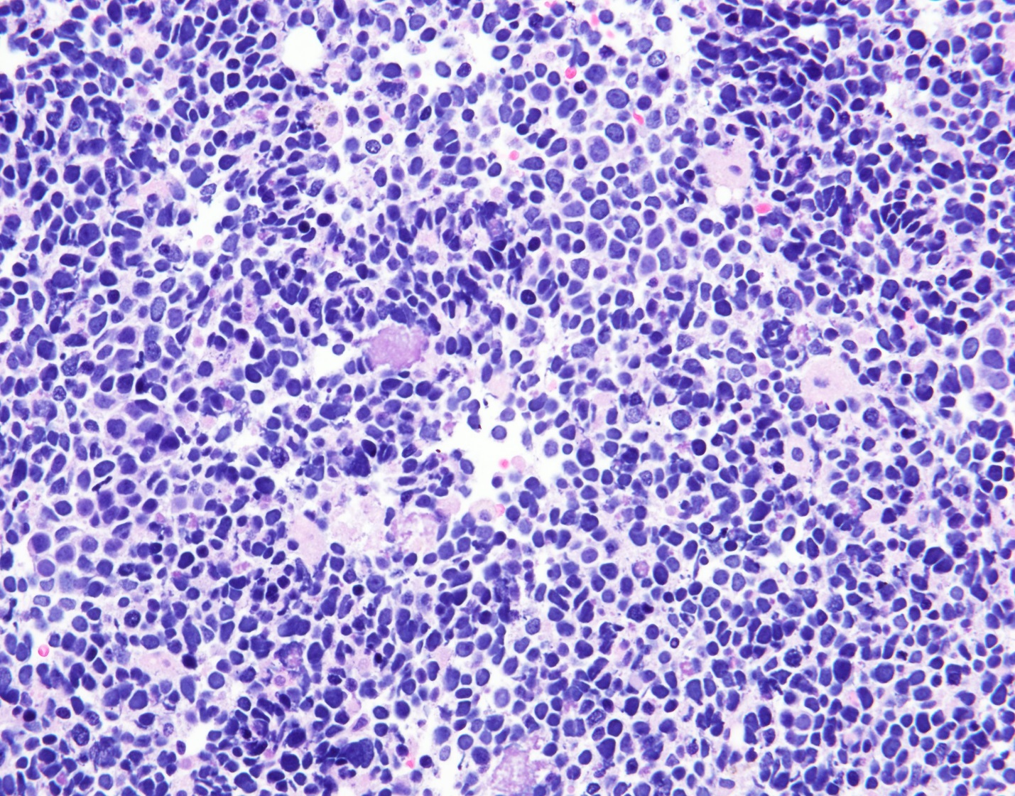
Case 4- Describe the findings on 20X

Slide 28
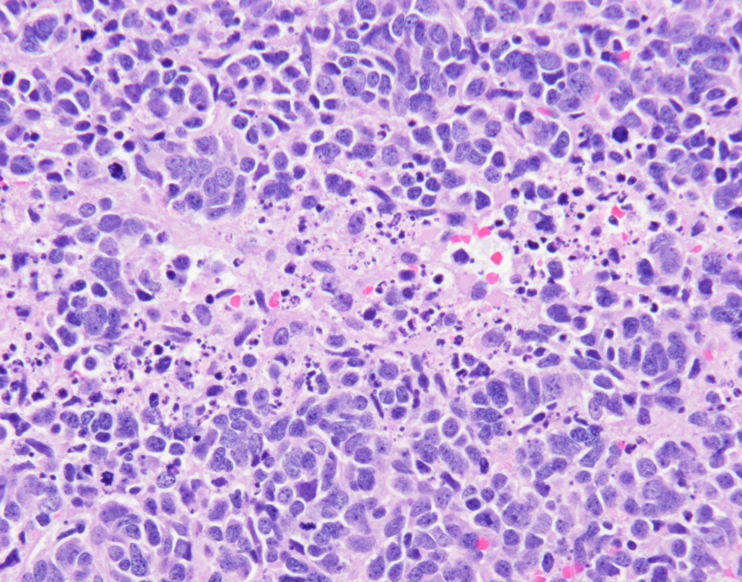
Case 5 - Describe the findings on 40x

Slide 29
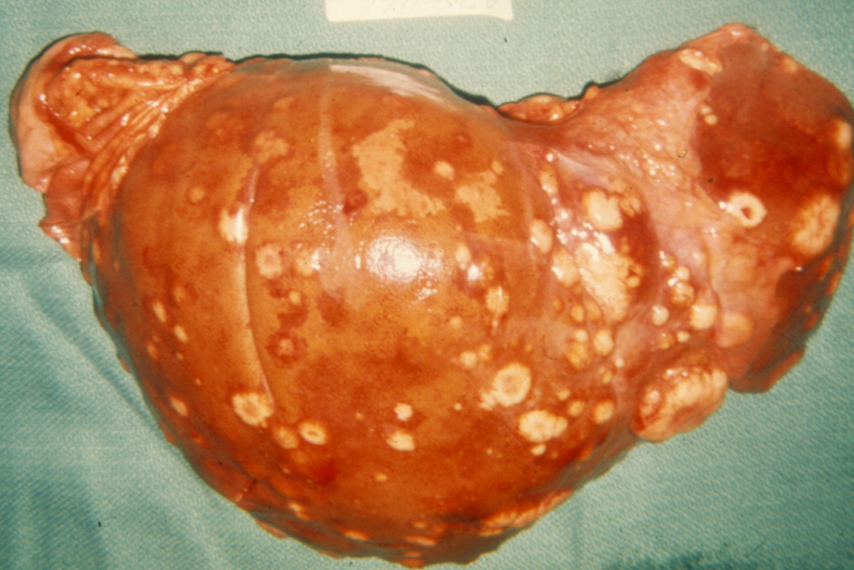
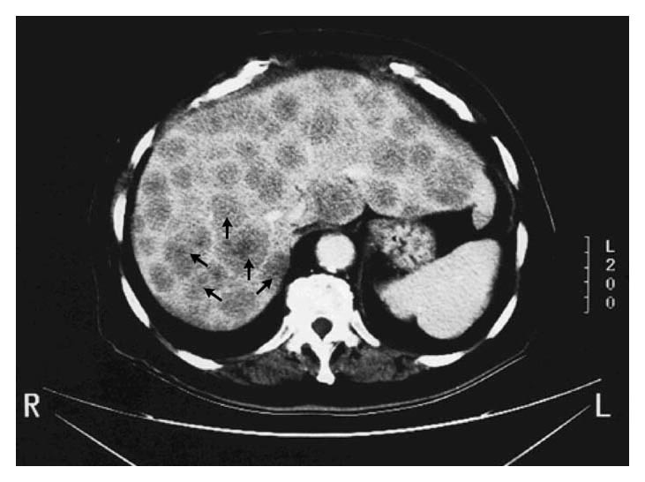
Case 4 Describe the gross findings and correlate them with the radiologic images seen below
Baron M, Lewis V. N Engl J Med 2001;345:180-180.

Slide 30
Case 4
What is your diagnosis?
Correlate the gross and histologic findings with the clinical findings.

Slide 31
Case 4 Interpret the laboratory data and correlate with the clinical scenario (the patient appears euvolemic)
BASIC METABOLIC PNL
Sodium 125
Potassium 3.9
Chloride 94
C02 24
BUN 8
Creatinine 0.8
Glucose 90

Slide 32
Case 5
A 25 year old female presented to the otolaryngology clinic with complaints of recurrent sneezing, rhinorrhoea, productive cough, on and off fever and breathlessness on exertion since childhood. She has had repeated hospital admissions for recurrent chest infections.
She has no drug allergies but is allergic to “dust”.
Nasal examination revealed boggy, bluish mucosa over bilateral inferior turbinates with mucoid nasal discharge.
On chest auscultation there were crepitations and wheezes over bilateral lung fields

Slide 33
Case 5 – Describe the findings
Case courtesy of Dr Sajoscha Sorrentino, Radiopaedia.org, rID: 19942

Slide 34
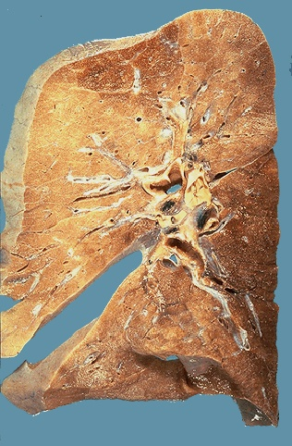
Case 5 – Describe the pathology
Normal fixed lung

Slide 35
Case 5
Summarize the case

Slide 36
Case 5
What is your diagnosis?
Describe the pathogenesis. Correlate with the clinical findings

